Slide 1
New Models for FQHC Partnerships with Hospitals
Speakers:
Margarita Pereyda, MD, Principal, HMA
Margaret Kirkegaard, MD, Principal, HMA
Santina Wheat, MD, MPH, Erie Humboldt Park Site Medical Director, Northwestern McGaw Family Medicine Residency
Moderator:
Carl Mercurio, HMA Information Services
November 4, 2015

Slide 2
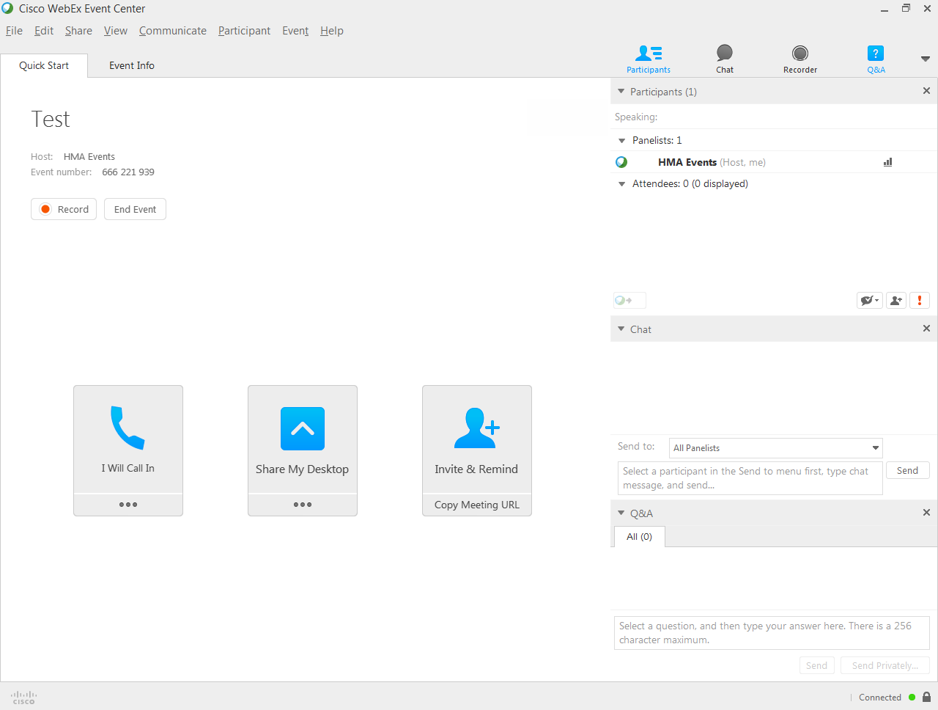

Slide 3
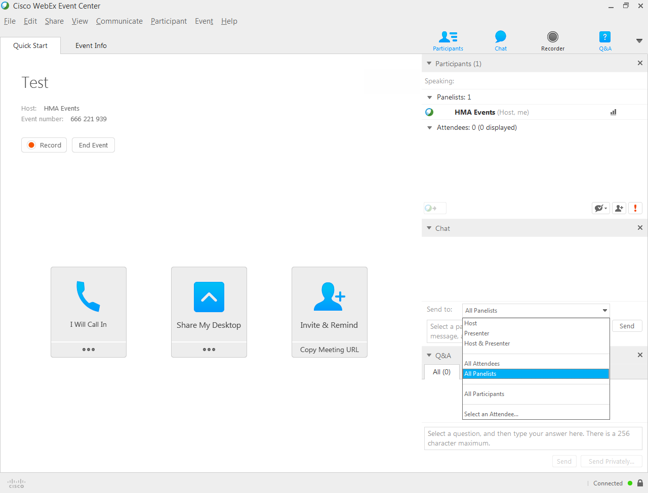

Slide 4
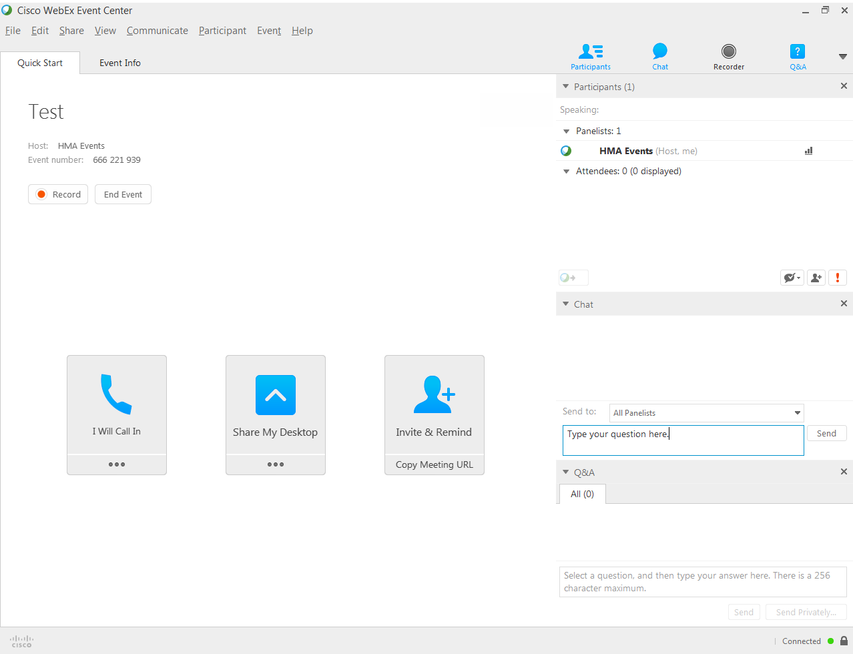

Slide 5
Learning Objectives
Value of FQHCs in team-based approach to care
FQHCs, mental health, and post-discharge care
Key contracting considerations between hospitals and FQHCs, including the potential for risk-sharing arrangements
Role of FQHCs and graduate medical education (GME)

Slide 6
Defining a Federally Qualified Health Center
Public or private non-profit, charitable, tax-exempt organization that receives funding under Section 330 of the Public Health Service Act (Section 330)
Determined by the Department of Health and Human Services (DHHS) to meet requirements to receive funding without actually receiving a grant (i.e., an FQHC “lookalike”)
Estimated to save the national health care system up to $24 billion a year
  $6.7 billion in savings for the federal share of the Medicaid program, and is
  Driven by lower utilization of costly specialty care, emergency departments, and hospitals

Slide 7
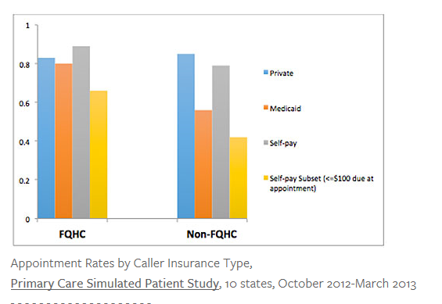
FQHCs: Key Access Point to Primary Care for Expanded Medicaid Population

Slide 8
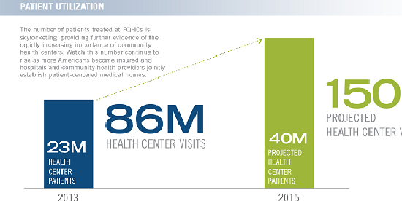
FQHCs: Expanding Patient Volume
Avanza Healthcare Strategies Infographic May 2015

Slide 9
Patients Served by FQHC by State

Slide 10
Cornerstone of the FQHC Model
Be located in a federally-designated medically underserved area or serve a federally-designated medically underserved population
Serve all residents of the FQHC’s service area or all residents who belong to a targeted “special population, regardless of an individual’s or family’s ability to pay
Provide a full continuum of primary and preventive care services
Be governed by an independent community-based board of directors that complies with all Section 330-related requirements

Slide 11
Benefits of a Hospital-FQHC Partnership
Help to avoid the unnecessary duplication of services, lowering the costs of providing care and ultimately strengthening the existing safety net delivery system
Reduce the need for more expensive in-patient and specialty care services as well as emergency room visits, resulting in significant savings to a community’s health care system
Allow limited federal, state and local resources to be targeted and allocated to areas that most require them

Slide 12
What FQHCs Bring to the Table
Cost-related reimbursement for services provided to Medicare, Medicaid, and Children’s Health Insurance Program (CHIP) beneficiaries
Coverage for the FQHC and its providers under the Federal Tort Claims Act (FTCA)
Discount drug pricing under Section 340B of the Public Health Service Act
Federal Anti-Kickback statute protection under the safe harbor for FQHC grantees

Slide 13
FQHC Safe Harbor Standards
Established in 2007 by OIG at DHS
Must be codified in written agreement
Meet standards
  Must have reasonable expectation arrangement will contribute meaningfully to services for the underserved
  Must periodically re-evaluate the arrangement (at least annually)
Permits:
  Monetary or in-kind donations
  Low cost or no cost leases and/or purchase agreements

Slide 14
FQHC Strengths to Leverage
Patient/Family Centered Models of Care
Wrap around services - can address Social Determinants of Health
  Case Management
  Transportation
  Translation
  Nutrition
  Social Work Services
Behavioral Health Services
Oral Health
Multi-disciplinary workforce

Slide 15
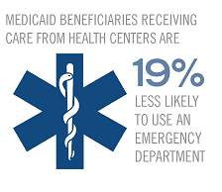
Areas of Collaboration
ER Diversion Programs
Transitions of Care
Programs
Patient Navigation Services

Slide 16
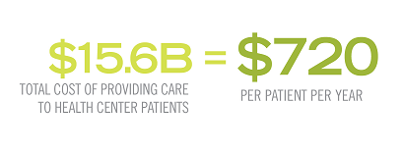
Hospital-FQHC-MH Provider
Can address individuals with co-occurring illnesses
Provide wrap-around services
Provide gap services: Physical Health for MH provider, MH for FQHC

Slide 17
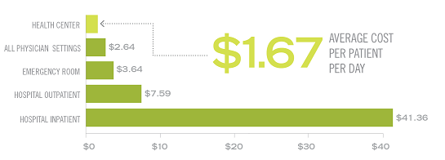
Advantages to Hospital Systems
Converting cost centers
Willing partner able to take all insurance types
Ensuring safe hospital discharges even for most vulnerable
Partnering with advance practices with existing HIT, QA processes and Risk Management/Compliance programs
Avanza Healthcare Strategies Infographic May 2015

Slide 18
Advantages to Tax-Exempt Hospital Systems
Ability to focus community benefit and other charitable funds in a strategic and population health focused manner
Redirection of charitable spend from avoidable ER care to EB medical care and cost effective site of service

Slide 19
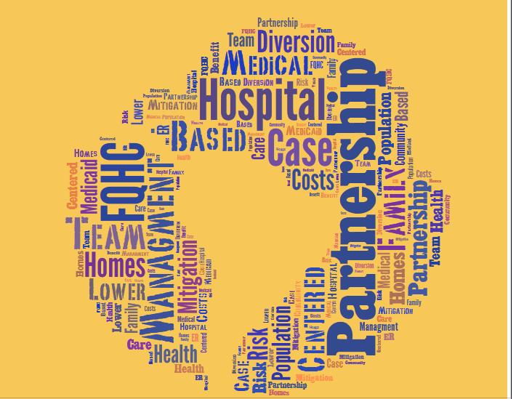
Partnerships

Slide 20
Case Management
Hospital provides work space for outreach case managers in hospitals' ER’s
Outreach case managers provide patients with information about using a FQHC as their medical home
Outreach case managers provide patient education and support to integrate patients into the FQHC system

Slide 21
Community Scheduling
ER staff uses a web-based tool to schedule real-time follow-up appointments
ER staff could check FQHC provider availability by location and schedule appointments so that patients have a written confirmation of their follow-up appointment at the time they leave a hospital
Public transportation schedules and/or transportation vouchers could be provided
FQHC' staff could access the data base for information to contact the patients and remove any barriers to follow up

Slide 22
Technical Assistance
Hospitals donate staff and resources to expand capacity and add locations---create a sustainable funding source to pay for secondary or tertiary care services for its patients
Primary care grants represent one of the largest percentages of grant giving in the United States

Slide 23
Provide Support Services
Hospitals vend back office and specialized resources to its FQHC partner
Hospitals provide real estate, equipment, furnishing, or support an FQHC through back office services
Savings due to outsourcing back office and specialized resources to hospitals could be used to expand the FQHC's primary care reach

Slide 24
Actively Divert Appropriate Cases from ER
ER staff use an in-person and/or telephonic triage system to refer patients who do not require an ER level of services to an FQHC
FQHC provides registered patients with a medical home including dental and behavioral healthcare, and manage chronic conditions
FQHC social workers arrange for necessary follow-up care

Slide 25
Actively Divert Appropriate Cases from ER
Hospital lets an FQHC co-locate its clinics adjacent to, or in close proximity to it’s ER
Co-located clinics have business hours and days that overlap with the hours of highest frequency of hospitals' ER utilization

Slide 26
Expanded Co-location:
Mental Health
Expand the co-location model to include community mental health
Hospital ER staff assess mental health clients with medical co-morbidities and link to co-located BH Provider with follow up through an FQHC

Slide 27
Converting Hospital-Based PCC to FQHC
Hospitals convert some of their primary care locations to new FQHCs or merge them into an existing FQHC
Especially attractive for high risk activities such as obstetrics

Slide 28
Population Health—Community Health
Stewarding overall community health resources
Actual health status of a community can be lifted
Every hospital owes it to itself and to its community to help FQHCs thrive

Slide 29
Limitations To Consider
Benefits are only available when services are provided by the FQHC within its scope of project

Slide 30
Hospital FQHC-based Training Programs

Slide 31
FQHC-GME Collaboration
Historically, few GME programs have included training options at FQHCs. Traditional Medicare funding is a disincentive for community based training
Some FQHCs have served as rotation sites for residency training but are much less likely to host a continuity clinic
FQHCs experience issues such as lack of payment for increased resident utilization, unpredictability of resident scheduling, operational support needed for supervised care all present barriers to FQHC-GME collaboration

Slide 32
The Teaching Health Center
The Teaching Center (THCGME) was a provision of the ACA
Provides funding outside of the traditional Medicare GME funding streams directly to community-based health centers
Additional funding allocated through Medicare Access and CHIP Reauthorization Act of 2015
Sixty THCGME programs in 24 states are currently training over 550 residents in primary care, psychiatry and dentistry
Shifts the paradigm; creates a central role for FQHCs, and establishes new partnerships between FQHCs and training hospitals

Slide 33
Teaching Health Center :
Erie Family Health Center
The Northwestern McGaw Family Medicine Residency at Humboldt Park
Erie Family Health Center is large, multi-site FQHC in Chicago serving 50,000 pts
Developed an innovative, community-based primary care training program to foster development of culturally competent physicians equipped to manage underserved populations
Collaboration with Northwestern University and Norwegian American Hospital

Slide 34

Family Medicine Residency Program Overview
Teaching Health Center

Slide 35
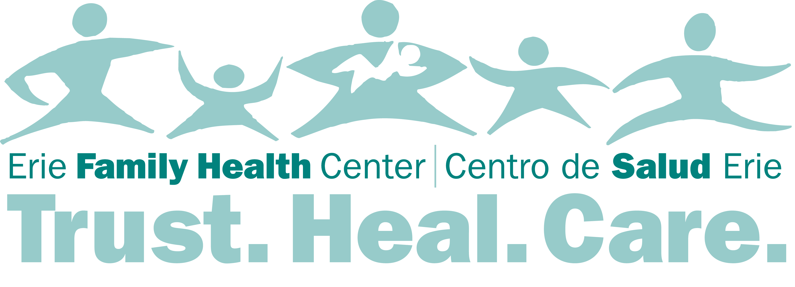


The Partnership
The Teaching Health Center Program is a unique and innovative collaboration that combines the resources of a successful and sustainable community health center with the support of a nationally recognized academic health center and medical school, in conjunction with a safety net hospital.
Each institution provides core components to the program:
Erie Family Health Center is a community-based health center where the residents train under on-site faculty. Erie Humboldt Park Health Center is the residents’ base training site.
Northwestern University is the academic
medical school that supports the research
component of the residents training.
Norwegian American Hospital is the safety-net, acute care facility where the residents complete in-patient training, located in Humboldt Park community of Chicago.

Slide 36
History
One of the original 11 HRSA funded Teaching Health Centers
First class admitted July, 2010: $1.8 mill “start-up” grant from NMH
THC funding began January 2011: $16 mill over 5 years
  Only outcome tracked is if the grads stay in primary care

Slide 37

Erie Family Health Center
Started in 1957 by Dr. Robert Snyder – Northwestern Memorial Hospital internist
Initially staffed by students and volunteers
By 1970 became a fully staffed CHC
Today Erie has 13 sites and serves over 60,000 patients/year
Mission has remained the same: to provide accessible, affordable and high quality health care to those in need

Slide 38
Norwegian American Hospital
Founded by Norwegian immigrants in 1894 as a charitable mission
200 bed safety-net hospital – non-profit, governed by community Board of Directors
Culturally diverse – serving multiple ethnic groups in surrounding neighborhoods
  Originally many Polish, German and Russian immigrants
  Now mainly Latino populations from Puerto Rico, Cuba, Mexico and multiple Central and South American countries
  Also significant African American population

Slide 39
Program Mission Statement
Emerging from a collaborative partnership between Erie Family Health Center, Norwegian American Hospital and Northwestern Feinberg School of Medicine, the Northwestern McGaw Family Medicine Residency promotes quality education and patient care through:
Clinical excellence
Attentive to evidence-based medicine, cultural competency, and continuous quality improvement we promote patient well-being
Scholarship
Supported by dedicated time and committed resources we promote ongoing learning, research, publication and presentation to advance medical knowledge and wellness
Leadership
Through community engagement, needs assessment and advocacy we seek sustainable partnerships and innovative care models to address health disparities and community priorities

Slide 40
Teaching Health Center
The Teaching Health Center Program changes the paradigm of traditional medical education, focusing on developing the residency program within community‐based ambulatory primary care settings, which will ultimately produce primary care physicians ready to deliver health care in a reformed system to the underserved.
Impact in the Community
  Addresses the physician workforce shortage through training more Primary Care Physicians
    One of few GME programs guaranteed to produce primary care physicians
  Health Center trained physicians are 3 times more likely to work in a Health Center and almost 3 times more likely to work in underserved setting
  Recruitment of Faculty
  Access to additional services for patients (e.g., specialty clinics, residency inpatient care teams, etc)
  Continuity of hospital to community for our patients
  Access to resources from a hospital or medical school (e.g. information technology, research support, etc)
  Develops cultural competency skills to provide quality care to underserved
  Trains to be future community health center leaders, advocates, and researchers

Slide 41
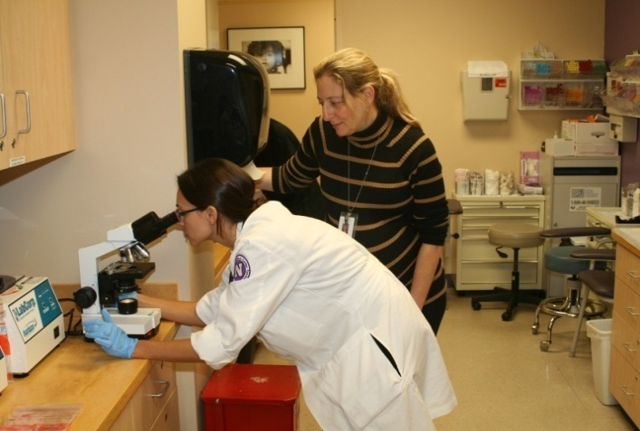
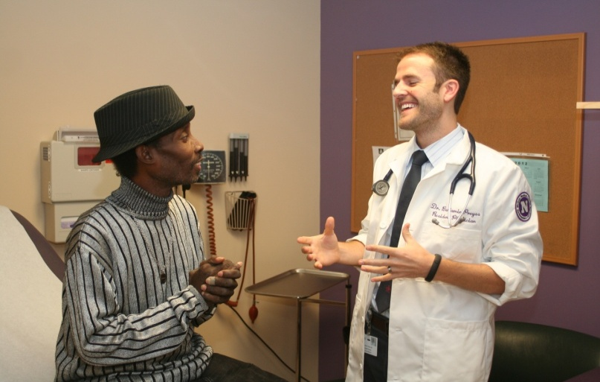
Community Impact
Expanded Erie’s capacity to provide services to more than 2,850 patients
Increased Erie Faculty productivity by close to 40%
Contributed to the creation of 28 jobs in the community
Residents are involved in hospital improvement committees and QI initiatives
Strengthen relationship between FQHC and hospital
Nearly all graduates have chosen to remain in safety-net primary care, addressing critical provider shortages in these communities

Slide 42
Q & A
Margarita Pereyda, MD
mpereyda@healthmanagement.com
Margaret Kirkegaard, MD
mkirkegaard@healthmanagement.com
Santina Wheat, MD, MPH
swheat@eriefamilyhealth.org
November 4, 2015

