Slide 1
WWW.HEALTHMANAGEMENT.COM
February 7, 2018
Donna Laverdiere, Principal
Nora Leibowitz, Principal
New Life for 1332 Waivers: Next Steps in State Health Insurance Exchange Market Innovation

Slide 2
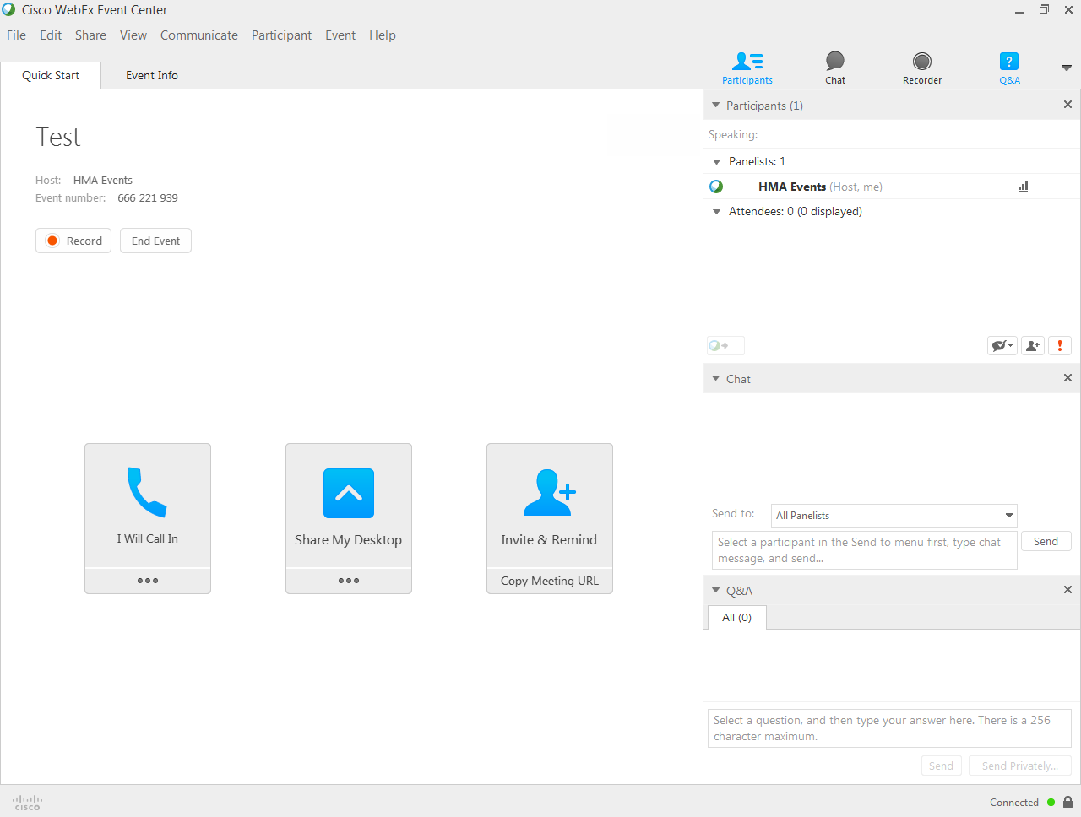

Slide 3
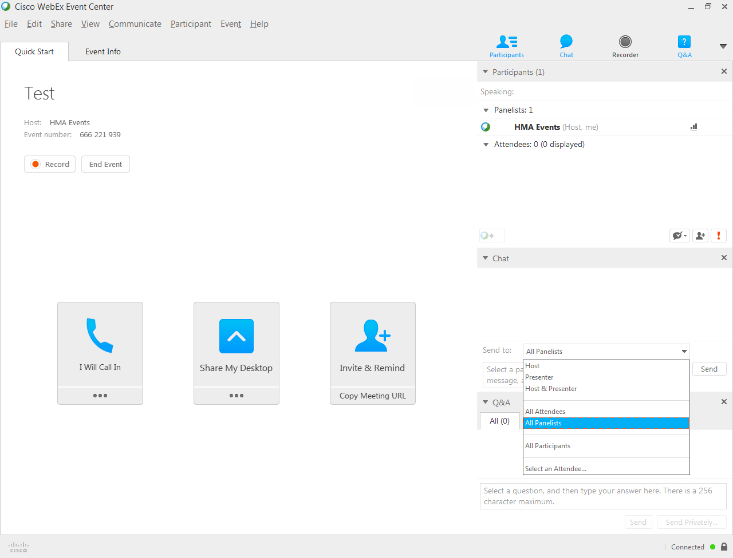

Slide 4
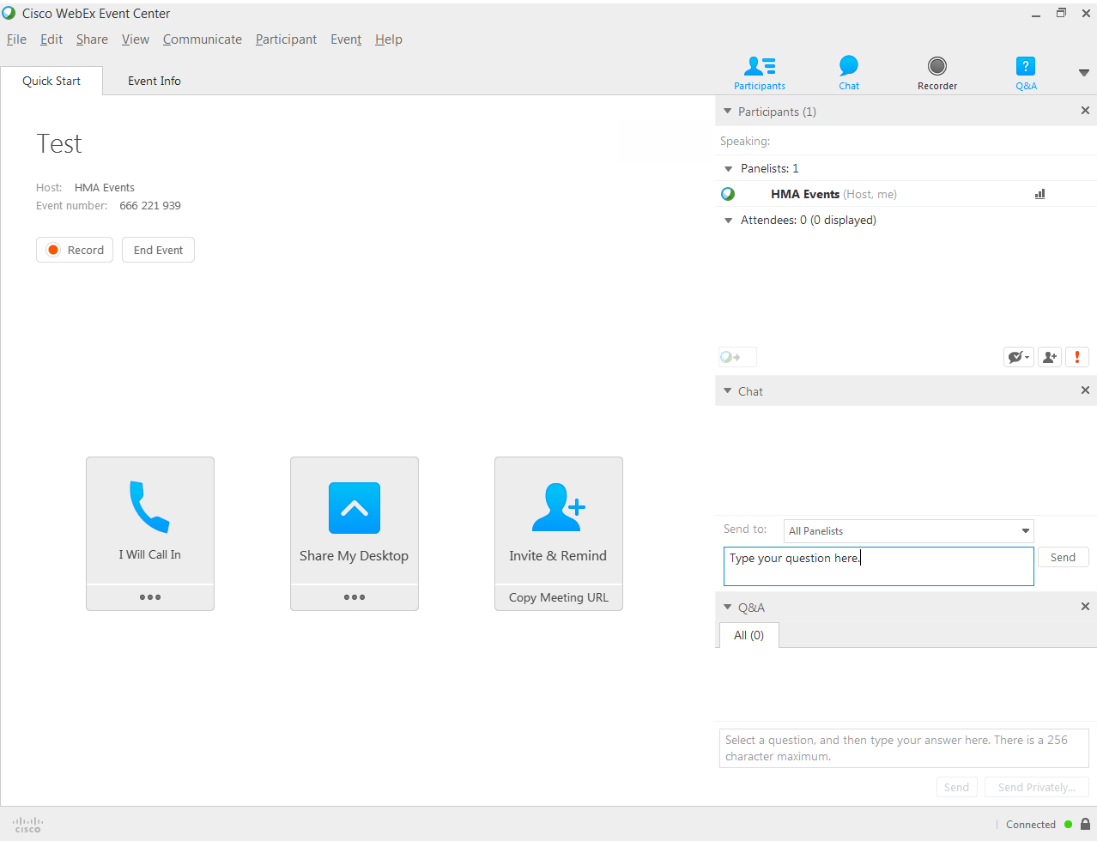

Slide 5
Webinar Overview
Background and Current Guidance on Section 1332 State Innovation Waivers
Congressional Proposals
Current Status of Section 1332 Waivers
Potential Future Section 1332 Waivers
Implications for States, Plans, and Providers

Slide 6
Background

Slide 7
Overview of Current Statutory and Regulatory Requirements
Key documents set forth the requirements for Section 1332 waivers and express Federal support.
Section 1332 of the ACA
45 CFR Section 155.1300-1328
December 16, 2015 Guidance
March 2017 Letter: 1332 & reinsurance
Basic parameters of the 4 guardrails and approval process.
Detailed application information and requirements related to public comment periods.
Detailed guidance on economic and financial analyses required as well as deficit neutrality requirements.
HHS letter to Governors encouraging waivers for Reinsurance.

Slide 8
FOUR GUARDRAILS
Section 1332 of the ACA
Coverage
Affordability
The ACA established four guardrails for Section 1332 Waiver proposals.
Comprehensiveness
Deficit Neutrality

Slide 9
Key Points from the Regulations
Section 155.1300-1328 of the Exchange regulations establish:
Section 1332 waiver application requirements
Requirements related to the economic and financial analyses that need to be presented to support the application
Requirements related to public notice and comment periods
Monitoring and reporting requirements for states
Time period for federal review and comment period
45 CFR Section 155.1300-1328

Slide 10
Key Points from the Guidance
The December 16, 2015 guidance establishes that:
Deficit neutrality cannot take into account savings in other programs
Any additional administrative costs to the federal government are likely to result in disapproval
Any increases in federal premium tax credit or Medicaid expenditures are not allowed
Affordability of coverage may not decrease for anyone, including vulnerable groups, statewide
42 CFR Section 300-1308
December 15, 2015 Guidance

Slide 11
The “Fifth Guardrail”
Section 1332 waivers must also adhere to all the non-waivable provisions of the Affordable Care Act, including market reforms
Certain innovative plan designs and enrollment restrictions may implicate guaranteed issue and other market reform provisions
42 CFR Section 300-1308

Slide 12
Limitations on Waivers under Current Guidance
Coverage Expansion
Budget Neutrality
Subsidy Increase
Budget Neutrality
Elimination of Mandate(s)
Coverage
Changes to EHB
Comprehensiveness

Slide 13
Recent
Congressional Proposals

Slide 14
American Health Care Act (House, March 2017)
Would Decrease Need for Section 1332 Applications
Proposed Broad New Waiver Authority
State definition of individual and small group EHBs
State-established age band other than AHCA 5:1 standard
States with reinsurance/market stabilization can use health as a rating factor for those without continuous coverage
$8B available to offset premiums, out of pocket costs for people impacted
Notes:
AHCA – introduced in March, passed the house May 4, 2017
-one part of bill says states can define or take federal 5:1, another part says ratio is waivable
waivers may not be applied to health plans offered through CO-OP plans, multi-state plans, or to ACA innovation waivers (Section 1332), Basic Health Plan programs (Section 1331), interstate compact programs (Section 1333).
While no lifetime or annual limits on EHBs, would be allowed for items state excluded from EHB
FIRSP would have $15 billion over 9 years (2018-26) – CMS would administer, collecting percentage fee (amount TBD) from carriers. Auto enrollment based on health conditions; carriers could voluntarily enroll other people in the program. CMS would set up a process for states to take over administration starting in 2020.
75% of claims between $50,000 and $350,000 (starting in 2020, CMS Administrator can establish different reinsurance rate and claims thresholds.) Funding available through the Patient and State Stability Fund includes:
$100 billion over 9 years ($15 billion per year for 2018-2019, $10 billion per year for 2020-2026) for grants to states or for default reinsurance program;
$15 billion for a new Federal Invisible Risk Sharing Program (see below);
$8 billion over 5 years (2018-2023) for states that elect community rating waivers (see below) to provide financial assistance to people whose premiums are surcharged based on health status under that waiver;
$15 billion for the year 2020 to be used solely for maternity coverage and newborn care and mental health and substance use disorders.
State matching funding of 7% required in 2020, phasing up to 50% in 2026. A different state matching schedule applies for the CMS-administered default reinsurance program (10% in 2020, phasing up to 50% in 2024.) Grants cannot be made to a state unless it agrees to make matching funds available. Any remaining funds at year end will be re-allocated to the Federal Invisible Risk Sharing Program.

Slide 15
American Health Care Act (House, March 2017)
New Waiver: Application Rules and Process
Waivers are approved if not denied within 60 days
Specify how waiver would meet at least one goal: reduce average premiums, increase enrollment, stabilize market, stabilize premiums for people with pre-existing conditions, or increase health plan choice
Reinsurance, Other Changes without a Waiver
Patient and State Stability Fund includes Federal Invisible Risk Sharing Program and reinsurance
Eliminates employer penalty
Premium tax credits available in/out of exchanges
Notes:
AHCA – introduced in March, passed the house May 4, 2017
-one part of bill says states can define or take federal 5:1, another part says ratio is waivable
waivers may not be applied to health plans offered through CO-OP plans, multi-state plans, or to ACA innovation waivers (Section 1332), Basic Health Plan programs (Section 1331), interstate compact programs (Section 1333).
Changes do not apply to section 1332 waivers
While no lifetime or annual limits on EHBs, would be allowed for items state excluded from EHB
FIRSP would have $15 billion over 9 years (2018-26) – CMS would administer, collecting percentage fee (amount TBD) from carriers. Auto enrollment based on health conditions; carriers could voluntarily enroll other people in the program. CMS would set up a process for states to take over administration starting in 2020.
75% of claims between $50,000 and $350,000 (starting in 2020, CMS Administrator can establish different reinsurance rate and claims thresholds.) Funding available through the Patient and State Stability Fund includes:
$100 billion over 9 years ($15 billion per year for 2018-2019, $10 billion per year for 2020-2026) for grants to states or for default reinsurance program;
$15 billion for a new Federal Invisible Risk Sharing Program (see below);
$8 billion over 5 years (2018-2023) for states that elect community rating waivers (see below) to provide financial assistance to people whose premiums are surcharged based on health status under that waiver;
$15 billion for the year 2020 to be used solely for maternity coverage and newborn care and mental health and substance use disorders.
State matching funding of 7% required in 2020, phasing up to 50% in 2026. A different state matching schedule applies for the CMS-administered default reinsurance program (10% in 2020, phasing up to 50% in 2024.) Grants cannot be made to a state unless it agrees to make matching funds available. Any remaining funds at year end will be re-allocated to the Federal Invisible Risk Sharing Program.

Slide 16
Better Care Reconciliation Act (Senate, June & July 2017)
Would have increased 1332 authority, eased approval
Changes to Application Requirements
Eliminates coverage, comprehensiveness, affordability requirements
Focus: increased access to comprehensive coverage, reduced premiums, increased enrollment
Authorization by state law or Governor and Insurance Commissioner certification
Notes:
June 26 – original version, amended July 13, July 20.
BRCA – only requires state to describe how it would address coverage, comprehensiveness and affordability of coverage
CBO analysis of BRCA – premiums would be lower and cost-sharing higher. CBO noted that while it wasn’t calculating lower insurance rates, that depending on the state waivers adopted, there could be coverage losses.
EHB can theoretically be waived in 1332

Slide 17
Better Care Reconciliation Act (Senate, June & July 2017)
Review and Approval Process
Expedited review for states with health care coverage emergency
Secretary must approve waiver unless proposal increases federal deficit
8 year waiver period, unlimited renewals
Could redefine EHBs, how financial assistance is allocated
2017-19: appropriates $2 billion that states applying for waivers can use to implement their programs
Notes:
June 26 – original version, amended July 13, July 20.
BRCA – only requires state to describe how it would address coverage, comprehensiveness and affordability of coverage
CBO analysis of BRCA – premiums would be lower and cost-sharing higher. CBO noted that while it wasn’t calculating lower insurance rates, that depending on the state waivers adopted, there could be coverage losses.
EHB can theoretically be waived in 1332

Slide 18
Lower Premiums Through Reinsurance Act of 2017 (Collins-Nelson)
Reinsurance Funding
Adds $4.5 billion for reinsurance that states can access through Section 1332 waivers
Expedited approval for reinsurance/high risk pool proposals using CMS template
90 day review
Notes:
Sept 19 introduced – referred to Committee on Finance
Template allows state applying for something very similar to past proposals to have a faster process

Slide 19
Bipartisan Health Care Stabilization Act of 2017 (Alexander-Murray)
Process Changes
Certification by Governor allowed
Expedited approval (45 day response, concurrent federal and state public comment) for urgent situation in which application is similar to approved waiver
Provisional approval allowed for 3 years
Waiver Requirements
Determination of “comparable affordability”
Will not increase the federal deficit over 10 years
Calculation can include changes to Medicaid, CHIP, Medicare or other federal health care programs
Notes:
Full approval within a year of the provisional waiver expiring – six year approval
CMS may not terminate a waiver during its term unless it doesn’t comply with requirements
New waiver guidance will supersede old guidance

Slide 20
Administrative Interpretation
Guidance still stands
March 2017 HHS letter reiterated statutory guidance, called for innovative state proposals
Administration encouraged applications over summer
Proposals Approved…Or Not
2017 had a lot of state interest in Section 1332 waivers, but few approvals
Notes:
BRCA – only requires state to describe how it would address coverage, comprehensiveness and affordability of coverage
CBO analysis of BRCA – premiums would be lower and cost-sharing higher. CBO noted that while it wasn’t calculating lower insurance rates, that depending on the state waivers adopted, there could be coverage losses.
EHB can theoretically be waived in 1332
AK – approve July 17, 2017 (for 1/1/18-12/21/22)

Slide 21
UPDATE ON STATE PROPOSALS

Slide 22
Approved 1332 Waivers
State | Waiver Summary
Hawaii | December 2016 – Exempts the state from the requirement that it run a SHOP and allows alternative use of the small business tax credit funds. Hawaii has a long-standing employer mandate.
Alaska | July 2017 – Utilizes previous High Risk Pool funds to fund reinsurance to lower Exchange premiums.
Minnesota | September 2017 – Approved reinsurance program but excluded savings from the Basic Health Plan in calculating pass-through funding.
Oregon | October 2017 – Reinsurance program funded by a premium tax. Effective for the current plan year.

Slide 23
1332 Waiver Withdrawals
State | Waiver Summary
California | January 2017 – Waiver would have allowed undocumented immigrants to purchase Exchange plans with no subsidy.
Oklahoma | September 2017 – Waiver would have implemented a reinsurance program for the 2018 plan year to lower premiums in the individual market. OK withdrew the waiver due to CMS delays.
Iowa | October 2017 – Waiver would have made major changes to subsidy structure as well as implement a reinsurance program. Withdrawn due to disagreements with CMS. Proposed waiver presented challenges related to 1332 guardrails and implementation timeline.

Slide 24
Pending/Upcoming 1332 Waiver Applications
State | Waiver Summary
Massachusetts | Waiver including a premium stabilization fund utilizing pass through funding from unpaid CSR payments was proposed in September 2017 and deemed incomplete in October 2017. MA is also considering several other reforms including a state-run employer responsibility payment program.
New Hampshire | Would create a reinsurance program but may not be submitted due to state challenges.
Vermont | Had proposed to waive SHOP internet portal requirement which was deemed incomplete by CMS. Vermont is no longer pursuing the change since subsequent guidance from CMS permitted direct enrollment for SHOP.

Slide 25
Potential Upcoming State 1332 Waiver Proposals
Kentucky
Oklahoma
1332 authorizing legislation passed.
May be considering further reforms under 1332 waiver authority.
➤
➤
➤
➤
➤
Idaho
Maine
Others?
Proposal out for comment extends APTC and CSR eligibility to working Idaho households under 100% FPL.
State law authorized consideration of a 1332 waiver for the existing reinsurance plan.
Rhode Island?
Texas?
Notes:
Idaho: Provide affordable coverage options to working Idaho households with incomes below 100% of the Federal Poverty Level (FPL) who are U.S. citizens not eligible for Medicaid, through the same mechanism that lawfully-present aliens currently obtain affordable coverage. 3. In conjunction with Idaho’s proposed Section 1115 Medicaid Waiver and Idaho Individual High Risk Pool, stabilize and decrease the cost of insurance premiums in the individual health insurance market. Essentially they want to use 1332 to cover the expansion population. They claim that by combining this with reinsurance, it does not impact affordability for higher income individuals purchasing on the Exchange.
Combining high risk pool with moving people below 100% into Exchange with APTC. Will need to do this in conjunction with 1115 waiver.

Slide 26
Take-Aways for States
Section 1332 Waivers are not going away yet
Congressional action would likely mean big changes to waiver authority and may provide additional flexibility
Federal administration response to applications could support state efforts to overhaul their health systems
Considerations
Types of changes
Politics
Limited funding
Timing
Approvals are staff-driven
Notes:
As described earlier – a congressional proposal could either vastly expand waiver authority/ease application or even make changes that lessen the need for a waiver
There is a good chance that the administration will support some proposals that are in line with its overall policy goals – understanding there is a tension between helping states and doing anything that might be seen as working within the frame of the ACA. The ability of states to get waivers through will depend in part on what they propose, the friendliness of the state and federal administrations, as well as the state’s ability to self-fund reform. In every case, building in significant time for federal review and negotiation is key – even in Oklahoma, a heavily republican state seeking to implement reinsurance, the application was taken down by the clock.

Slide 27
Impact on plans and providers

Slide 28
Potential Impact on MCOs
Type of Impact | Implications
Administrative Changes | IT system changes to accommodate new populations, new plan types, varied subsidy levels Changes to Exchange data submissions Increased reporting/accountability requirements Member services impacts Provider education impacts
Market/Contracting Changes | Changes to QHP certification requirements Changes to market dynamics and participation Possible new procurements under joint Medicaid proposals

Slide 29
Potential Impact on Providers
Type of Impact | Implications
Administrative Changes | Increased number of plans – more administrative burden Revisions to plan contracts Changes in quality reporting requirements
Contracting Changes | New insurance market entrants and need for new contracting arrangements Strengthened provider contracting standards for QHPs Increased scrutiny on quality performance Opportunities for innovation under new market dynamics
Beneficiary Impacts | Potential new populations with coverage, including previously uninsured with pent-up demand Ongoing need for member education and engagement

Slide 30
CONTACT US
Nora leibowitz
Principal
nleibowitz@healthmanagement.com
Donna Laverdiere Principal
dlaverdiere@healthmanagement.com

