Slide 1
Session Title Two decades of data: Insights from syringe service participants and EMS
Alice Bell, LCSW
Prevention Point Pittsburgh
Nabarun Dasgupta, MPH, PhD
University of North Carolina
March 18, 2024 Compassionate Overdose Response Summit

Slide 2
Funding & Disclosures
This research was funded by the US Food and Drug Administration via UNC (BAA #167, Contract 75F40122C00193)
The views presented do not necessarily reflect the views of the Funder, and should not be construed as Guidance or policy.
ND is on the Board of Remedy Alliance For The People, a non-profit bulk distributor of intramuscular and nasal naloxone.
These are preliminary results and subject to change.

Slide 3
Summary
Doses per reversal has remained steadily below 2 for 13 years.
The 1 mL vial had the lowest number of average doses per reversal administered, relative to other formulations.
4mg nasal spray was associated with more reported adverse events (emesis, anger) than 1 mL vials.

Slide 4
Methods
Retrospective review of overdose reversal reports at Prevention Point Pittsburgh syringe service program
August 2005 through January 2023
Reports were generated at initial training events and refill requests
Standardized data collection forms were used to record circumstances of naloxone administration, including adverse events.
Time trend (monthly average) of doses per reversal were visualized, and smoothed using a Gaussian moving average.
Doses per reversal, by naloxone formulation, were visualized using a basic kernel density smoother. Dosage units were standardized between formulations.
Two-sided Wald chi-square p-value tests were conducted on 2 df

Slide 5
Results
From August 2003 to January 2023 there were 16,904 service encounters by 7,582 unique participants, resulting in 70,234 doses of naloxone dispensed, with n=5,521 reversals reported, utilizing n=8,756 doses of naloxone.

Slide 6
Time Trend: Average doses per reversal have remained steadily below 2, from 2010-2023.

Slide 7
Average doses per reversal varied somewhat by formulation. In recent years, the number of doses of nasal naloxone has increased, while 1 mL vials have decreased.

Slide 8
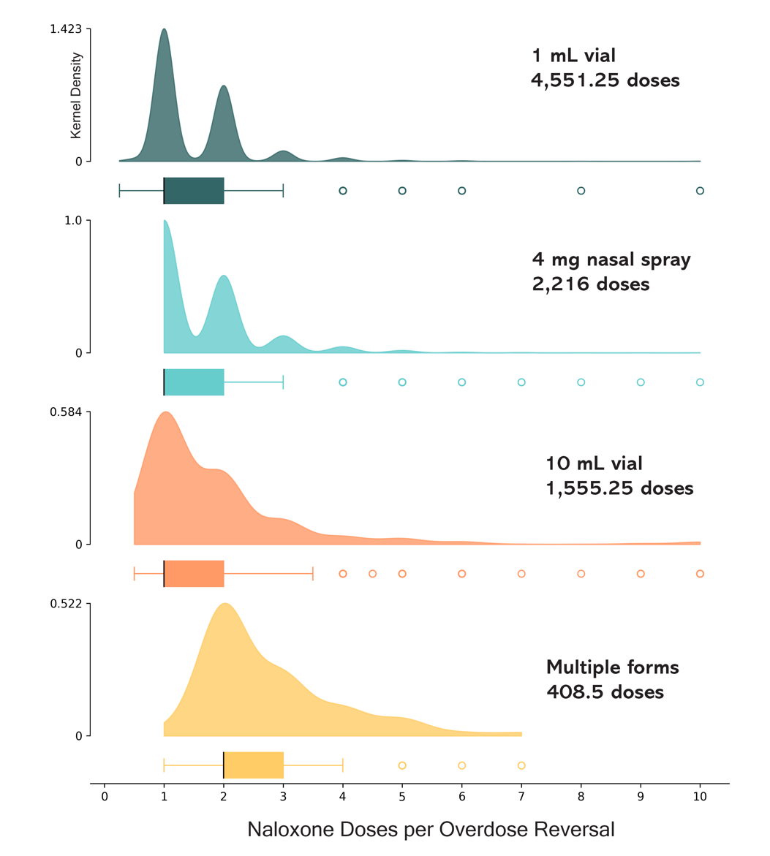
Average Naloxone Doses per Reversal
Form | Doses per Reversal (95% CI) | Relative Doses per Reversal Relative to 1 mL vial (95% CI)
1 mL vial | 1.51 (1.48, 1.54) | ref
Nasal spray (4mg) | 1.63 (1.58, 1.68) | +7.5% (3.7%, 11.5%) X² 3.9, p_{Wald}<0.001
10 mL vial | 1.85 (1.75, 1.94) | +22.1% (15.6%, 28.9%) X² 7.1, p_{Wald}<0.001
Multiple forms | 2.76 (2.58, 2.94) | +82.4% (70.3%, 195%) X² 17.1, p_{Wald}<0.001

Slide 9
Selected Adverse Events
Emesis (or “puking”) was reported in 13.2% (n=607) of reversals, but differed (Wald x² 108, 2 df, p<0.001) considerably by formulation. Reversals using the 4 mg nasal spray were twice as likely to result in emesis compared to the 1 mL vial (20.8% versus 9.6%). After adjusting for number of doses administered, there were 106 (95% CI: 82, 130) more emesis events per 1,000 reversals with the 4 mg nasal spray than the 1 mL vial at 0.4 mg/mL.
Anger was reported in 11.9% of reversals (n=546) and differed by formulation (Wald x² 108, 2 df, p<0.001). The 1 mL vial was associated with fewer angry AE reports, at 10.2%, compared to 15.1% of reversals with the 4 mg nasal spray. After adjusting for number of doses administered, per 1000 reversals there were 48.5 (95% CI: 47.8, 49.2) additional cases of anger after administration of the nasal spray.
Death was reported in 1.0% of reversals, with 7.8 per 1000 reversals with the 1 mL vial, and 14.6 per 1000 reversals with 4mg nasal spray. However, participants report that these were administered when the decedent was found too late for intervention, and naloxone administered “just in case.”

Slide 10
Limitations
Reversal reports were included if the participant returned for a refill. Reversals not resulting in refills were unobserved.
Doses by formulation did not account for personal characteristics or substances involved, and could have theoretically varied.
Reversal reports are subject to recall bias, but program experience suggests this is rare.
Experiences of SSP participants may not generalize to other populations.

Slide 11
Summary
Average doses per reversal has remained steadily below 2 for 13 years, including during transitions from Rx opioids to heroin to fentanyl in the local drug supply.
The 1 mL vial had the lowest number of average doses per reversal administered, relative to other formulations.
Despite lower doses, unsuccessful (death) reversals were rare, and less likely with 1 mL vials relatively to .
4mg nasal spray was associated with more reported adverse events (emesis, anger) than 1 mL vials.

