Slide 1
Examination of Naloxone Dosing Patterns for Opioid Overdose by ERmergency Medical Services in Kentucky during Increased Fentanyl Use from 2018 to 2021
Svetla Slavova, Ph.D.
University of Kentucky
Compassionate Overdose Response Summit
March 19, 2024
Notes:
Thank you for the opportunity to share the results rom our study on naloxone dosing patterns for opioid overdose by emergency medical services

Slide 2
Study Team
Peter Rock, MPH
Svetla Slavova, PhD
Phil Westgate, PhD
Aisaku Nakamura, PhD
Sharon Walsh, PhD
Rock P, Slavova S, Westgate PM, Nakamura A, Walsh SL. Examination of naloxone dosing patterns for opioid overdose by emergency medical services in Kentucky during increased fentanyl use from 2018 to 2021. Drug Alcohol Depend. 2024;255:111062. doi:10.1016/j.drugalcdep.2023.111062

Slide 3
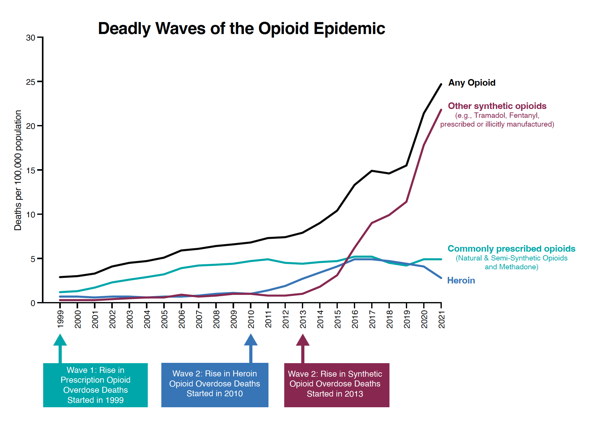
Deadly Waves of the Opioid Epidemic
Deadly Waves of the Opioid Epidemic
Data Source: CDC WONDER

Slide 4
Naloxone and Fentanyl
Naloxone is a short-acting opioid antagonist, commonly distributed in 4 mg intranasal doses
Fentanyl is highly potent compared to most other available opioids making it more lethal
Reports began to emerge that naloxone was ineffective against fentanyl and/or that numerous doses of naloxone were needed to reverse fentanyl-related overdoses
Higher dose formulations have recently been approved
Notes:
.

Slide 5
Study Objective
To leverage statewide population data to examine changes in naloxone doses administered during Emergency Medical Services (EMS) encounters for suspected opioid overdose in Kentucky over time, in the context of increased fentanyl and fentanyl analog (F/FA) availability in Kentucky communities

Slide 6
Methods: Data Sources
Emergency Medical Services (EMS) runs for suspected opioid overdoses in Kentucky, 2018-2021
Kentucky death certificates and post-mortem toxicology from the Kentucky Drug Overdose Fatality Surveillance System, 2017-2021
F/FA seizure data from the Kentucky State Police, 2018-2020

Slide 7
Methods: Study Measures
The main outcome measure was the total intranasal equivalent milligram (mg) naloxone administration for suspected opioid overdose encounters, calculated based on the recorded doses of naloxone administered by EMS and bystanders
Naloxone can be administered by various routes, including intranasal, intravenous, intramuscular, and more rarely intraosseous
A correction for relative potency by different routes was performed according to the potency estimates reported in Carpenter et al., 2020, to express all doses as intranasal equivalents
Carpenter, J., Murray, B.P., Atti, S., Moran, T.P., Yancey, A., Morgan, B., 2020. Naloxone dosing after opioid overdose in the era of illicitly manufactured fentanyl. J. Med. Toxicol. 16, 41–48. https://doi.org/10.1007/s13181-019-00735-w.

Slide 8
Methods: Study Measures
The main exposure of interest was the F/FA availability in the county of suspected opioid overdose treated by EMS, measured by two proxy measures:
A county-level 12-month rolling percentage of F/FA involvement in drug overdose deaths
An annual number of fentanyl drug seizures in a county

Slide 9
Methods: Study Measures
Patient demographic measures:
age, sex, race, ethnicity, county of incident occurrence, and rural/urban status of the county
Patient clinical characteristics:
initial Glasgow Coma Scale (GCS) – a measure of consciousness
encounter disposition classified as treated (released on site or transportation to emergency department), refused transportation (i.e., refused further treatment against medical advice), or death

Slide 10
Methods: Statistical Analysis
Descriptive analysis of intranasal naloxone total dose (INTD)
A linear mixed model with robust standard errors was used to evaluate INTD association with the exposure variables for estimated F/FA availability, adjusting for naloxone administration route, administration prior to EMS arrival, calendar year, rural/urban status, patient age, gender, race/ethnicity, and initial GCS.

Slide 11
Results:
Examined suspected opioid overdose cases (n=33,846) over 4 years
2018 = 6,853
2019 = 7,304
2020 = 9,801
2021 = 9,888
More than 99% of the cases we studied survived the overdose after treatment with naloxone

Slide 12
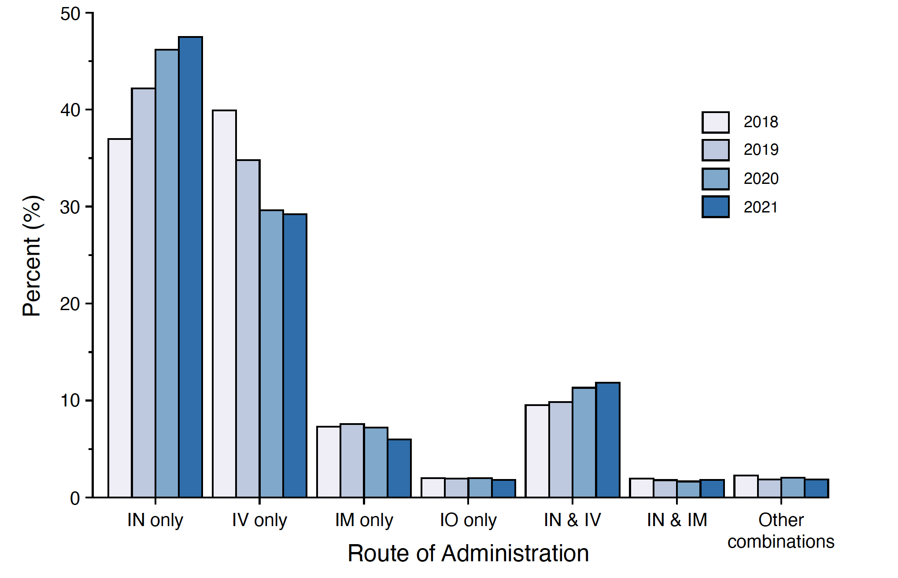
Naloxone administration EMS encounters for suspected opioid overdose, Kentucky, 2018–2021
IN=intranasal
IV=intravenous
IM=intramuscular
IO=intraosseous

Slide 13
Average Naloxone Doses Used to Treat Opioid Overdose
2018 = 4.5 mg
2019 = 4.5 mg
2020 = 4.7 mg
2021 = 4.7 mg
A total average increase of only 0.2 mg over the 4-year period

Slide 14
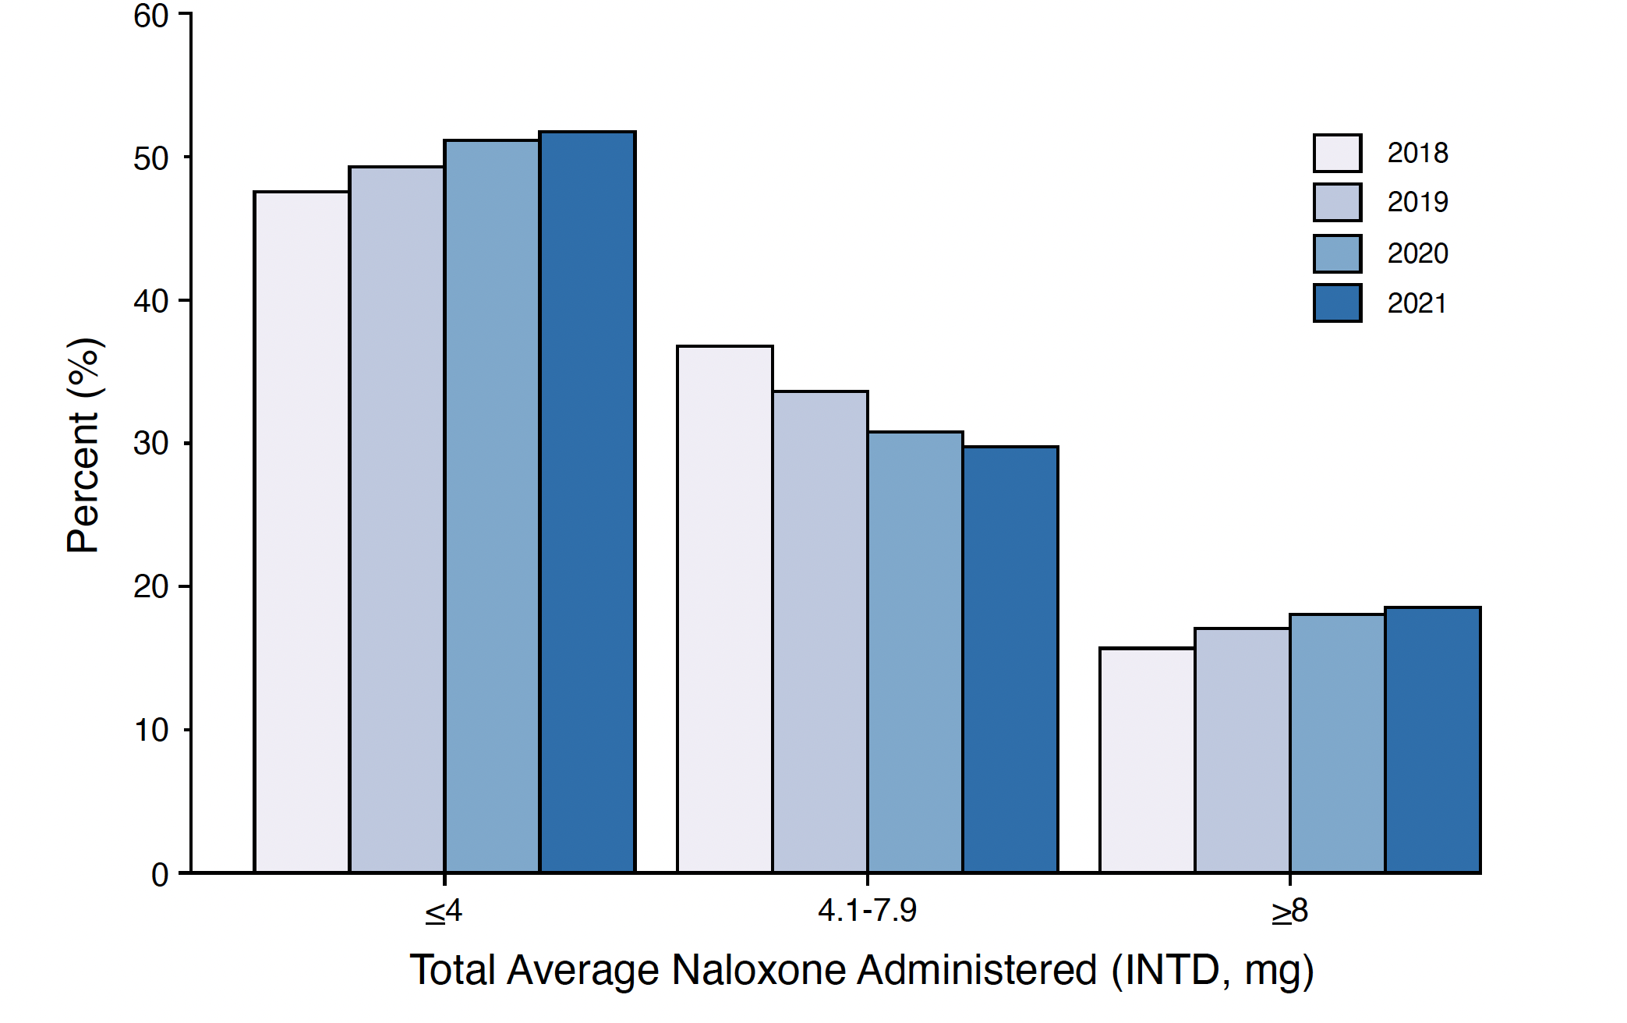

Slide 15
Examination of the High INTD Dose (≥ 8 mg) Cases
N=5,925 (17.5% total sample of 33,846 cases) were high dose INTD
Of those, n=4,313 (73%) resulted from multiple doses over time
The remaining n=1612 cases (<5% of the total sample) were recorded as a single dose entry;
in 63% of those cases, the dose was fully administered before EMS arrival, thus was reliant on self-report by bystander.
Repeated dosing was often provided within 4–5 minutes, which is somewhat longer than the recommended interval of 2–3 minutes in the approved product package inserts; but is in line with recommendations from National Association of State EMS Officials

Slide 16
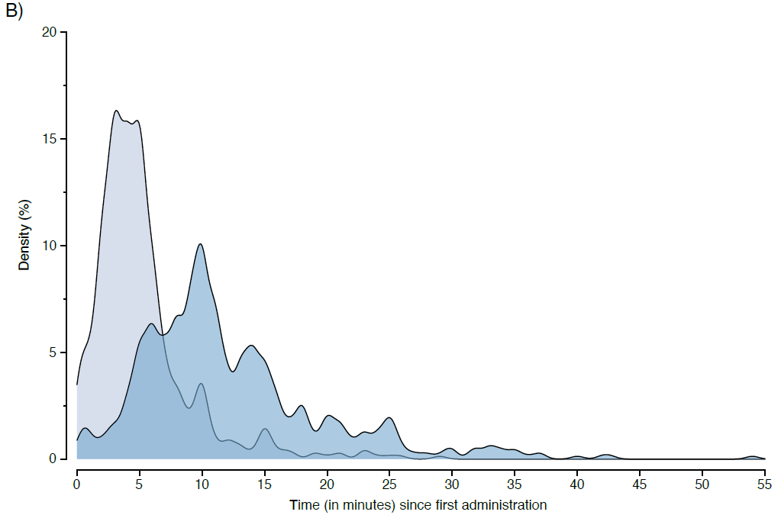
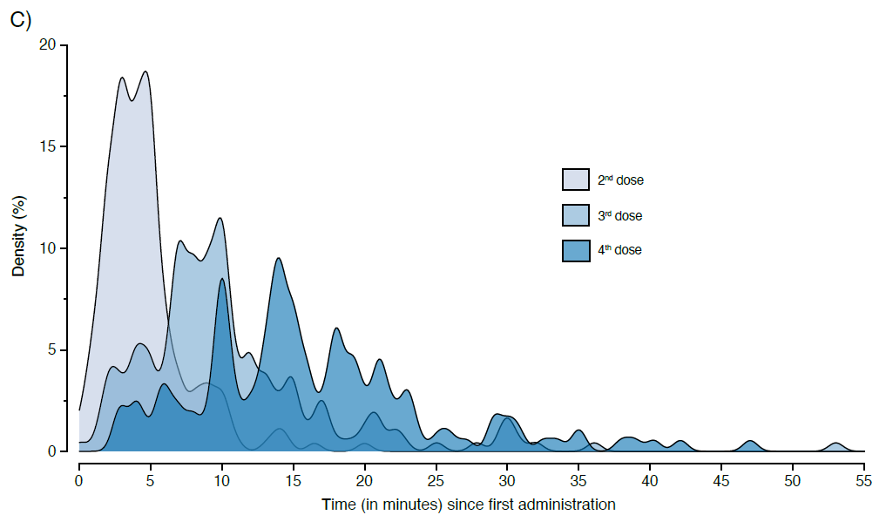
High INTD Dose (≥ 8 mg)
Time (in minutes) since first administration

Slide 17
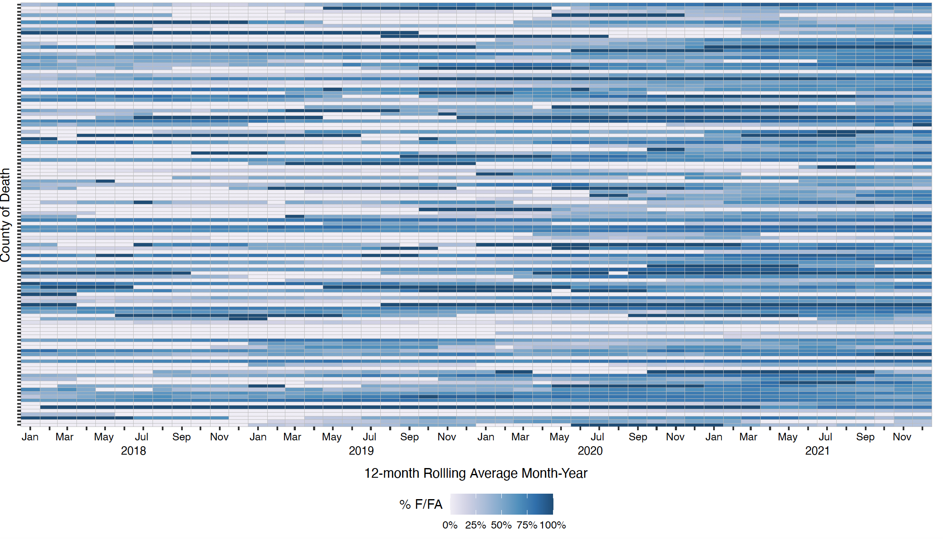
Heatmap of 12-month Rolling Percentage of F/FA-involved Overdose Deaths,
by County, and Over Time

Slide 18
Changes in Drug Seizures involving Fentanyl
13% increase from 2018 to 2019
9% increase from 2018 to 2019
Overall increase of ~20% over the study period

Slide 19
Relationship between Fentanyl/FA Availability and Naloxone Dose: Linear Mixed Models
There was no significant association of naloxone dose used to reverse overdose with rates of fentanyl-associated overdose deaths
There was no significant association of naloxone dose used to reverse overdose with number of police drug seizures containing F/FA

Slide 20
Conclusions
In the context of increasing F/FA in the illicit supply in Kentucky, we did not find data supporting the need for high dose naloxone formulations in opioid overdose encounters with EMS involvement

Slide 21
Funding This research was supported by the National Institutes of Health through the NIH HEAL Initiative under award UM1DA049406 (SLW) (ClinicalTrials.gov Identifier: NCT04111939) and the Centers for Disease Control (CDC) and Prevention through Partnership with Public Safety and First Responders under award NU17CE924971 (SS). The content is solely the responsibility of the authors and does not necessarily represent the official views of the National Institutes of Health, the Substance Abuse and Mental Health Services Administration, the NIH HEAL Initiative, or the CDC.
Acknowledgments The authors thank the Kentucky Office of Vital Statistics, Kentucky Department for Public Health, Kentucky Medical Examiners’ Office, the Kentucky Board of Emergency Medical Services, and the Kentucky State Police for their support for this study and providing data.
Svetla.Slavova@uky.edu

