Slide 1
Tuesday, April 19, 2016
New challenges require new kinds of teams with new competencies motivated by new leadership skills.
Presented by:
Terry Conway, MD, Managing Principal
Nancy Jaeckels Kamp, Managing Principal
Anthony J. Perry, MD, VP, Population Health and Ambulatory Services, Rush University Medical Center

Slide 2
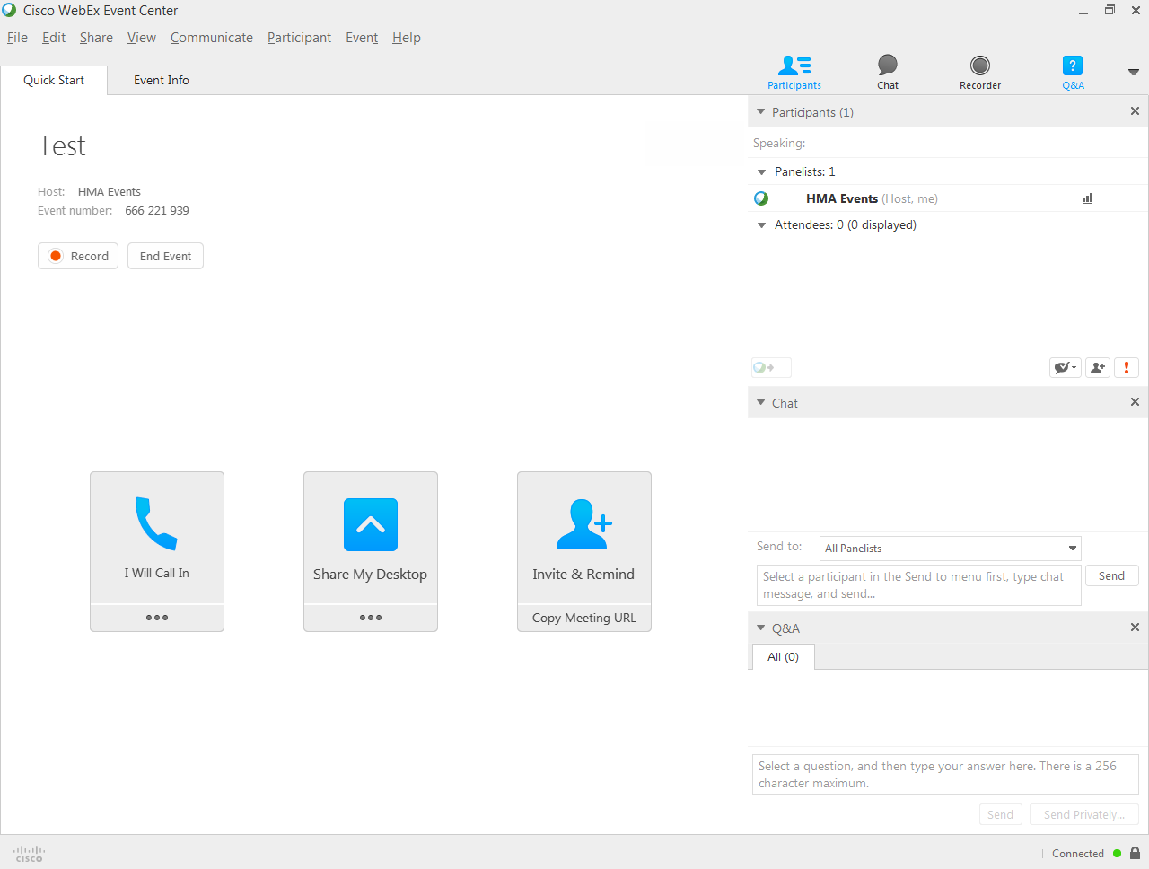

Slide 3
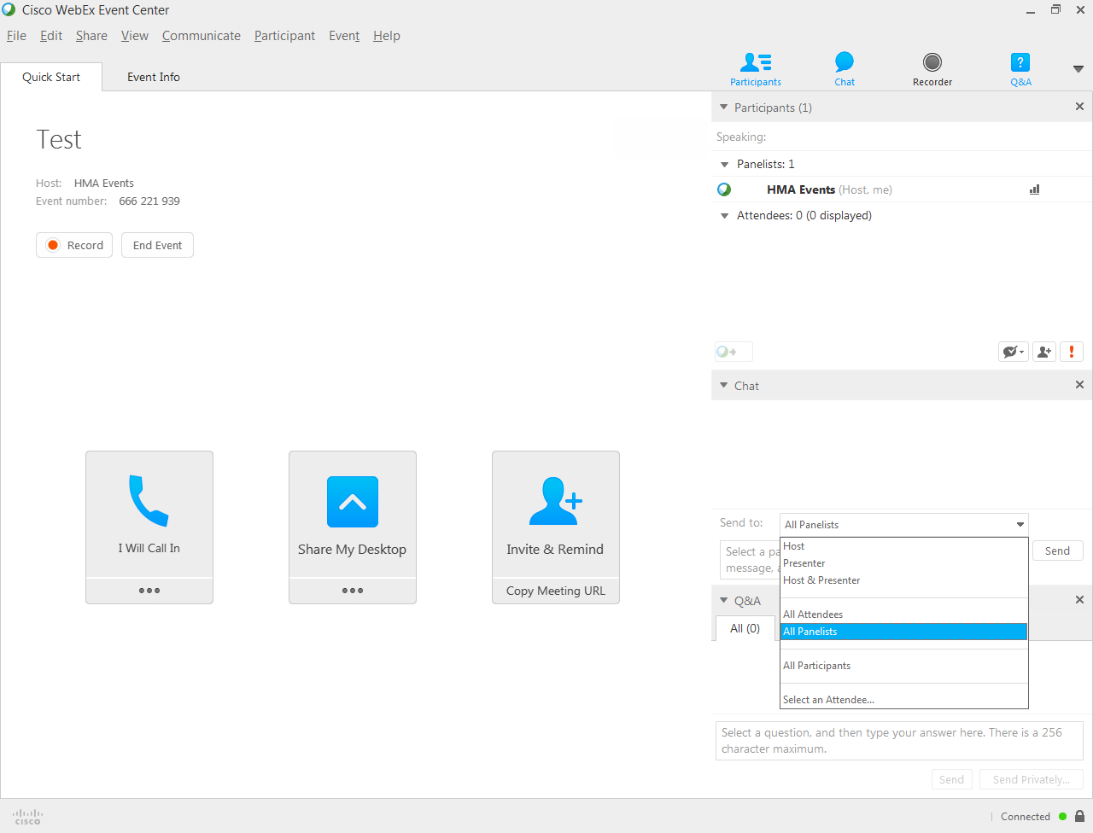

Slide 4
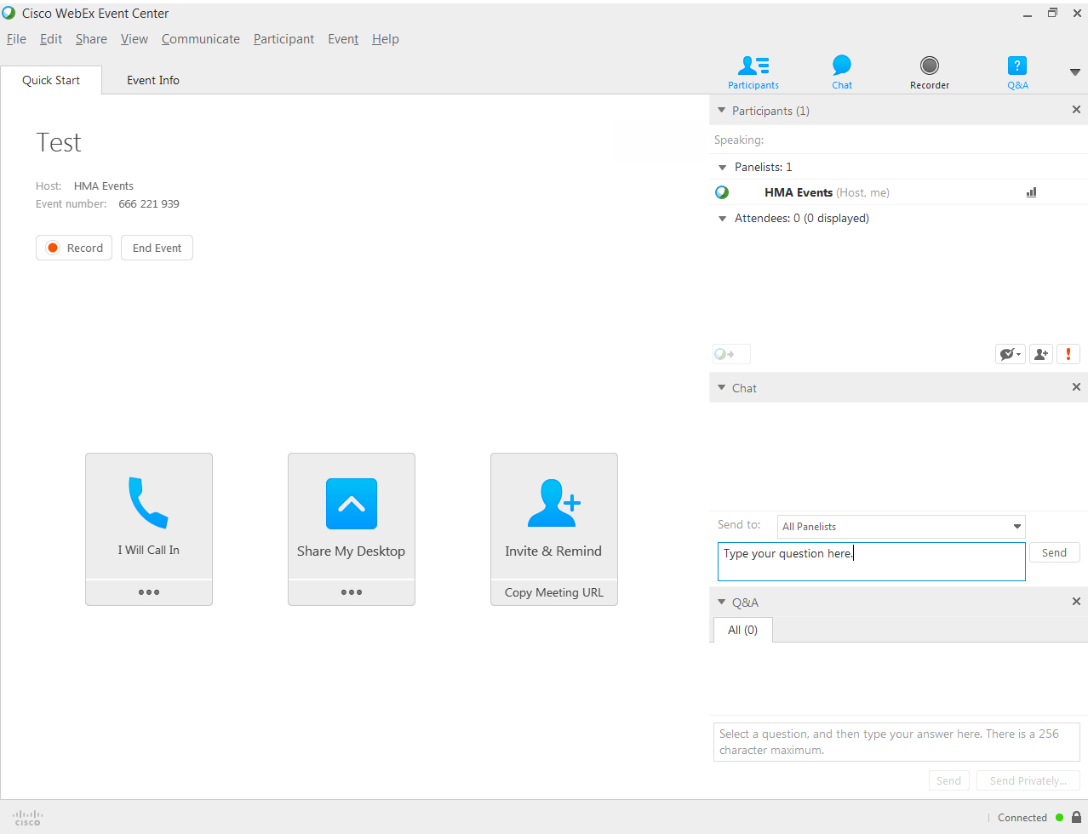

Slide 5
Objectives
Identify the new demands from the emerging health care driving the needed skills for leadership and team development.
Utilize a framework for guiding the assessment of leadership capacity across your organization.
Recognize best practices of leadership skills.
Understand the importance of engaged leaders in the transformation process.

Slide 6
Health Care for Vulnerable Populations
For the last twelve years, the same challenges have remained
Population is aging
Workforce shortage
Cost pressures
Competition
For the last twelve years, extraordinary new opportunities, challenges, and expectations have emerged
Expanded coverage
New organizational approaches to health and models of care
Cost consciousness and risk in the Safety Net

Slide 7
Lessons Learned
Financial incentives to providers have had limited success.
P4P
Health Outcomes
Cost
Networks that include all the parts of a health system often do not operate as a system of care.
It isn’t enough to recruit providers and clinical resources, or to tweak reimbursement.
The delivery system itself need fundamental change!

Slide 8
Value
Team Based Care
Inovation
Transfo
rmation
Population Health
Integrated Primary-Specialty-Behavioral Care
Person Centered
Integrated Delivery System
Transitional Care
Accountable
Medical – Health Home
Social Determinants of Health
Risk Stratification-Care Management

Slide 9
Leadership of the Delivery System is Vital to Success in Transformation
Vision, Worth, and Will
At multiple levels
Articulated, public, repetitive, and personal
Expectation of Outcomes
Measurement
Change in Values
Autonomy to shared decisions
Authority to teamwork
From disengagement of professionals to engagement

Slide 10
Leadership of the Delivery System is Vital to Success in Transformation
System View
The leader understands their role in system transformation
Evidence, ideas, innovation are actively sought
Constant Improvement
Collaboration and Partnership
Welcome the “Outsiders” in
Patients
Community
Execution of Change
At each level of care

Slide 11
Nature and/or Nurture in Leadership
The Right Stuff
Authenticity
Drive
Skills
Change Management
Organizational Design
Evidence Basis
There is Science
The Leader keeps abreast of it.

Slide 12
Leaders and the Patience of a Revolutionary

Slide 13
What’s Happening for You?
How would you rate your ability to lead teams to address the challenges of delivering care in the safety net?

Slide 14
Why Change?
Value of Care
To survive and thrive in this new health care environment, we need to focus less on volume and more on the value of care.
Moving towards the Triple Aim
Population health outcomes
Better individual patient care experiences
Lower cost per capita
Managed care moving toward value-based payment
Future of volume-based, enhanced FQHC rates is uncertain

Slide 15
Strategic Steps for New Leadership
Building adaptive leadership and the tools to help lead:
Understanding quality metrics and population health management
Understanding contracting and payment methodology and how it drives clinical care
Recruitment and retention of the right people for the change
Engaging and developing staff in new changes
Engaging consumers, meeting expectation, and cultural competencies
New technologies

Slide 16
Leaders to Transform Care
To Empower leadership to transform the change needed in this new health care environment, a different type of change style and of leadership is required:
Technical Changes/Technical leaders
Adaptive Changes/Adaptive leaders

Slide 17
What is Technical and Adaptive Change?
Technical change – change in a system or processes – training can help you make a technical change (i.e., how to use a new EMR)
Adaptive change – requires a change in belief, value, attitude or habits of behavior (i.e., why should I start using this EMR and is it going to change my life?)

Slide 18
The most common cause of leadership failure is treating an adaptive problem with a technical fix.

Slide 19
Organizational Change
“Lasting success lies in changing individuals first; then the organization follows.”
YOU are the leaders of those individuals.
Source: Black and Gregersen, Leading Strategic Change: Breaking Through the Brain Barrier. 2003.

Slide 20
Dimensions of Adaptive Change
Leadership capacity
Alignment of behaviors and beliefs
Tools for shaping and supporting the new culture (new change)
Change support by all formal and informal leaders

Slide 21
Leadership Capacity
Leadership has to be equipped to embed and reinforce new behaviors.
To build that capacity:
Equip governing body to be leaders for new culture
Equipping all executives, middle management, supervisors to be role models and reinforce new behaviors and beliefs and understand steps of change

Slide 22
Leadership Capacity
Get on the balcony
Identify both technical and adaptive challenges but focus on adaptive
Keep level of distress tolerable
Give the work back to the people
Be supportive and challenging of the change

Slide 23
Alignment of Behaviors and Strategies
Define organization’s strategy or new culture (who is the population you serve and the mission and culture needed to serve them best)
Assess current norms and behaviors
Gap between current and where you want to be – what doesn’t fit and what does support the new strategy
How to get alignment (see slides leadership and tools)

Slide 24
Tools to Shape and Support the New Way
Messaging – consistent from all levels of leadership all the way through – what they are focusing on as important, others will too
Setting up clear, mutual expectations for behaviors, participation, attitude as well as performance expectations (give and gets)
Hardwiring the new ways through policies, training, metrics, work redesign, etc.

Slide 25
Framework and Tools for Leaders
Quality Metrics and Population Health
As a leader do you:
Know what quality metrics you collect?
Evaluate if the current metrics will support the vision and purpose ?
Ask for and review reports routinely?
Use those data to present gaps and opportunities to your staff and drive change?
Contracting and Payment
As a leader do you:
Engage with partners and expand possibilities?
Help to drive the contracts with payers to best meet the needs of your vulnerable population?
Understand how the contract and payment drives the service practices and the need for alignment of both?

Slide 26
Framework for Leaders
Engaging the right people in change
As a leader do you:
Engage the head and the heart
Know who your change agents are and help to develop them
Fuel curiosity and support future – focused thinking
Set clear expectations for work practices, and triple aim goals
Strive for a team approach and healthy work culture
Fail fast, fail early and fail cheap but do not stop
Engaging consumers
As a leader do you:
Strategize on consumer feedback methods
Review feedback and use it for improvement
Engage a consumer focus group or advisory board in helping to drive decisions
Provide your staff with training on patient/consumer engagement techniques

Slide 27
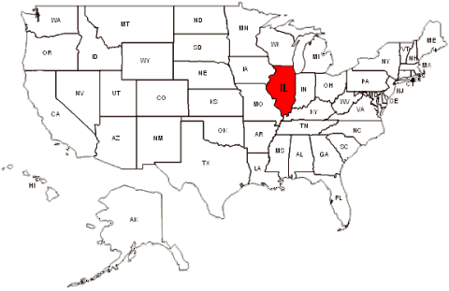
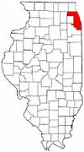
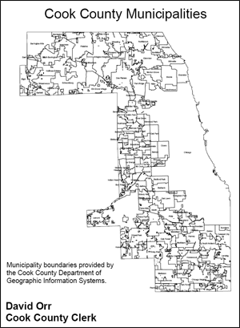
Let’s Get Local

Slide 28
Study of Leadership
Why change:
Disparity gaps
Rapid system change
Empowerment of adaptive change:
Individual change led to organizational change
Understanding the environment
Combining with:
Alignment of behaviors and strategies
Technical change

Slide 29
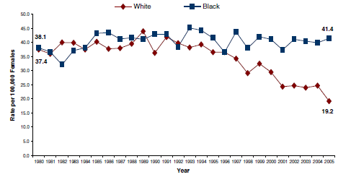
Chicago’s Disparity Gap Growing
Black and white age adjusted mortality. Chicago 1980-2005
Source: Ansell et al; http://www.suhichicago.org/files/publications/Taskforce%20paper.pdf

Slide 30
Medical Home Network
Source: www.mhnchicago.org/participants.html

Slide 32
Illinois Medicaid
2011 Illinois Medicaid Reform Law requires the state to enroll 50% of Medicaid clients in “care coordination” by 1/1/15
Medicaid managed care enrollment
Dual eligible (Medicare-Medicaid) program
Accountable Care Entities
2012 SMART Act
$1B in cuts to Medicaid spending
Decreased FamilyCare to 133% FPL
4 prescription limits

Slide 33
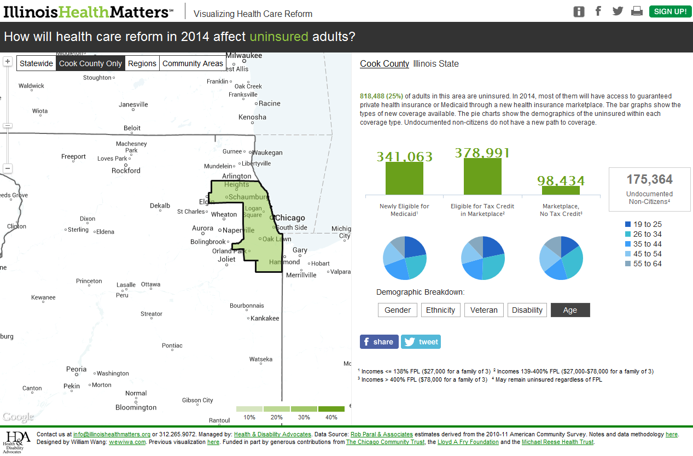
Exchanges & Medicaid

Slide 34
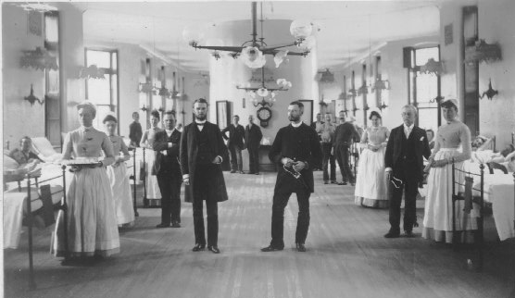
Medicaid program for uninsured adults in Cook County

Slide 35
Medical Home Network
“Lasting success lies in changing individuals first; then the organization follows.”
Source: www.mhnchicago.org/participants.html
Notes:
Add alignment of behaviors and strategies and vision (build from the medical home)

Slide 36
… Adaptive Change Followed
At-risk entity
Cook County Hospitals and Health System
CountyCare: ~160,000 insured lives
HMO/TPA: “acting on behalf of”
HMO/TPA
Care Management and Coordination; IT Infrastructure
MHN ACO:
~80,000 lives
HMO/TPA
~80,000 lives
Complex Care
3 Hospitals
9 FQHCs
1 Care
1 Care
1 Care
1 Care
Rush
1 Care
1 Care
1 Care
1 Care
1 Care
1 Care
1 Care
1 Care
1 Care
1 Care
1 Care
1 Care
1 Care
1 Care
Practices working within a shared MHN ACO care model to improve quality and utilization
Practices working within a HMO/TPA led care model to improve quality and utilization

Slide 37
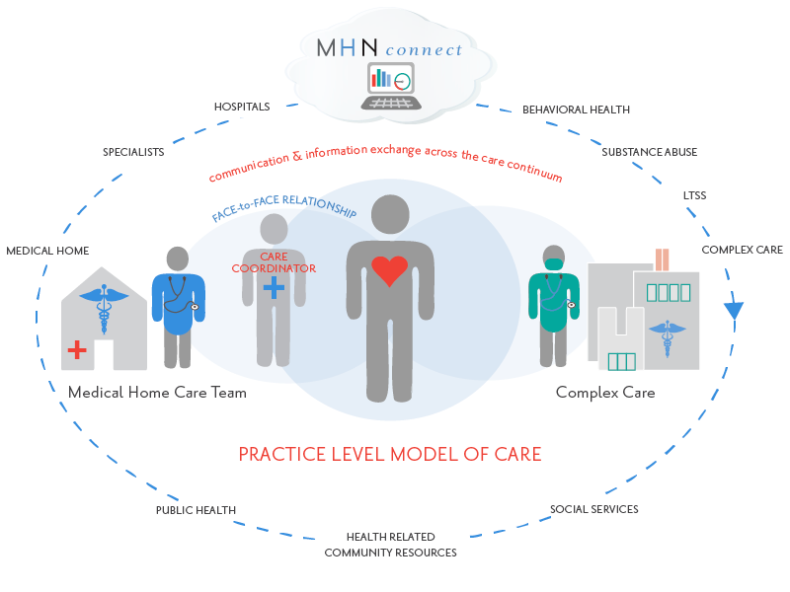
… Technical Change Followed
Point 2:
Real-Time Data
SINGLE IT PORTAL TO CONNECT 20 HOSPITAL EDs TO FQHCs AND PRIMARY CARE OFFICES; ADT FEED; HEALTH RISK ASSESSMENTS; REFERRALS
Point 1:
Shared Governance
MHN ACO
50%/50%
HOSPITALS/FQHCs
Point 4:
Rush Performs 4Cs: Centralized Complex Care Coordination
PMPM $ ACO SUPPORT;
SUPPORTS FQHCs/PC; COMPLEX DISCHARGES
Point 3:
Practice Level Change
CLINICAL COMMITTEE;
PRACTICE MODEL;
SHARED STANDARDS
* Source: http://mhnaco.org/mhn-model-of-care/
37
Notes:
Leadership Capacity: Equip governing body to be leaders for new culture
Alignment Of Behaviors and Strategies

Slide 38
MHN’s Proven Ability to Impact Cost, Engagement, and Outcomes
Total Cost of Care
ACA Readmission
The difference in cost of care for MHN versus other Medicaid patients in IL is 3.5% in Year 1 and 5% in Year 2 below trend
External
Network
External Network
MHN
MHN
5% LOWER COST
(risk adjusted)
15% BETTER OUTCOME
Difference is MHN risk adjusted cohort vs Non-MHN risk adjusted cohort percent change in cost of care
Source: Findings of the MHN HFS Care Coordination Pilot for the Illinois Health Connect population
ACA Utilization
Patient Engagement
Inpatient Days/1000
ED Visits/1000
MHN’s engagement efforts reach almost 2½ times as many patients as other Medicaid providers
MHN ACO:
71% COMPLETE
External Network:
31% COMPLETE
17% BETTER OUTCOME
17% BETTER OUTCOME
130% BETTER OUTCOME
Period: July 1, 2014 – May 19, 2015
Notes:
Art
HFS contract- 7 day f up initiative
The combination of alerts and care management follow-up ultimately reduced total cost of care
Good results against the non-MHN matched cohort re impact of initiative
Actuarial impact 1st year results against the matched cohort (500K lives)
were that we reduced cost 3.1% (12.6M),
utilization for day 7 day follow with the medial home post IP or ER d /charge 10.3% high and
we reduced our 30 day readmit rate 12.4%.
Year 2 Results – non risk adjusted at present
Cost -12.2% from baseline
7 day f up post IP or ED 14.3% over baseline
30 day readmit rate -15.6% better
ACO—early---best network performer all utilization measures for first 9 months

Slide 39
Study of Leadership
Why change:
Disparity gaps
Rapid system change
Empowerment of adaptive change:
Individual change led to organizational change
Understanding the environment
Combining with:
Alignment of behaviors and strategies
Technical change

Slide 40
“I’ve never been treated this way before”
Empowered Leadership Can Transform Care for Vulnerable Populations

Slide 41
Next Steps
HMA and Rush will be offering a full-day workshop on this leadership focus on June 7th in Chicago
More leadership workshops will be offered in other cities and states – if interested, please connect with us.

Slide 42
Q & A
Terry Conway, MD, Managing Principal, HMA tconway@healthmanagement.com
Nancy Jaeckels Kamp, Managing Principal, HMA nkamp@healthmanagement.com
Anthony J. Perry, MD, VP, Population Health and Ambulatory Services, Rush University Medical Center Anthony_J_Perry@rush.edu

