Slide 1
What’s Next for Medicaid? Findings from the 16th Annual Kaiser Medicaid Budget Survey
Vernon Smith, Kathy Gifford, Eileen Ellis and Barbara Edwards
November 16, 2016

Slide 2
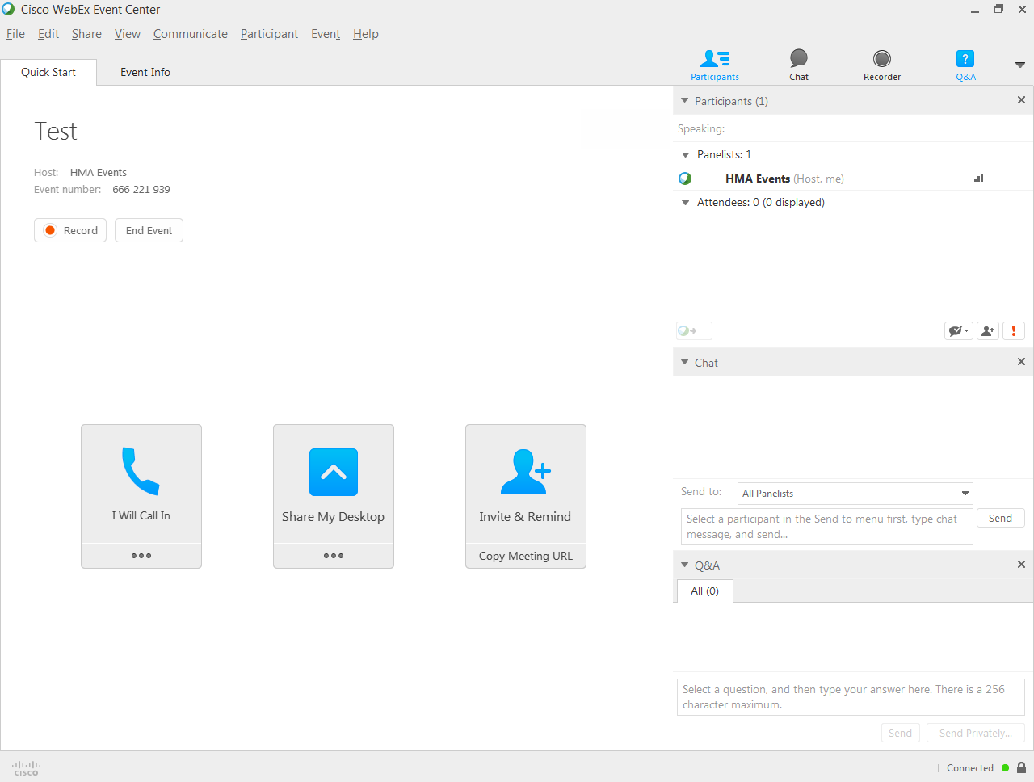

Slide 3
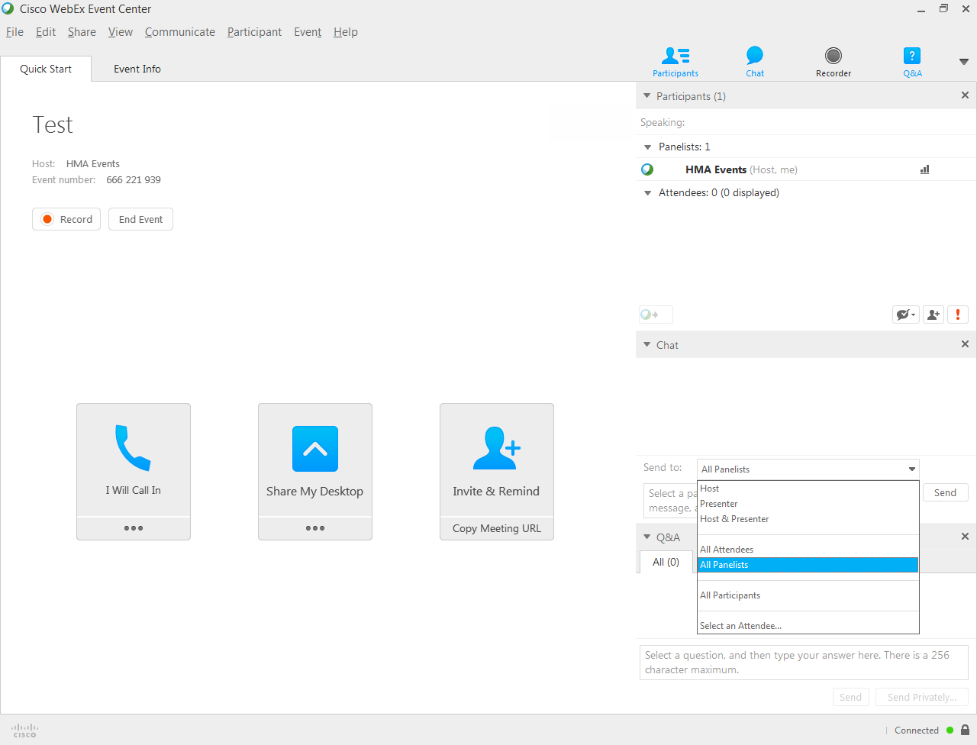

Slide 4
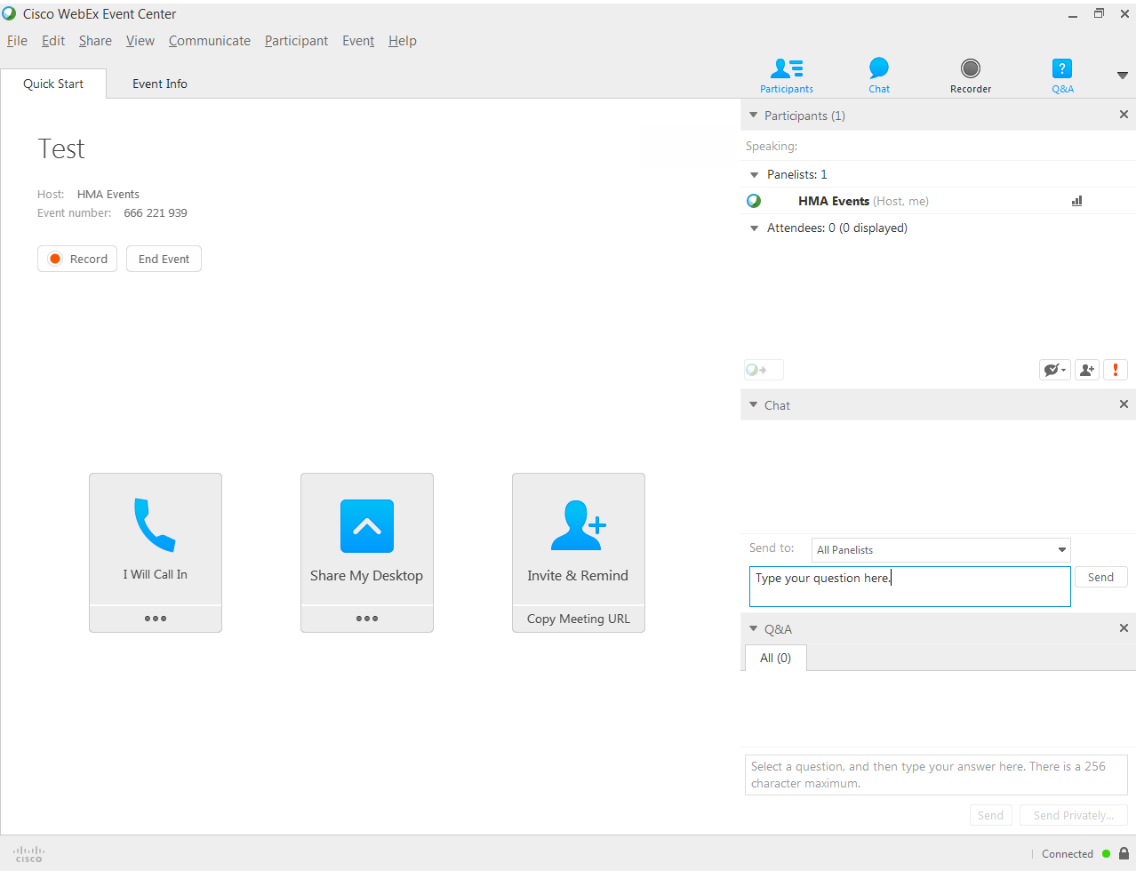

Slide 5
Conducted by HMA for the Kaiser Family Foundation in Collaboration with the National Association of Medicaid Directors
Survey results released in three separate reports:
Medicaid Enrollment & Spending Growth: FY 2016 & 2017
An analysis of national trends in state Medicaid enrollment and spending
Implementing Coverage and Payment Initiatives
A detailed look at policy changes and initiatives in all 50 state Medicaid programs
Putting Medicaid in the Larger Budget Context: An In-Depth Look at Four States in FY 2016 and FY 2017
MD, MT, NY and OK
Available at: www.kff.org or www.healthmanagement.com

Slide 6
Recessions and ACA implementation resulted in peaks in total Medicaid spending and enrollment growth
NOTE: For FY 1998-2013, enrollment percentage changes are from June to June of each year. FY 2014-2016 reflects growth in average monthly enrollment. Spending growth percentages refer to state fiscal year. FY 2017 data are projections based on enacted budgets.
SOURCE: Kaiser Family Foundation, Medicaid Enrollment & Spending Growth: FY 2016 & FY 2017; October 2016, available at: http://kff.org/health-reform/press-release/50-state-survey-finds-slower-growth-in-total-medicaid-spending-nationally-in-fy-2016-and-projected-for-fy-2017-as-earlier-increases-from-the-affordable-care-acts-coverage-expansions-taper-off/
5

Slide 7
Enrollment and total spending slowed in FY 2016 and are projected to slow in FY 2017; state spending uptick projected for FY 2017
NOTE: Average annual percentage change from previous fiscal year. FY 2017 growth reflects projections in enacted budgets.
SOURCE: Enrollment growth for FY 2015-2016 is based on KCMU analysis of CMS, Medicaid & CHIP Monthly Applications, Eligibility Determinations, and Enrollment Reports, accessed October 2016. The spending growth rate for FY 2015 is derived from KCMU Analysis of CMS Form 64 Data. All other growth rates are from the KCMU survey of Medicaid officials in 50 states and DC conducted by Health Management Associates, October 2016.
6

Slide 8
Medicaid enrollment and total spending growth for expansion and non-expansion states are slowing in FY 2016 and projected to slow in 2017
Medicaid Enrollment
Total Medicaid Spending
NOTE: Percentages reflect the median percent change for each group of states for each year. FY 2017 growth reflects projections in enacted budgets. In FY 2016, Alaska and Montana moved and in FY 2017, Louisiana moved to the expansion state group.
SOURCE: Enrollment growth for FY 2015-2016 is based on KCMU analysis of CMS, Medicaid & CHIP Monthly Applications, Eligibility Determinations, and Enrollment Reports, accessed October 2016. The spending growth rate for FY 2015 is derived from KCMU Analysis of CMS Form 64 Data. All other growth rates are from the KCMU survey of Medicaid officials in 50 states and DC conducted by Health Management Associates, October 2016.
7

Slide 9
Medicaid Expansion Decisions by Year of Implementation
VT
ME
WA
NH*
MT*
ND
MN
OR
MA
SD
WI*
NY
ID
MI*
CT
RI
WY
PA
NJ
NE
IA*
OH
DE
NV
IL
IN*
MD
CA
UT
CO
WV
VA
KS
MO
KY
DC
NC
AZ
TN
NM
OK
AR*
SC
AK
MS
AL
GA
TX
LA
FL
HI
Implemented in FY 2014 (26 States including DC)
Implemented in FY 2015 (3 States)
Implemented in FY 2016 (2 States)
Implemented in FY 2017 (1 State)
Not Implementing At This Time (19 States)
NOTES: *AR, IA, IN, MI, MT, and NH have approved Section 1115 waivers. WI covers adults up to 100% FPL in Medicaid, but did not adopt the ACA expansion.
SOURCE: KCMU survey of Medicaid officials in 50 states and DC conducted by Health Management Associates, October 2016.
8

Slide 10
Since 2014, 32 states adopted the ACA Medicaid expansions, plus a few states made targeted eligibility changes
SOURCE: Kaiser Commission on Medicaid and the Uninsured Survey of Medicaid Officials in 50 states and DC
conducted by Health Management Associates, October 2016. http://kff.org/medicaid/report/implementing-coverage-and-payment-initiatives-results-from-a-50-state-medicaid-budget-survey-for-state-fiscal-years-2016-and-2017/
9

Slide 11
Corrections Related Enrollment Policies
Medicaid’s Role in Health Care for Incarcerated Individuals has Increased:
More are eligible due to ACA Medicaid expansion
48 states obtain (or plan to obtain) Medicaid reimbursement for inpatient care
41 states (by end of FY 2017) will suspend eligibility (rather than terminate) during incarceration
Many states provide enrollment assistance prior to release, and/or help to connect to healthcare upon release
SOURCE: Kaiser Commission on Medicaid and the Uninsured Survey of Medicaid Officials in 50 states and DC conducted by Health Management Associates, October 2016.

Slide 12
States were most likely to increase payment rates for MCOs and nursing facilities, and to freeze hospital rates
States with Rate Increases
3
4
States with Rate Restrictions
NOTES: Restrictions include rate cuts for any provider or freezes for nursing facilities or hospitals. FY 2017 rates were not set for MCOs in Florida or Minnesota at the time of the survey. Illinois did not provide a response for FY 2017 rates as a budget for FY 2017 had not been enacted at the time of the survey. SOURCE: KCMU Survey of Medicaid Officials in 50 states and DC conducted by Health Management Associates, October 2016.
11

Slide 13
At least 8 states reported plans to use provider taxes to finance the state share of Medicaid expansion costs
WA
VT
ME
MT
ND
MN
NH*
OR
MA
SD
WI
NY
ID
MI
RI
WY
PA
CT
NE
IA
NJ
IL*
IN*
OH*
DE
NV
CO*
MD
CA
UT
WV
VA
DC
KS
MO
KY
NC
AZ*
TN
NM
OK
AR*
SC
MS
AL
GA
AK
TX
LA*
FL
In place in FY 2016
3+ provider taxes/fees (34 states including DC)
HI
2 provider taxes/fees (10 states)
1 provider tax/fee (6 states)
No provider taxes/fees (1 state)
NOTES: Includes Medicaid provider taxes as reported by states. States may have other taxes on health insurance premiums or health insurance claims that are not reflected here. * Indicates states reporting plans to use provider taxes or fees to fund all or part of the state share of ACA Medicaid expansion costs beginning in January 2017.
SOURCE: KCMU survey of Medicaid officials in 50 states and DC conducted by Health Management Associates, October 2016.
12

Slide 14
Managed care remains the predominate medicaid delivery system in most States
As of July 1, 2016:
Notable MCO program expansions in FY 2016 or FY 2017:
39 states had MCO contracts
Of these, 7 also operated PCCM program
3 states ending a PCCM program and transitioning enrollees to MCOs (IA, RI, WV)
MO expanding MCOs statewide in FY 2017
AL implementing RCOs in FY 2017
16 states had PCCM programs
Down from 19 states in July 2015
Of these, 7 also had an MCO program
Only 3 states had no comprehensive managed care
Alaska, Connecticut and Wyoming
SOURCE: Kaiser Commission on Medicaid and the Uninsured Survey of Medicaid Officials in 50 states and DC conducted by Health Management Associates, October 2016.

Slide 15
In 2016, at least 75% of all Medicaid beneficiaries are in an MCO in 28 states (up from 21 states in 2015)
1
1
NOTES: Limited to 39 states with MCOs in place on July 1, 2016. Of the 32 states that had implemented the ACA
Medicaid expansion as of July 1, 2016, 27 had MCOs in operation. SOURCE: Kaiser Commission on Medicaid and the
Uninsured Survey of Medicaid Officials in 50 states and DC conducted by Health Management Associates, October 2016.
14

Slide 16
MCO Coverage of Behavioral Health, July 2016
Coverage of BH and SUD services varies across the 39 MCO states
 | Specialty Outpatient MH | Inpatient MH | Outpatient SUD | Inpatient SUD
Always carved-in | 20 | 24 | 24 | 26
Always carved-out | 12 | 10 | 9 | 8
Varies (by geography or other factor) | 7 | 5 | 6 | 5
SOURCE: KCMU Survey of Medicaid Officials in 50 states and DC conducted by Health Management Associates, October 2016.

Slide 17
42 states now have delivery system initiatives; new initiatives in 21 states in FY 2016 and 25 states in FY 2017
In Place in FY 2015:
NOTES: Expansions include rollouts of existing initiatives to new areas or groups, and other increases in enrollment or providers.
SOURCE: KCMU Survey of Medicaid Officials in 50 states and DC conducted by HMA, October 2016. www.kff.org
16

Slide 18
Benefit enhancements in FY 2016 and for FY 2017 were most commonly for behavioral health, substance use disorders, tele-health & dental services
NOTES: States reported benefit restrictions, eliminations, enhancements, and additions in FY 2016 and FY 2017. Excluded from these changes are the implementation of alternative benefit plans for the Medicaid expansion group. Home and community-based services (HCBS) and pharmacy benefit changes are also excluded. SOURCE: Kaiser Commission on Medicaid and the Uninsured Survey of Medicaid Officials in 50 states and DC conducted by Health Management Associates, October 2016.
17

Slide 19
States are focused on pharmacy cost-containment, and strategies to address the opioid epidemic
31 states in FY 2016 and 23 in FY 2017 implemented or plan to implement pharmacy cost containment efforts
Nearly all states reported specific opioid-focused pharmacy management policies
Targeted to specialty and high cost Rx
Quantity limits, Use of prior authorization
Required use of Prescription Drug Monitoring Programs
Expanded access to naloxone
Most states with MCOs carve drugs into capitation payments
Exceptions: CO, MO, NE (until January 2017) and TN
Uniform requirements for clinical protocols, PA and/or PDLs reported by a number of states
SOURCE: Kaiser Commission on Medicaid and the Uninsured Survey of Medicaid Officials in 50 states and DC conducted by Health Management Associates, October 2016.
Notes:
Icons Available on Slides 80-82

Slide 20
17 of the 39 MCO states expanded or implemented new quality initiatives in MCOs in FY 2016; 17 also in FY 2017
In Place in FY 2015:
NOTES: States with MCOs indicated if selected quality initiatives were in place in FY 2015, new or expanded in FY 2016 or FY 2017. SOURCE: KCMU Survey of Medicaid Officials in 50 states and DC conducted by Health Management Associates, October 2016.
19

Slide 21
Almost every state is expanding community-based Long Term Services and Supports
NOTES: "HCBS Waiver or SPA Expansion" includes increases to the number of Section 1915(c) waiver slots, serving more people under existing waiver caps, or the addition of Section 1915(i) or Section 1915(k) state plan options to serve more individuals. SOURCE: Kaiser Commission on Medicaid and the Uninsured Survey of Medicaid Officials in 50 states and DC conducted by Health Management Associates, October 2016.
20

Slide 22
16 states are implementing new housing-related services in 2016, 2017
States Implementing/Expanding Housing-Related Services Outlined in CMS Information Bulletin
FY 2016 only | RI | FY 2016 and 2017
OH | CT, DC, DE, FL, HI, NJ, RI, VT | CA, LA, MA, NC, OK, TN, WA
Almost half the states reported they already offer housing-related services in 2016 that they expected to continue beyond MFP expiration (under MFP, c waiver, or other authority)
SOURCE: Kaiser Commission on Medicaid and the Uninsured Survey of Medicaid Officials in 50 states and DC conducted by Health Management Associates, October 2016.
21

Slide 23
Managed LTSS remains a strong trend in 2016, 2017
23 states had MLTSS arrangements in June 2016
21 states had at least one MCO arrangement that offers physical and LTSS in one contract
10 states in 2017 will have a duals Financial Alignment Demonstration; 5 states require Medicaid MCOs to offer D-SNP
Seniors most likely to be required to enroll in MLTSS (13 states); people with ID/DD least likely to be required to enroll in MLTSS (8 states)
MLTSS Populations Expansions 2016 - 2017
 | 2016 | 2017
Geographic Expansion | IA, ID, SC, WI | SC, WI
New Population Group | IA, NJ, NY, SC | IL, NY, SC, TN, TX
SOURCE: Kaiser Commission on Medicaid and the Uninsured Survey of Medicaid Officials in 50 states and DC conducted by Health Management Associates, October 2016.
22

Slide 24
Looking ahead, Medicaid priorities are focused on goals and strategies to improve care and outcomes for high need populations
Strategies
Seriously Mentally Ill
Criminal Justice Involved
Elderly and Disabled
Duals
Goals
Cost Containment
Improved Outcomes
Improved Population Health
Integration Physical and Behavioral Health
Opioid Harm Reduction
Value Based Purchasing
ACO, Episode of Care, Health Homes, DSRIP
Populations
Focus on Social Needs
Managed Long-Term Care
Increase Access
SOURCE: Kaiser Commission on Medicaid and the Uninsured Survey of Medicaid Officials in 50 states and DC conducted by Health Management Associates, October 2016.
23

Slide 25
CONTACT US
Vernon Smith
Senior Fellow
VSmith@healthmanagement.com
Kathy gifford Principal
KGifford@healthmanagement.com
Eileen ellis
Senior Fellow
EEllis@healthmanagement.com Barbara Edwards Principal
BEdwards@healthmanagement.com

