Slide 1
The Intersection of HIV and Substance Use: Enhancing the Care Continuum with Evidence-Based Practices
Training Series: Session 3
October 20, 2021
Copyright © 2021 Health Management Associates, Inc. All rights reserved. The content of this presentation is PROPRIETARY and CONFIDENTIAL to Health Management Associates, Inc. and only for the information of the intended recipient. Do not use, publish or redistribute without written permission from Health Management Associates, Inc.

Slide 2
Utilizing Zoom
Ensure your audio is linked to your Zoom participant ID.
If you joined the audio by computer microphone and speaker, then you’re all set.
If you joined the audio with a phone and did not enter your unique participant ID then enter # <your participant ID> # on your phone now. Note: Your unique participant ID can be found by clicking on the lower left corner of your Zoom screen where it says ‘Join Audio’ and your Participant ID will appear.
Ensure you are on mute. On the bottom left corner of your screen, you will see a red line through the microphone.
Your participation throughout today via chat is appreciated!
Locate the chat box. On the bottom middle of your screen, click on the chat icon. This will open the “Zoom Group Chat” pane on the right side of your screen. You will see messages throughout the webinar on there. When prompted by the presenters, type in your answers or questions there.
ON MUTE MICROPHONE ON
Copyright © 2021 Health Management Associates, Inc. All rights reserved.

Slide 3
Housekeeping
Today is Session 3
This series is eligible for both CEU’s and CME’s
These activities have been approved for CEU’s by the Minnesota Board of Behavioral Health and Therapy for 3 hours of credit for LADCs and LPC/LPCCs (total of 12 hours if all four sessions are fully attended)
These activities have been approved for CME’s by the American Academy of Family Physicians for 3 hours of credit (total of 12 hours if all four sessions are fully attended)
Please complete the evaluation and post-test for the webinar that will be sent out via email after each session.
You will be receiving a PDF of today’s presentation.
Follow-up questions?
Contact Cami McIntire: cmcintire@healthmanagement.com
Copyright © 2021 Health Management Associates, Inc. All rights reserved.

Slide 4
Acknowledgments
We would also like to thank our community partners for their support in developing this curriculum.
Copyright © 2021 Health Management Associates, Inc. All rights reserved.

Slide 5
Land Acknowledgment
Every community owes its existence and vitality to generations from around the world who contributed their hopes, dreams, and energy to making the history that led to this moment. Some were brought here against their will, some were drawn to leave their distant homes in hope of a better life, and some have lived on this land for more generations than can be counted. Truth and acknowledgment are critical to building mutual respect and connection across all barriers of heritage and difference.
We begin this effort to acknowledge what has been buried by honoring the truth. We are standing on the ancestral lands of the Dakota people. We want to acknowledge the Dakota, the Ojibwe, the Ho Chunk, and the other nations of people who also called this place home. We pay respects to their elders past and present.
Please take a moment to consider the treaties made by the Tribal nations that entitle non-Native people to live and work on traditional Native lands. Consider the many legacies of violence, displacement, migration, and settlement that bring us together here today. Please join us in uncovering such truths at any and all public events.*
*This is the acknowledgment given in the USDAC Honor Native Land Guide – edited to reflect this space by Shannon Geshick, MTAG, Executive Director Minnesota Indian Affairs Council
Copyright © 2021 Health Management Associates, Inc. All rights reserved.

Slide 6
Today’s Presenters
Charles Robbins, MBA
(he/him/his)
Principal
Health Management Associates
Claudia Figallo, MPH, LAADC
(she/her/hers)
Counselor/Supervisor
San Francisco AIDS Foundation
Helen DuPlessis, MD, MPH
(she/her/hers)
Principal
Health Management Associates
Copyright © 2021 Health Management Associates, Inc. All rights reserved.

Slide 7
Disclosures
Faculty | Nature of Commercial Interest
Charles Robbins, MBA | Mr. Robbins discloses that he is an employee of Health Management Associates, a national research and consulting firm providing technical assistance to a diverse group of health care clients.
Helen DuPlessis, MD, MPH | Dr. DuPlessis discloses that she is an employee of Health Management Associates, a national research and consulting firm providing technical assistance to a diverse group of health care clients. She is also a Board Member of Blue Shield of California Health Plan.
Claudia Figallo, MPH, LAADC | Ms. Figallo is an employee of the San Francisco AIDS Foundation, a non-profit which promotes health, wellness, and social justice for communities most impacted by HIV, through sexual health and substance use services, advocacy, and community partnerships.
Jeanene Smith, MD | Dr. Smith discloses that she is an employee of Health Management Associates, a national research and consulting firm providing technical assistance to a diverse group of health care clients.
Copyright © 2021 Health Management Associates, Inc. All rights reserved.

Slide 8
Agenda for Webinar Series
Session | Topics
#1 WEDNESDAY, OCT 6 12:00 pm to 3:00 pm | Understanding HIV HIV Testing and Treatment The Science of Addiction, Screening, and Assessment
#2 WEDNESDAY, OCT 13 12:00 pm to 3:00 pm | MAT: Including MAT for Justice Involved Persons Mental Health Treatment and Counseling Stimulant Use Chem Sex
#3 WEDNESDAY, OCT 20 12:00 pm to 3:00 pm | HIV Risk Reduction SUD Harm Reduction Ethical and Legal Issues Funding and Policy Considerations HIV and Stigma Motivational Interviewing
#4 WEDNESDAY, OCT 27 12:00 pm to 3:00 pm | Cultural, Racial and Sexual Identities HIV Positivity, Pregnancy, and SUD Accessing, Obtaining, and Integrating Services for Individuals with HIV and SUD in Minnesota
Copyright © 2021 Health Management Associates, Inc. All rights reserved.

Slide 9
Understanding HIV Risk Reduction, SUD Harm Reduction, Ethical and Legal Issues, Funding and Policy Considerations, HIV and Stigma, and Motivational Interviewing
Let’s begin!

Slide 10
Glossary of Terms (revisited)
Sexual orientation – a person’s identity in relation to the gender or genders to which they are sexually attracted (straight, gay, lesbian, asexual, bisexual, pansexual)
Gender identity and/or expression - internal perception of one’s gender; how one identifies or expresses oneself.
Cisgender – a term used to describe a person whose gender identity aligns with those typically associated with the sex assigned to them at birth
Transgender – refers to an individual whose current gender identity and/or expression differs from the sex they were assigned at birth (may have transitioned or be transitioning in how they are living)
Gender Expansive - refers to an individual who expresses identity along the gender spectrum (genderqueer, gender nonconforming, nonbinary, agender, two spirit)
Sexual Minority – refers to a group whose sexual identity orientation or practices differ from the majority of and are marginalized by the surrounding society.
SOURCE: Centers for Educational Justice and Community Engagement, UC Berkeley
Race - is usually associated with inherited physical, social and biological characteristics. In this context that means race is associated with biology. Institutionalized in a way that has profound consequences (White, African American, American Indian Alaskan Native, Native Hawaiian or Pacific Islander)”
Ethnicity - a term used to categorize a group of people with whom you share learned characteristics and identify according to common racial, national tribal, religious, linguistic, or cultural origin or background. (Hispanic, Non-Hispanic Black, Non-Hispanic Black, etc.)
SOURCE: US Office of Management and Budget: Federal Register Vol. 62(210): 58782
Copyright © 2021 Health Management Associates, Inc. All rights reserved.
Notes:
US Census categories for race (set by OMB):
White
Black or African American
American Indian and Alaska Native
Asian
Native Hawaiian and Pacific Islander
Two or more races
US Census Categories for ethnicity
Hispanic or Latino
Not-Hispanic or Latino

Slide 11
Glossary of Terms (revisited)
Health Insurance Portability and Accountability Act (HIPAA) - required the creation of national standards to protect sensitive patient health information (PHI) from being disclosed without the patient’s consent and includes a Privacy Rule addressing disclosure of and access to PHI; the Security Rule protects disclosure of and access to electronic PHI (e-PHI) a subset of information covered by the Privacy Rule
Code of Federal Regulations, Title 42, Part 2 (42 CFR Part 2) – a complicated set of regulations that strengthen the privacy protections afforded to persons receiving alcohol and substance use treatment (in addition to the more general privacy protections afforded in HIPAA). The regulations restrict the disclosure and use of alcohol and drug patient records which are maintained in connection with any individual or entity that is federally assisted and holds itself out as providing, and provides, alcohol or drug abuse diagnosis, treatment or referral for treatment (42 CFR § 2.11)
Family Education Rights Protection Act (FERPA) - protects the privacy of student education records in public or private elementary, secondary, or post-secondary school and any state or local education agency that receives funds under an applicable program of the US Department of Education.
SOURCES: Centers for Disease Control and Prevention; and the Substance Abuse and Mental Health Services Administration
Copyright © 2021 Health Management Associates, Inc. All rights reserved.
Notes:
US Census categories for race (set by OMB):
White
Black or African American
American Indian and Alaska Native
Asian
Native Hawaiian and Pacific Islander
Two or more races
US Census Categories for ethnicity
Hispanic or Latino
Not-Hispanic or Latino
FERPA The Act serves two primary purposes. It gives parents or eligible students more control over their educational records, and it prohibits educational institutions from disclosing “personally identifiable information in education records” without the written consent of an eligible student, or if the student is a minor, the student’s parents (20 U.S.C.S. § 1232g(b)). An eligible student is one who has reached age 18 or attends a school beyond the high school level

Slide 12
Common Acronyms (revisited)
ART – Antiretroviral therapy
AUD – Alcohol use disorder
IDU – Injection or intravenous drug use
MAT – Medication assisted treatment or
Medications for addiction treatment
MSM – Men who have sex with men
OUD – Opioid use disorder
PEH – Person(s) experiencing homelessness
PEP – Post-exposure prophylaxis
PrEP – Pre-exposure prophylaxis
PLWH – Person(s) living with HIV
PWID – Person(s) who injects drugs
SUD – Substance use disorder
Copyright © 2021 Health Management Associates, Inc. All rights reserved.

Slide 13
HIV Risk Reduction

Slide 14
Learning Objectives:
HIV Risk and SUD Harm Reduction
I
II
III
IV
Identify at least 3 critical HIV sexual transmission risk reduction strategies, including but not limited to PrEP and PEP
Define Harm Reduction as it relates to both SUD and HIV and describe at least 3 harm reduction strategies
Describe the current risks associated with synthetic opioids and specific harm reduction strategies to mitigate those
Describe the relationship between SUD and HIV risk
Copyright © 2021 Health Management Associates, Inc. All rights reserved.

Slide 15
Definitions
HIV risk reduction is the selective application of appropriate techniques and management principles to reduce the likelihood of a risky event and/or the negative consequences of such an event.
The goal of risk reduction counseling is to help patients decrease risks to themselves and others, thereby decreasing the number of new HIV infections.
Risk reduction helps decrease the rates of HIV infection through targeted prevention efforts.
SUD harm reduction incorporates a spectrum of practical strategies and ideas from safer use, to managed use, to abstinence, all to meet individuals who use drugs where they are, addressing conditions of use as well as the use itself.
Copyright © 2021 Health Management Associates, Inc. All rights reserved.

Slide 16
Risks for HIV Infection
Risks for HIV infection
Unprotected sex
Sharing needles
Mother to child
Strategies for HIV prevention
Safer sex (condoms)
Routine testing
Antiretrovial advances
Viral suppression (U=U)
PrEP and PEP
Copyright © 2021 Health Management Associates, Inc. All rights reserved.

Slide 17
PrEP and PEP
PrEP (pre-exposure prophylaxis) is medicine people at risk for HIV take to prevent getting HIV from sex or injection drug use. When taken as prescribed, PrEP is highly effective for preventing HIV.
PEP (post-exposure prophylaxis) means taking medicine to prevent HIV after a possible exposure. PEP should be used only in emergency situations and must be started within 72 hours after a recent possible exposure to HIV.
Copyright © 2021 Health Management Associates, Inc. All rights reserved.

Slide 18
Injection Drug Use and HIV Infection
HIV and Hepatitis C
Syringe access programs
A variety of syringes to match a variety of injecting practices
Related supplies (e.g., alcohol swabs, ties/tourniquets, etc.)
Safe smoking supplies (e.g., clean pipes, straws, lip balm)
Sexual health supplies
Overdose prevention supplies and education
Health educators available for brief interventions
Test strips for Fentanyl and other drugs
Opportunities for Hepatitis C and HIV testing and linkage
Copyright © 2021 Health Management Associates, Inc. All rights reserved.

Slide 19
SUD Harm Reduction

Slide 20
Harm Reduction for HIV and Alcohol
Exploring benefits and challenges
Discussing Drug, Set, Setting
Exploring how to limit alcohol
Alternating drinks
Limiting budget
Types of drinks including non-alcoholic
Apps for support
Groups for support
Copyright © 2021 Health Management Associates, Inc. All rights reserved.
Notes:
It feels a bit like this slide sets the “agenda” for us to talk about each of these. Because address some and not all on the subsequent slides, consider making a comment about which will be addressed in more detail.

Slide 21
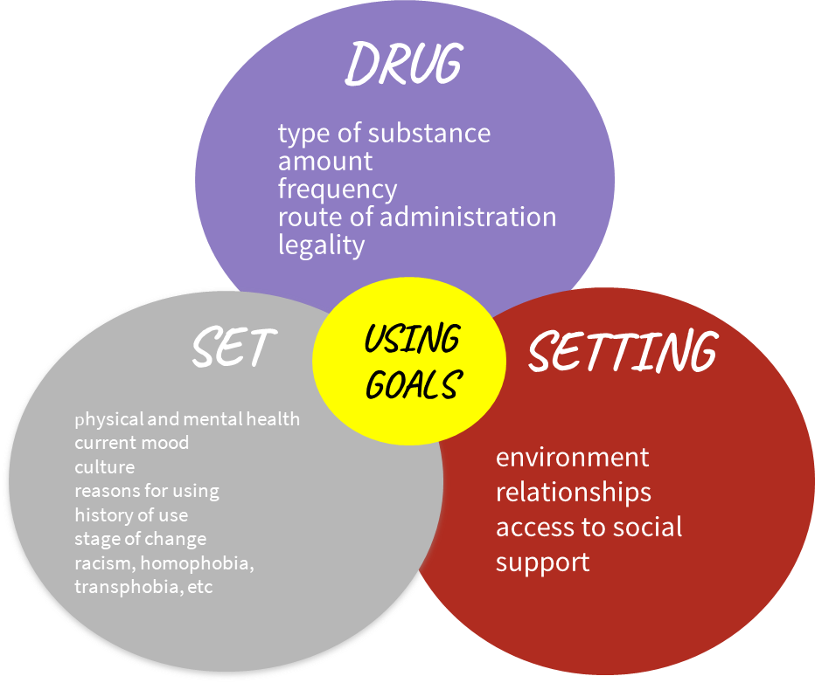
Adapted from Zinberg’s model of Drug, Set and Setting
Copyright © 2021 Health Management Associates, Inc. All rights reserved.

Slide 22
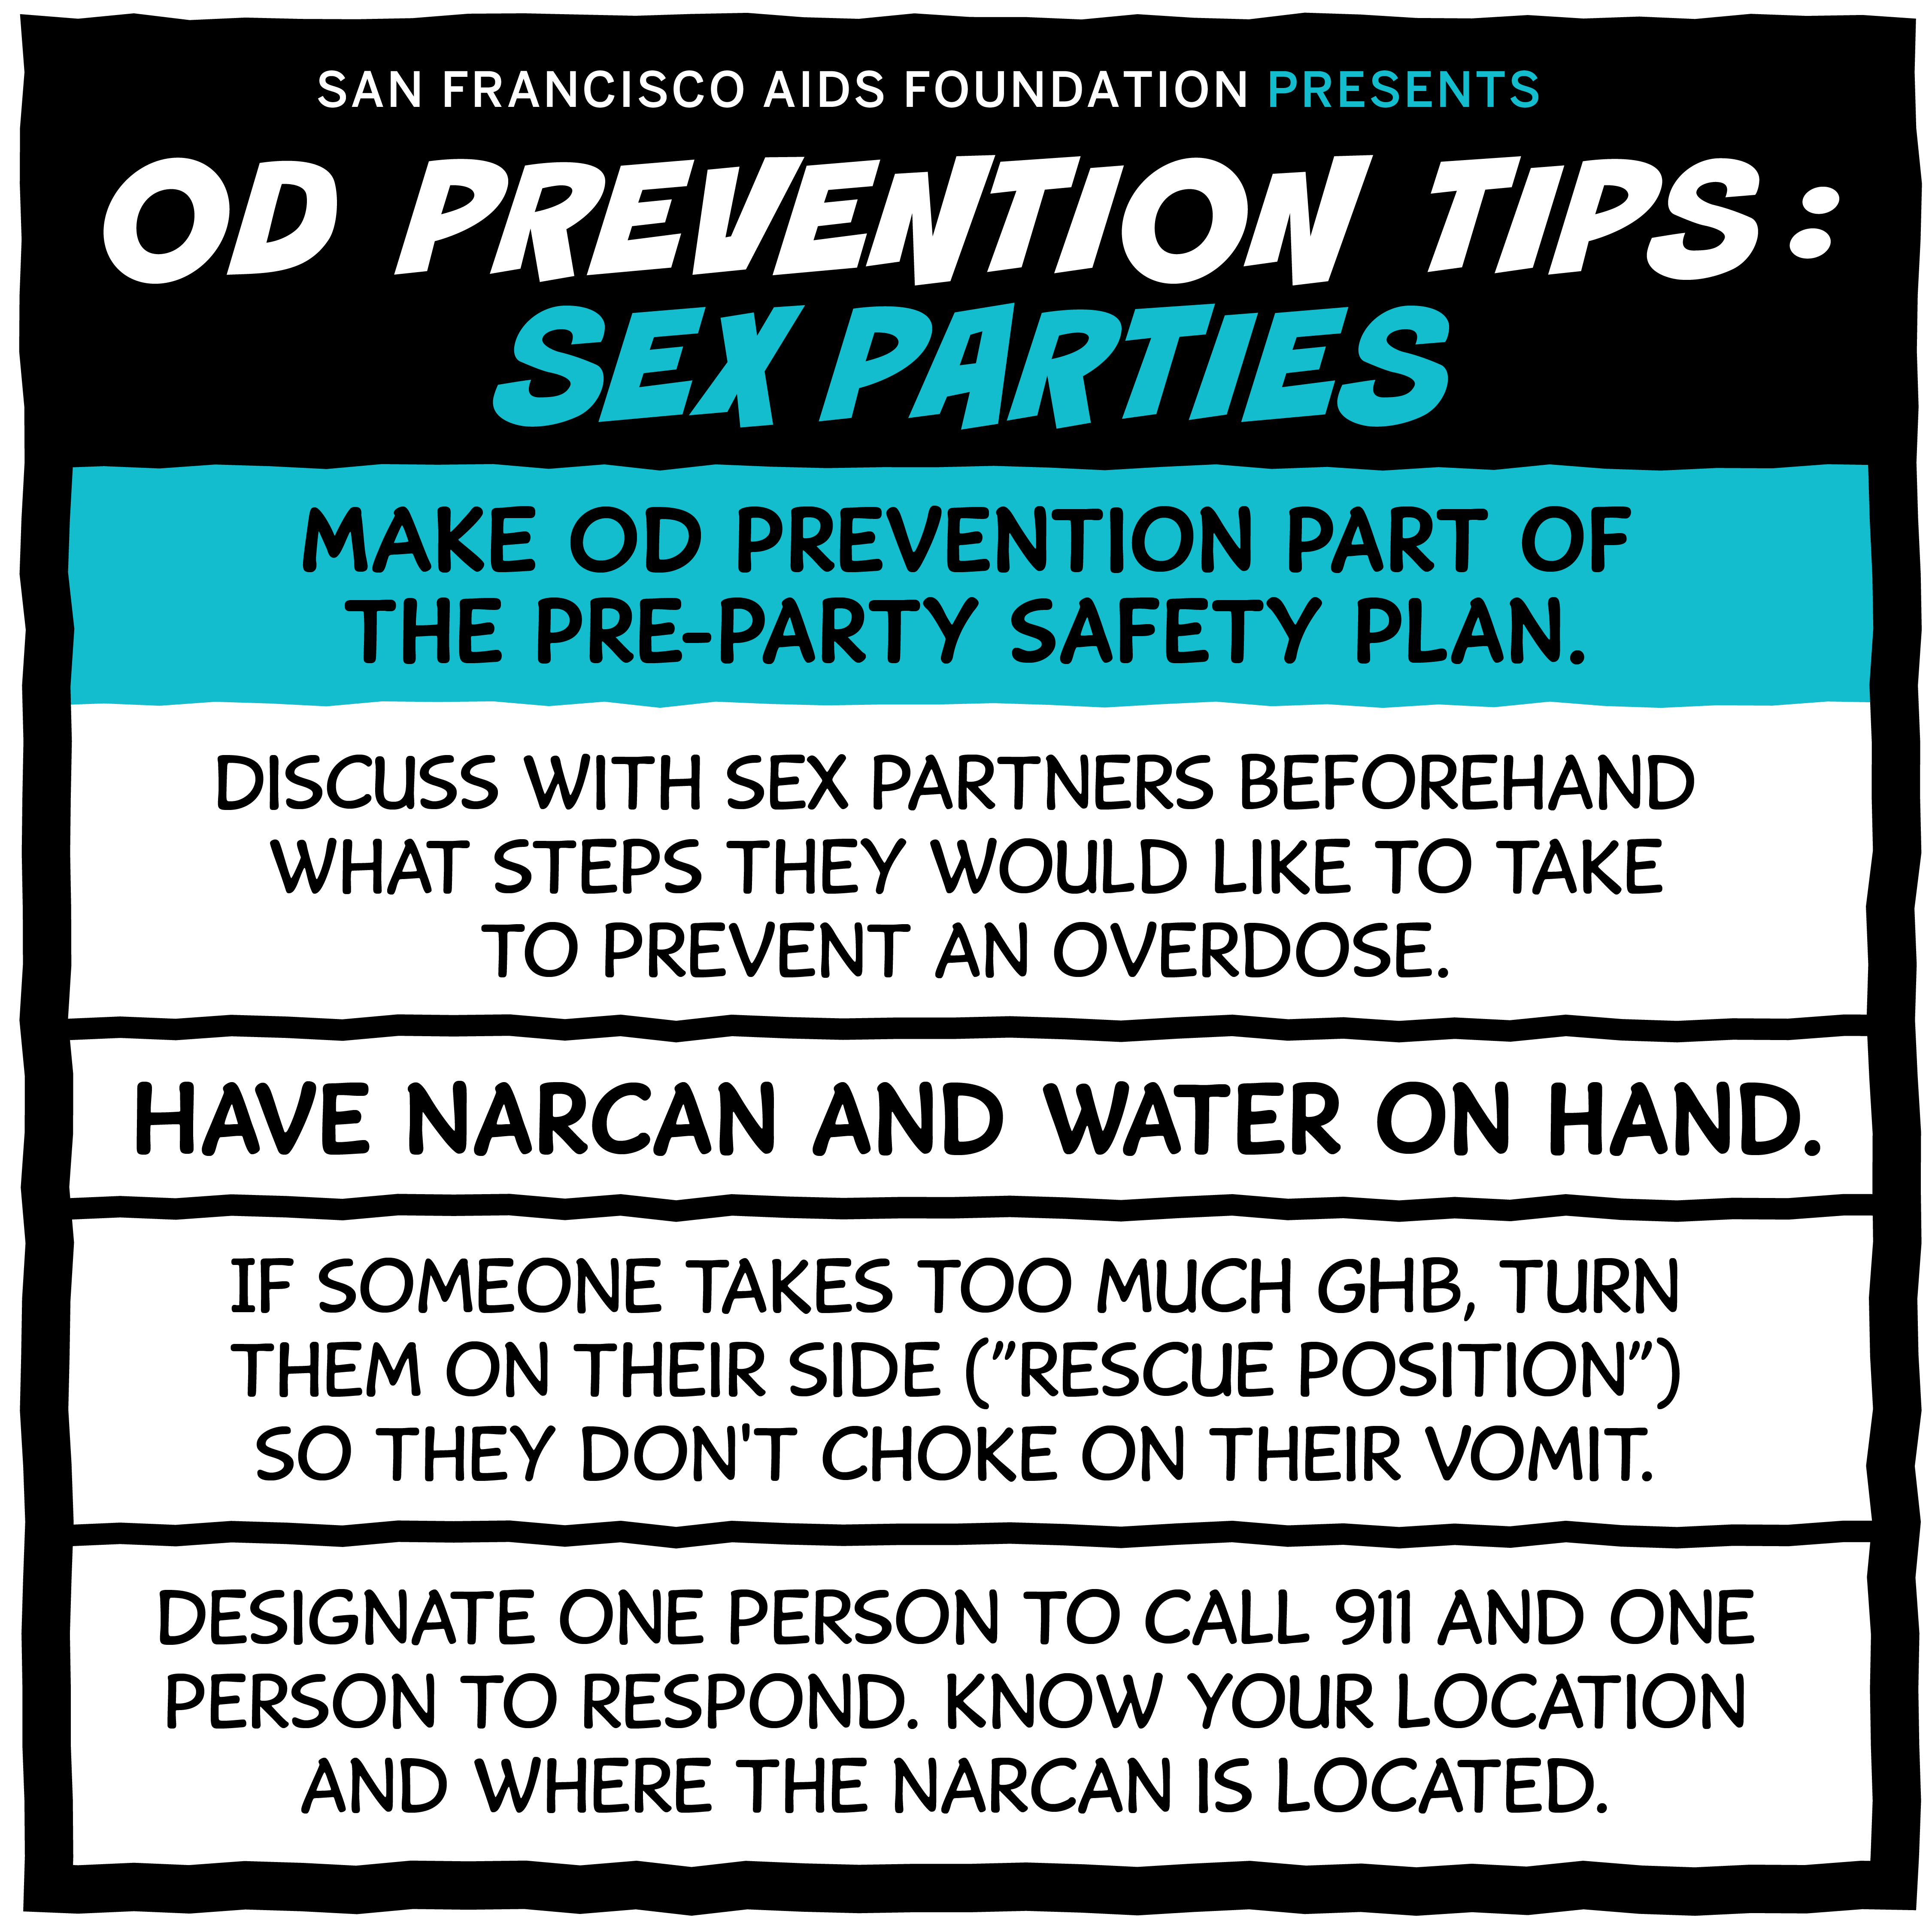
Harm Reduction: Substance Use + Sex
Building Healthy Online Communities - https://bhocpartners.org/
Testing-Including home testing https://together.takemehome.org
Hooking up and meth
Tweaker.org
Copyright © 2021 Health Management Associates, Inc. All rights reserved.

Slide 23
Discussing Sex-Drug Linked Behavior
These are the five general motivations for sex/drug linked behavior:
1. To increase ability to sexually function (e.g., erections, better orgasms, etc.)
2. To change level of sexual interest, desire, or arousal (e.g., to increase interest in sex or frequency of sex)
3. To experience a specific sexual turn-on (same-sex desires, “specific” turn-ons, etc.)
4. To escape from negative or overwhelming feelings (e.g., anxious, sad, lonely. Also includes feeling ugly or unwanted, etc.)
5. To express feelings of love, affection, and commitment (e.g., wanting to feel close, needing to be touched, etc.)
From Sexual Health in Drug and Alcohol Treatment (Douglas Braun-Harvey, 2009)
Copyright © 2021 Health Management Associates, Inc. All rights reserved.

Slide 24
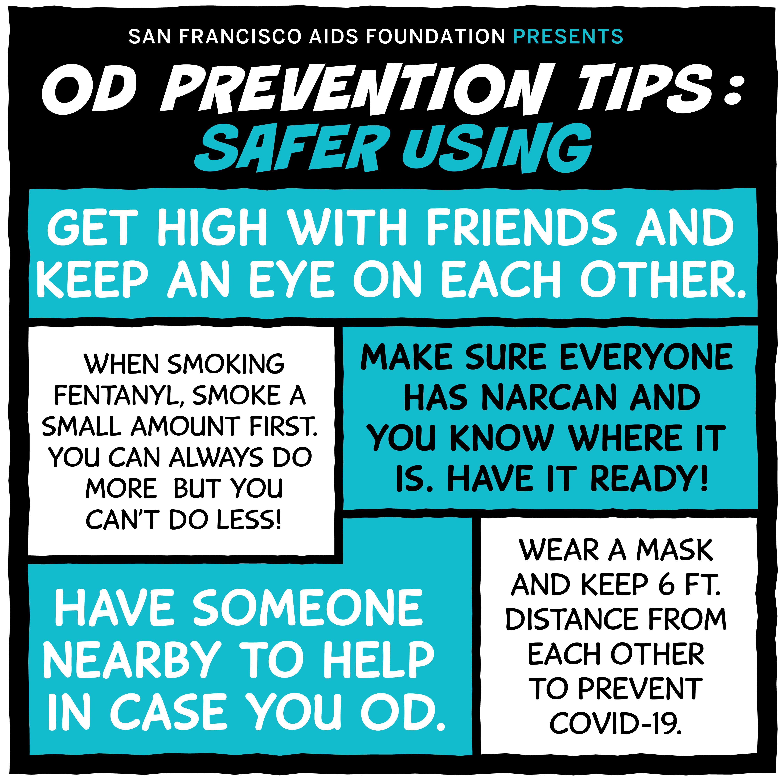
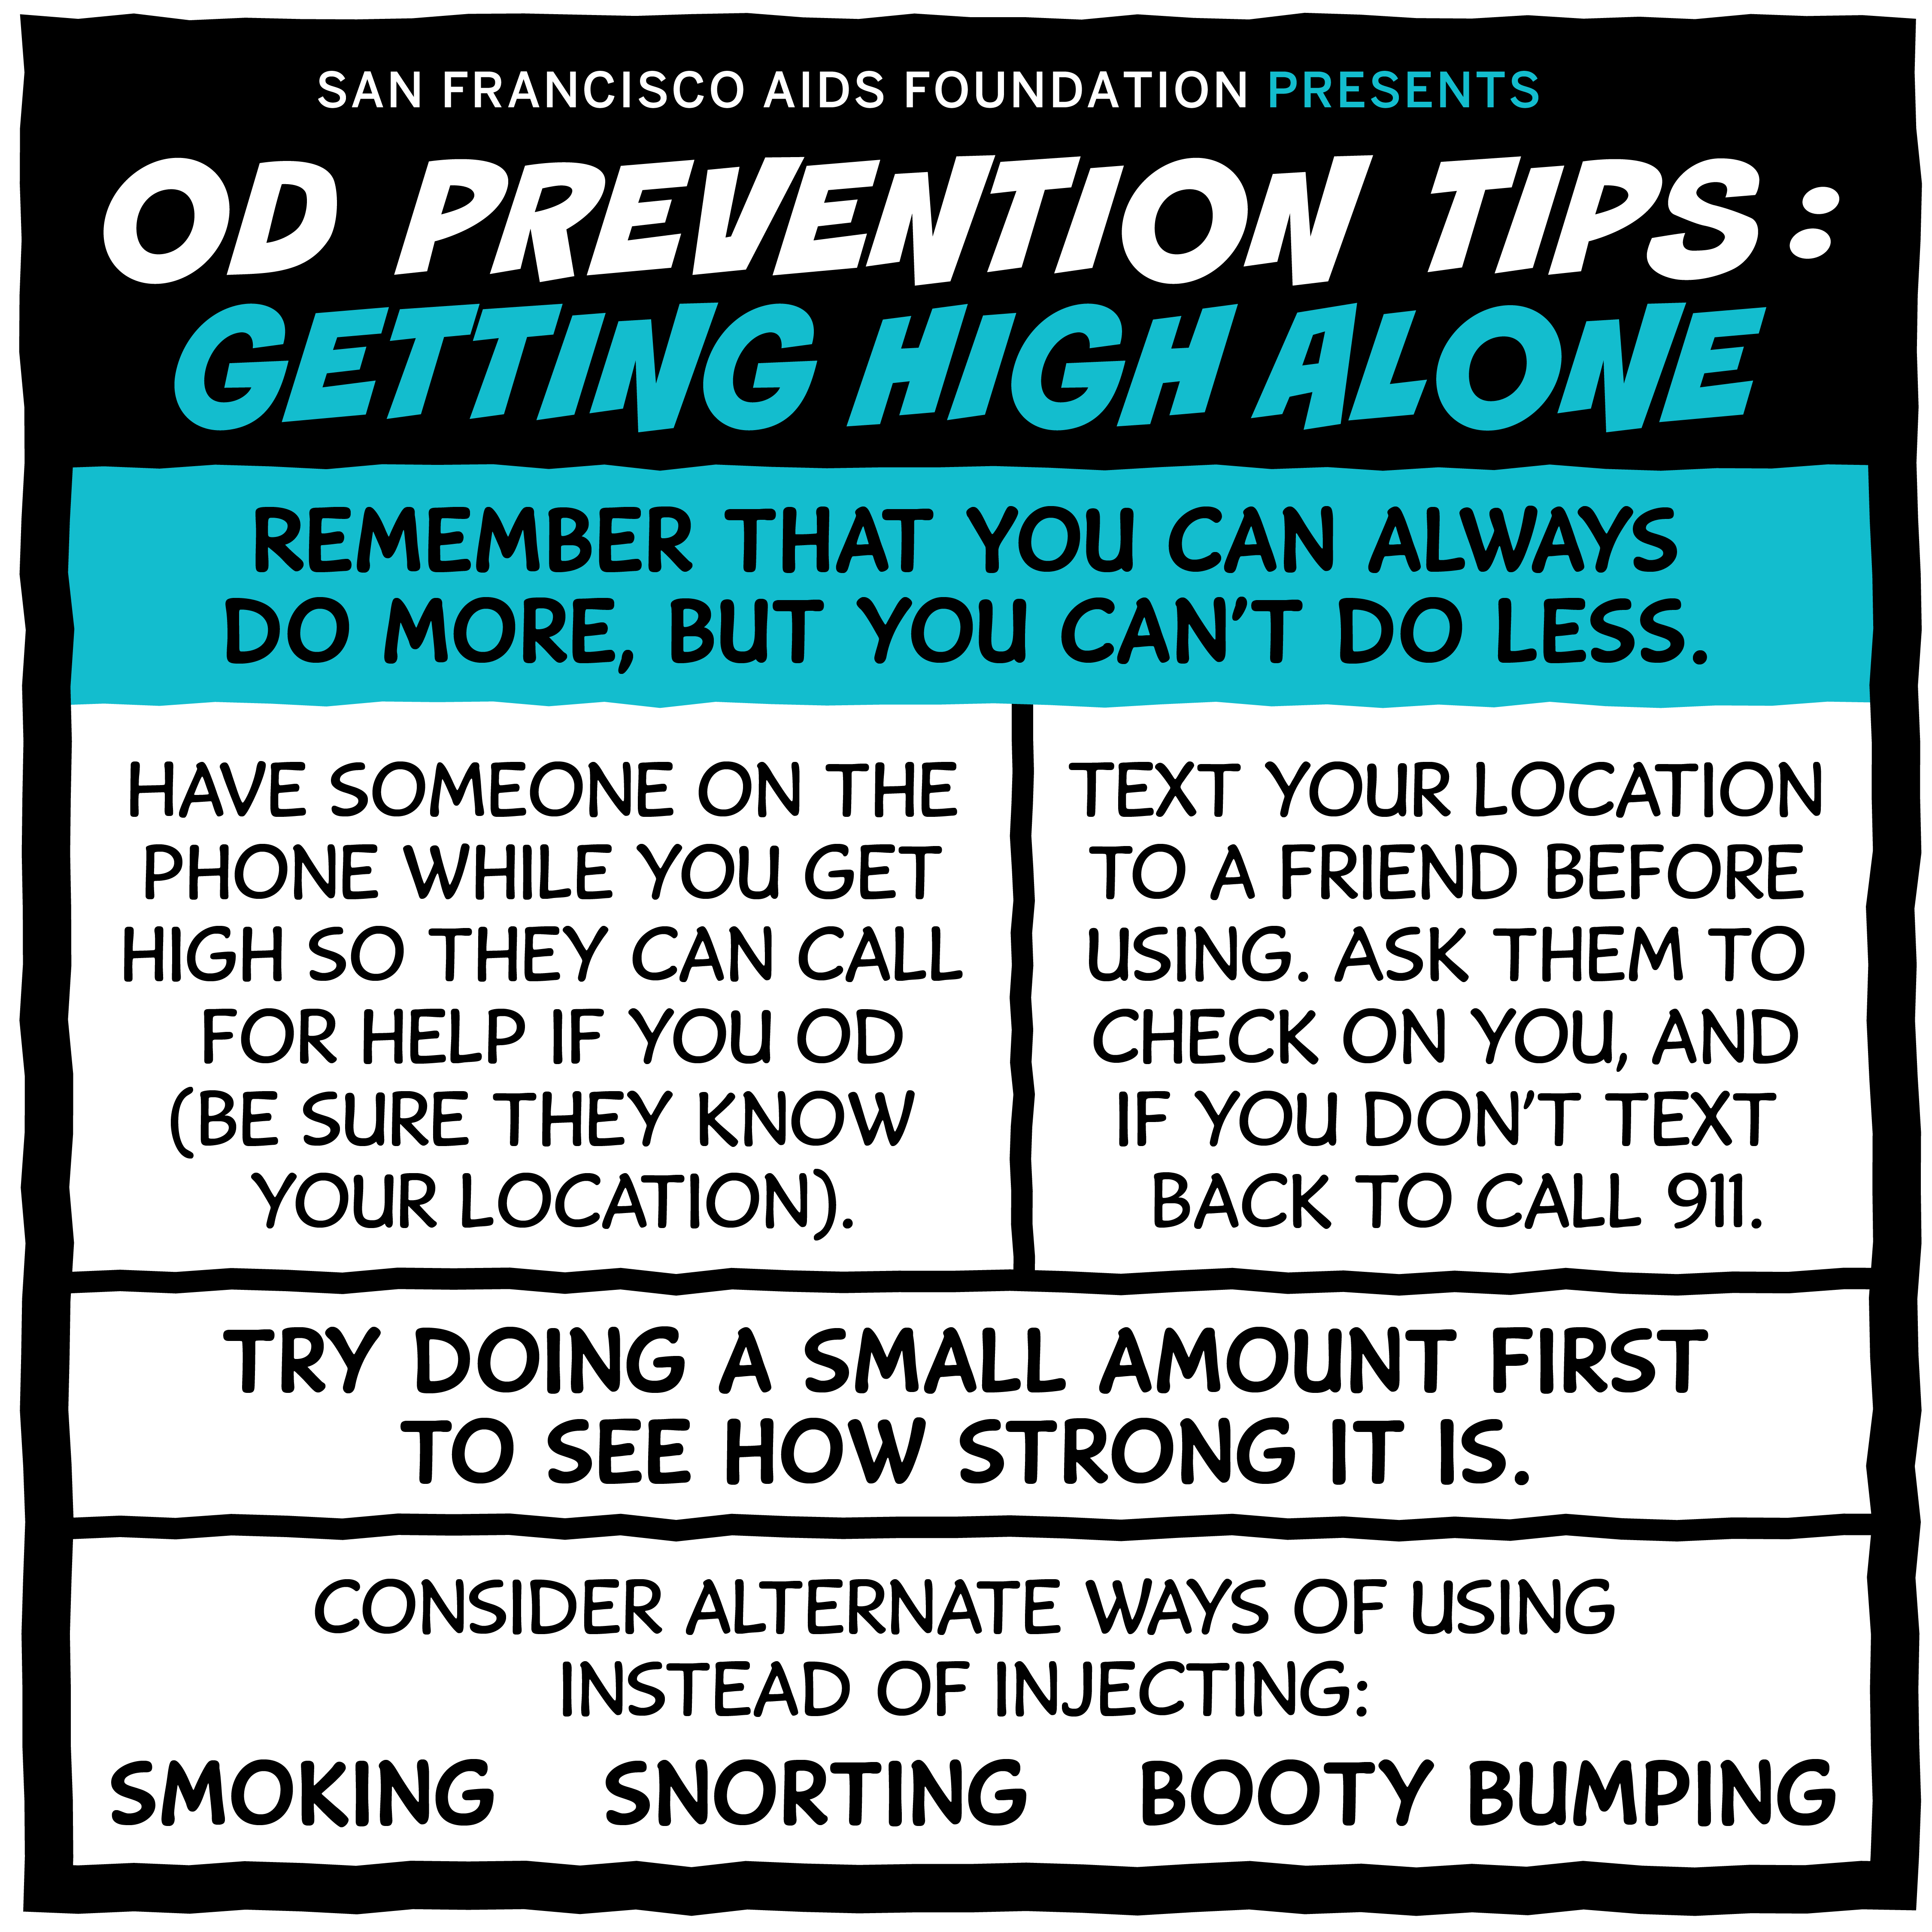
Overdose Prevention – Safer Use
Copyright © 2021 Health Management Associates, Inc. All rights reserved.
Notes:
Mention that these are examples of harm reduction poster/handouts/communication.

Slide 25
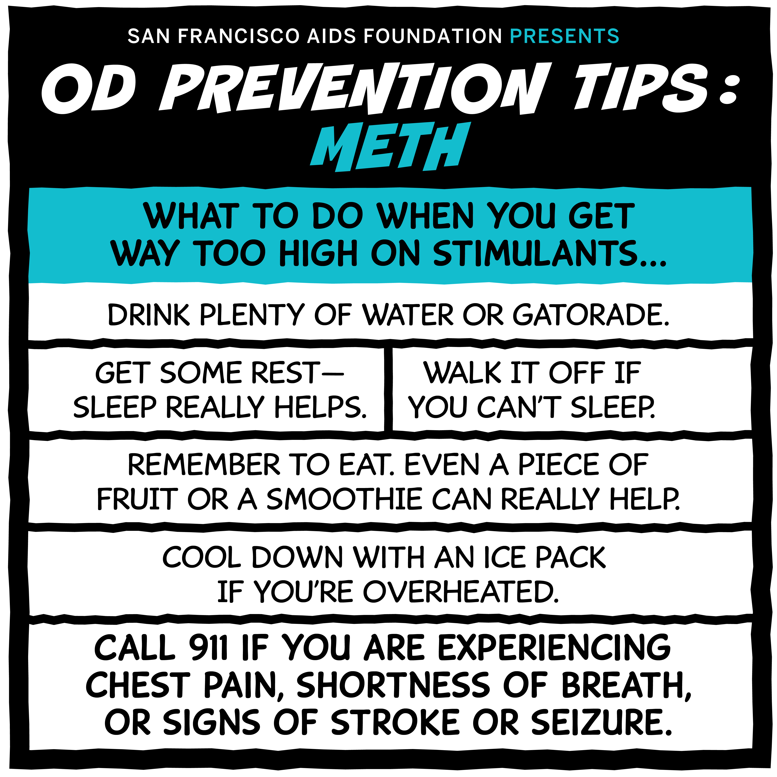
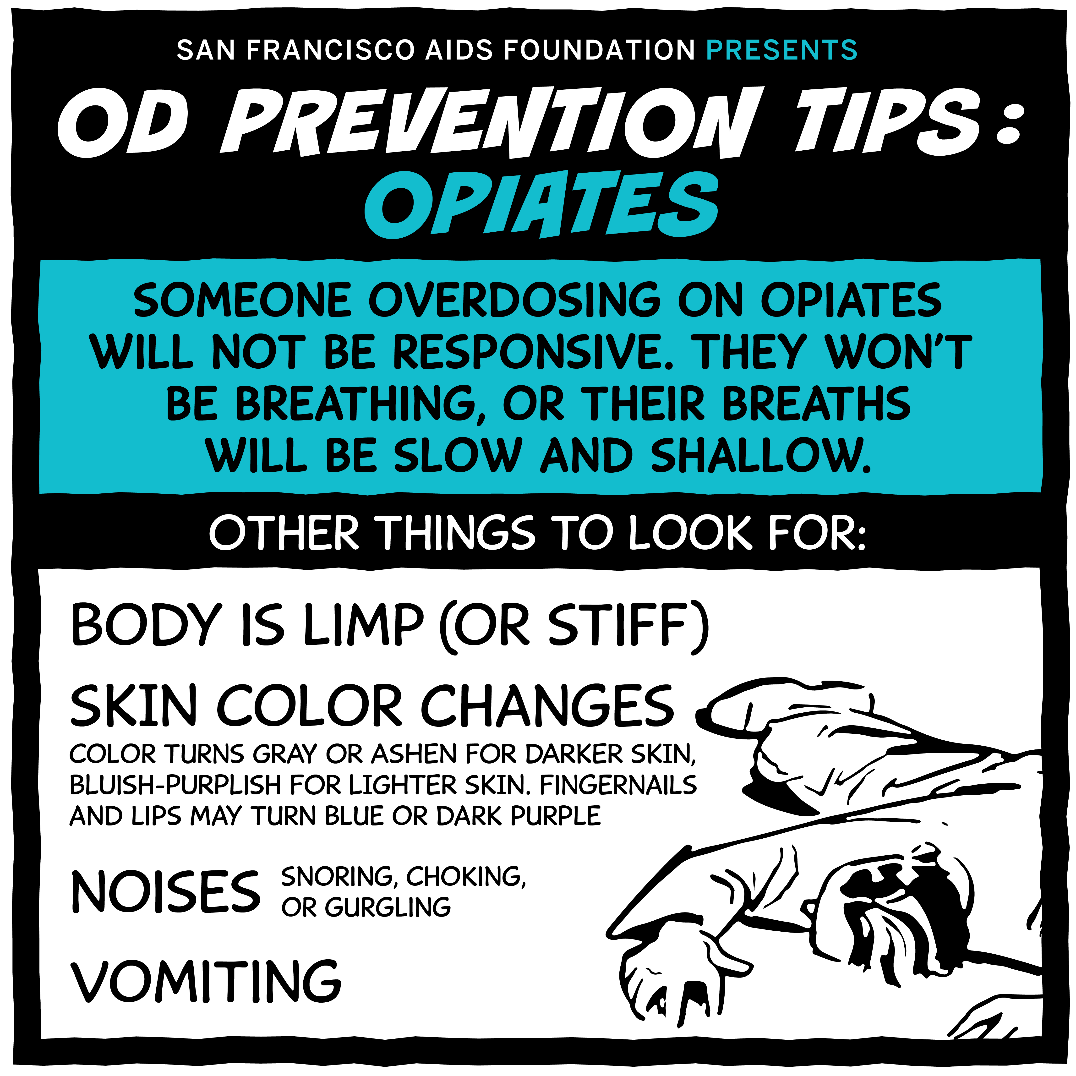
Overdose Prevention – Meth and Opiates
Copyright © 2021 Health Management Associates, Inc. All rights reserved.

Slide 26
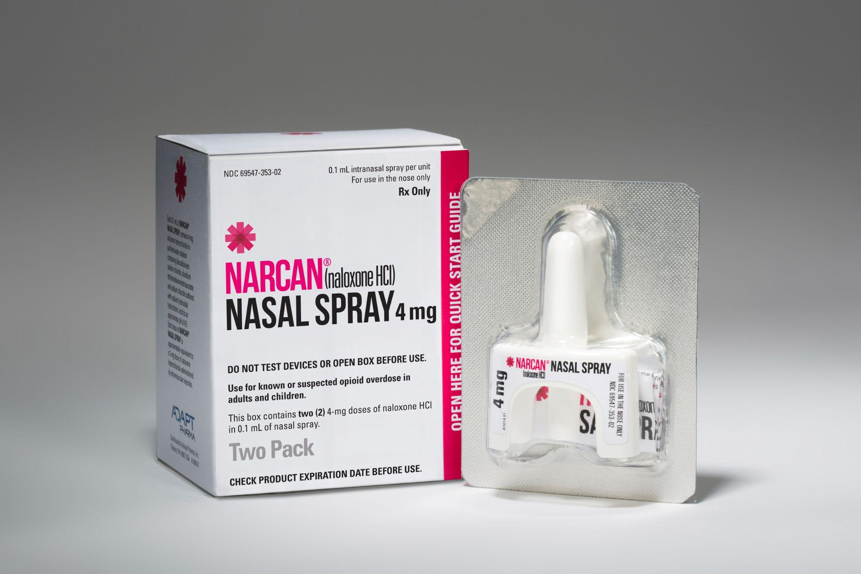
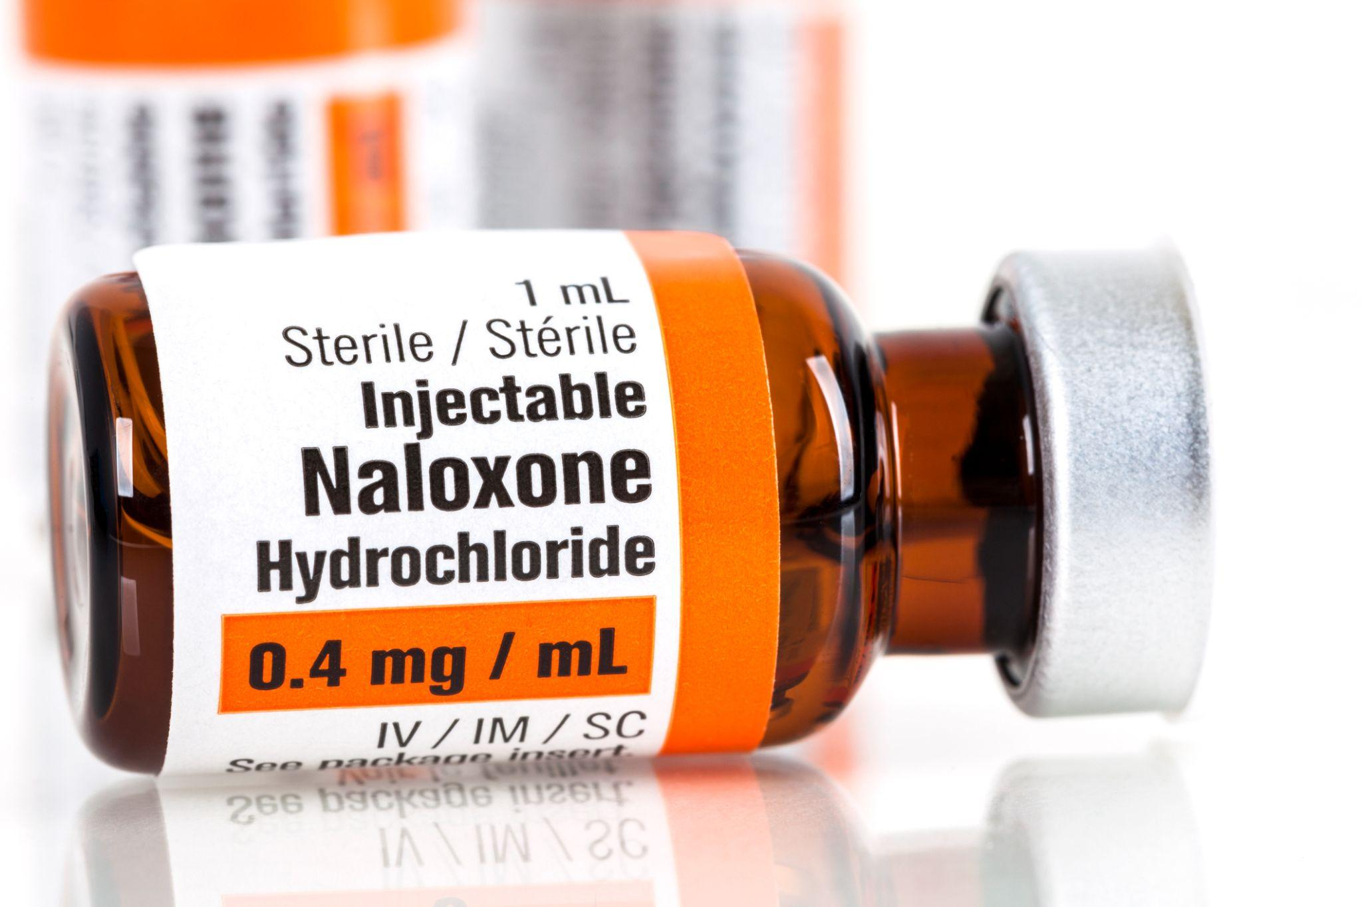
Naloxone (Narcan) Saves Lives
What is Naloxone?
Signs of overdose
What to do
Ways to administer Naloxone
Considerations in the fentanyl era
Who should carry Naloxone?
MN Good Samaritan/Steve’s Law
Copyright © 2021 Health Management Associates, Inc. All rights reserved.
Notes:
Consider commenting about potential coverage of naloxone for harm reduction (not all states cover)
MN Good Sam law provides immunity from:
Drug possession, paraphenalia charges
Conditions of Supervision status (e.g., probation, parole or pre-trial conditions)
Can use act of providing first aid or rendering aid to OD as a mitigating factor for a crime in which immunity is not provided
The effect of Good Sam Laws ,may be limited by lack or awareness, skepticism and lack of trust
Subd. 2. Authority to possess and administer opiate antagonists; release from liability.
(a) A person who is not a health care professional may possess or administer an opiate antagonist that is prescribed, dispensed, or distributed by a licensed health care professional pursuant to subdivision 3.
(b) A person who is not a health care professional who acts in good faith in administering an opiate antagonist to another person whom the person believes in good faith to be suffering a drug overdose is immune from criminal prosecution for the act and is not liable for any civil damages for acts or omissions resulting from the act.
Sec. 4. [604A.05] GOOD SAMARITAN OVERDOSE MEDICAL ASSISTANCE. Subdivision 1. Person seeking medical assistance; immunity from prosecution.
A person acting in good faith who seeks medical assistance for another person who is experiencing a drug-related overdose may not be charged or prosecuted for the possession, sharing, or use of a controlled substance under sections 152.023, subdivision 2, clauses (4) and (6), 152.024, or 152.025, or possession of drug paraphernalia. A person qualifies for the immunities provided in this subdivision only if:
(1) the evidence for the charge or prosecution was obtained as a result of the person's seeking medical assistance for another person; and
(2) the person seeks medical assistance for another person who is in need of medical assistance for an immediate health or safety concern, provided that the person who seeks the medical assistance is the first person to seek the assistance, provides a name and contact information, remains on the scene until assistance arrives or is provided, and cooperates with the authorities.
Good faith does not include seeking medical assistance during the course of the execution of an arrest warrant or search warrant or a lawful search.

Slide 27
HIV and Substance Use Stigma, Motivational Interviewing

Slide 28
Learning Objectives:
HIV and Substance Use Stigma, Motivational Interviewing
I
II
III
Define the 3 different types of stigma and how stigma influences testing, retention in treatment and outcomes of HIV and SUD
Describe how cultural considerations can influence treatment engagement
List at least 3 effective motivational interviewing tools
Copyright © 2021 Health Management Associates, Inc. All rights reserved.

Slide 29
Unpacking Stigma
“I've learned that people will forget what you said, people will forget what you did, but people will never forget how you made them feel.” – Maya Angelou
Picture from Unsplash.
Copyright © 2021 Health Management Associates, Inc. All rights reserved.
Notes:
^{CAPTA}
The Child Abuse Protection and Treatment Act mandates that states have in place “policies and procedures to address the needs of infants born with and identified as being affected by illegal substance abuse or withdrawal symptoms from prenatal drug exposure.
CAPTA was most recently amended by the Comprehensive Addiction and Recovery Act of 2016 (P.L. 114-198, 7/22/16). Title V, section 503 of the act modified the CAPTA state plan requirement for infants born and identified as being affected by substance abuse or withdrawal symptoms or Fetal Alcohol Spectrum Disorder by adding criteria to state plans to ensure the safety and well-being of infants following the release from the care of health-care providers, to address the health and substance use disorder treatment needs of the infant and affected family or caregiver, and to develop the plans of safe care for infants affected by all substance abuse (not just illegal substance abuse as was the requirement prior to this change).

Slide 30
How do we define stigma?
Copyright © 2021 Health Management Associates, Inc. All rights reserved.

Slide 31
Categories of Stigma
Category (group)
Self-Stigma
+ Generalization
Stereotype (label)
+ Judgment
Social Stigma
Prejudice (attitude)
+ Action
Structural Stigma
Discrimination (behavior)
+ Power
Oppression/ “Isms”
(process, system)
S. Harrell, Ph.D.
Copyright © 2021 Health Management Associates, Inc. All rights reserved.
Notes:
SELF STIGMA - “[Internalizing and endorsing negative] stereotypes of the self (e.g. “I am dangerous”) [and] prejudice (e.g. “I am afraid of myself”) results in self-discrimination (e.g. self-imposed isolation)...low self-esteem and poor self-efficacy…Self-discrimination, particularly in the form of self-isolation, has many pernicious effects leading to decreased healthcare service use, poor health outcomes, and poor quality of life”—Corrigan & Rao
Disapproval of a person based on perceivable social characteristics that serve to distinguish them from other members of a society
SOCIAL STIGMA - Operationalized through behaviors of various social groups including educators, employers, policymakers and healthcare providers
STRUCTURAL STIGMA - Institutional level discrimination of certain groups. On every organizational level, we can find examples of rules, policies and practices that discriminate against certain groups. Because they are codified assumptions that inform how our agencies are structured, they may be insidious, difficult to detect
Since May, 2020 we’ve been forced to confront the simultaneous reality of the legacy of structural and social stigma that catalyze racism and disparities in health outcome whose roots go far deeper than the novel coronavirus. While comparing racism and how people with SUD are treated might seem like a stretch, I want to spend a minute on the mechanisms at work when stigma gives rise to the “isms” so we have a better understanding of how devastating stigma can be, and why we should work to eliminate or at least minimize it.
Shelly Harrell, a psychologist in Southern California, describes how encountering people – with whom we typically share many commonalities, but also differences – often finds us using our natural tendency to categorize people as a way of bringing order to the complicated set of inputs we get from people (hair color, skin color, temperament, language, carriage). So we label or stereotype. On its face, that may not be so bad, except that when we do this, we often lose site of the individuals and what makes them human, as well as the opportunity to establish a relationship. And if we label/stereotype someone (or a group), and we have some judgement about how we think they will be or act – they are just drug-seeking, they don’t care about their unborn child, they don’t belong in this community etc. – we move into the attitudinal realm that describes prejudice; opinions not based on actual experience or reason. And If we act on that prejudice – we cross the street, lock the car door or short-change an intake assessment – we move into the behavioral realm of discrimination. Treating people differently (i.e., discrimination) in the context of a relationship characterized by a power differential, is a recipe for oppression. That oppression may be made manifest individually or systemically in any number of ways. Who gets called on in an elementary school classroom? Who gets access to a small business loan? Who gets the opportunity to benefit from the additional care coordination resources or services that might position them to succeed on their recovery journey and as parents?
Engaging in a manner that acknowledges and actively combats stigma is hard work. It requires a willingness to develop relationships, to get to know our clients, listen to their stories and accept the chronic disease nature of their OUD/SUD; to care for and empathize with them, which demands that we make ourselves vulnerable to connecting with dark feelings similar to theirs; and a commitment to walk with them, to be there for them in a supportive manner on this long and winding journey. As Renee Brown opined in describing the difference between empathy and sympathy, “Rarely can a response make things better. What makes things better is connection.”
If we can move toward those connections without stigma and every awful behavior and consequence that flows inevitably from that, we will again be “touched, as surely they will be, by the better angels of our nature (Abraham Lincoln, 1861).”

Slide 32
Stigma
Key Elements:
Blame and Moral Judgment
Pathologize and Patronize
Fear and Isolation (the opposite of connection)
Criminalize
Functions of Stigma:
Difference --- To keep people out
Danger ---To keep people away
Discrimination---To keep people down
National Harm Reduction Coalition
Copyright © 2021 Health Management Associates, Inc. All rights reserved.
Notes:
Accentuate differences: Sensationalize danger; enable/condon discrimination

Slide 33
How does stigma impact people with HIV & people who use drugs?
Incarceration
Limit to housing options
Limit to treatment options
Poor or unavailable healthcare services
Limit access to culturally concordant services
Fewer funds for research
Poor treatment for pain
Poor treatment for mental health concerns
Limit to job opportunities
Loss of parenting rights
Loss of reproductive rights
Disconnection from families or loved ones
People are less likely to ask for support
Possible hepatitis C (HCV) and sexually transmitted infections (STIs)
Lack of access to OD prevention
Lack of access to syringes
Copyright © 2021 Health Management Associates, Inc. All rights reserved.

Slide 34
Stigma if Often Supported by
Lack of context
Misinformation and myths
Discriminatory or dehumanizing language
Poorly conceived policies
Copyright © 2021 Health Management Associates, Inc. All rights reserved.

Slide 35
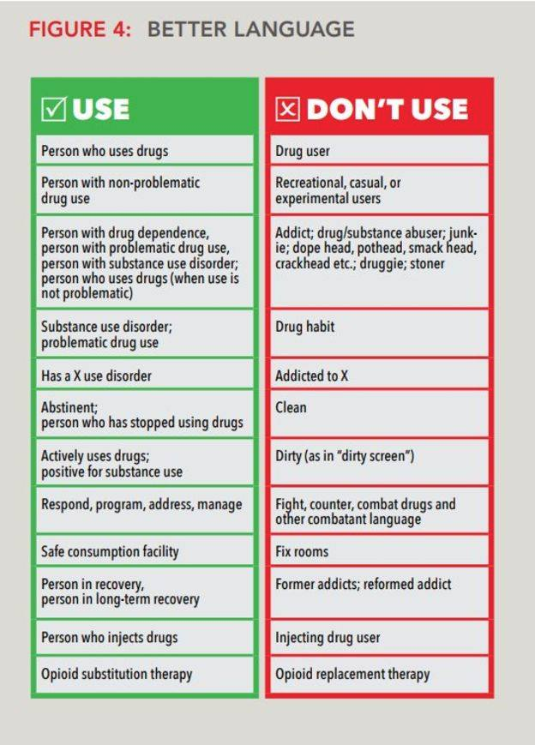
Language
Remember:
Beverages are alcoholic,
not people
Laundry is dirty and clean,
not people
Copyright © 2021 Health Management Associates, Inc. All rights reserved.

Slide 36
Chatter fall
What are some of the ways you can begin to dismantle stigma (individually or in your organization)?
Type your response in the chat feature, but DON’T CLICK ENTER
When instructed to do so, CLICK ENTER
Image provided by Unsplash Photos
Copyright © 2021 Health Management Associates, Inc. All rights reserved.
Notes:
What are some ways to begin to dismantle stigma individually and as a community?
How can your team address stigmatizing language and microaggressions?
How can we create treatment centered on compassion and inclusion?

Slide 37
Anti-stigma campaign by UK agency, Release
https://www.release.org.uk/nice-people-take-drugs
https://supportdontpunish.org/
Explore networks which support people who use drugs such as: INPUD, VOCAL and Urban Survivors Union.
Copyright © 2021 Health Management Associates, Inc. All rights reserved.
Notes:
Stigma mitigation campaigns

Slide 38
References: Stigma and Harm Reduction
Corrigan, P. W., & Watson, A. C. (2002). Understanding the impact of stigma on people with mental illness. World psychiatry : official journal of the World Psychiatric Association (WPA), 1(1), 16–20.
Stangl, A.L., Earnshaw, V.A., Logie, C.H. et al. The Health Stigma and Discrimination Framework: a global, crosscutting framework to inform research, intervention development, and policy on health-related stigmas. BMC Med 17, 31 (2019). https://doi.org/10.1186/s12916-019-1271-3
Minnesota Harm Reduction and Overdose Prevention Fact Sheet https://www.health.state.mn.us/communities/opioids/documents/sudresourcesheet.pdf
Zinberg, N. E. (1984). Drug, set, and setting: The basis for controlled intoxicant use. New Haven: Yale University Press.
Project Implicit at Harvard University has a number of implicit bias resources and tests that should be reviewed before you dive in. https://implicit.harvard.edu/implicit/takeatest.html
Harm Reduction resources for you:
Recovery Research Institute https://www.recoveryanswers.org/resource/drug-and-alcohol-harm-reduction/
National Harm Reduction Coalition - https://harmreduction.org/our-work/action/california/
California Department of Public Health Injury and Violence Prevention Branch - https://www.cdph.ca.gov/Programs/CCDPHP/DCDIC/SACB/Pages/NaloxoneGrantProgram.aspx
Copyright © 2021 Health Management Associates, Inc. All rights reserved.

Slide 39
Learning Objectives:
Motivational Interviewing
I
II
III
IV
Define and explain Motivational Interviewing (MI) and how it can be utilized with clients contemplating behavior change
Explain the stages of change and how they relate to understanding and supporting clients
Identify the principles and spirit of MI
Explain OARS (Open-Ended Questions, Affirmations, Reflections and Summaries)
Notes:
Shannon/ Presenter

Slide 40
Stretching and Grounding
Copyright © 2021 Health Management Associates, Inc. All rights reserved.
40

Slide 41
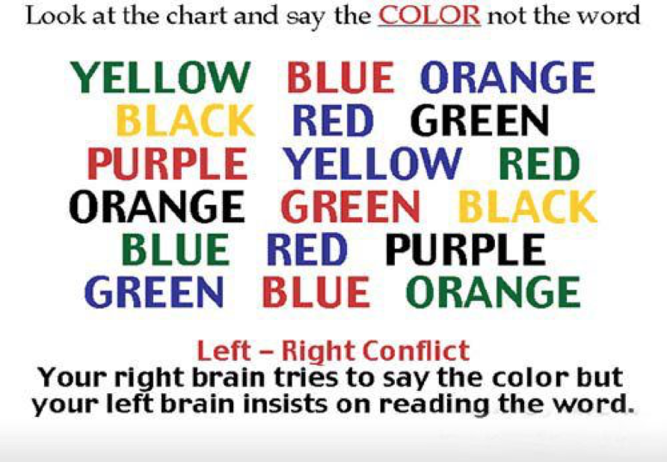
This is your Brain on Change
Copyright © 2021 Health Management Associates, Inc. All rights reserved.

Slide 42
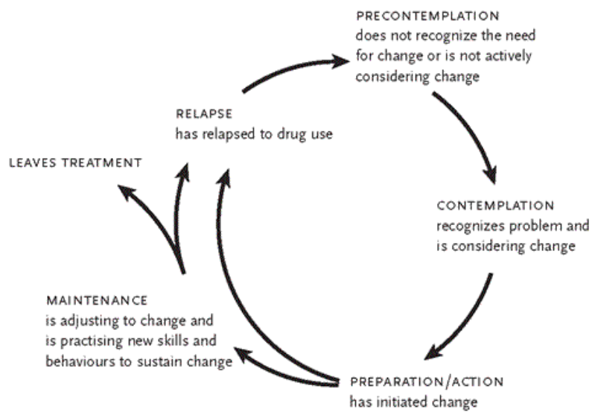
Transtheoretical Model of Change
Prochaska J, DiClemente C. Changing for Good: A Revolutionary Six Stage Program for Overcoming Bad Habits and Moving Your Life Positively Forward. New York, Avon Bools. 1995
Copyright © 2021 Health Management Associates, Inc. All rights reserved.
Notes:
The Transtheoretical Model (also called the Stages of Change Model), developed by Prochaska and DiClemente in the late 1970s, evolved through studies examining the experiences of smokers who quit on their own with those requiring further treatment to understand why some people were capable of quitting on their own. TTM focuses on the decision-making of the individual and is a model of intentional change; operating on the assumption that people do not change behaviors, especially habitual behaviors, quickly and decisively. Rather, change occurs continuously through a cyclical process. TTM ignores social context; as arbitrary lines between stages; no set time in ea stage; people make coherent decisions/plans
Precontemplation (40%) - In this stage, people do not intend to take action in the foreseeable future (defined as within the next 6 months). People are often unaware that their behavior is problematic or produces negative consequences. People in this stage often underestimate the pros of changing behavior and place too much emphasis on the cons of changing behavior. RAISE AWARENESS
Contemplation (40%) - In this stage, people are intending to start the healthy behavior in the foreseeable future (defined as within the next 6 months). People recognize that their behavior may be problematic, and a more thoughtful and practical consideration of the pros and cons of changing the behavior takes place, with equal emphasis placed on both. Even with this recognition, people may still feel ambivalent toward changing their behavior. RESOLVE/ID AMBIVALENCE
Preparation (Determination) (20%) - In this stage, people are ready to take action within the next 30 days. People start to take small steps toward the behavior change, and they believe changing their behavior can lead to a healthier life. HELP ID APPROPRIATE CHANGE STRATEGIES
Action - In this stage, people have recently changed their behavior (defined as within the last 6 months) and intend to keep moving forward with that behavior change. People may exhibit this by modifying their problem behavior or acquiring new healthy behaviors. HELP IMPLEMENT AND LEARN TO ELIMINATE RELAPSE
Maintenance - In this stage, people have sustained their behavior change for a while (defined as more than 6 months) and intend to maintain the behavior change going forward. People in this stage work to prevent relapse to earlier stages. DEVELOP NEW SKILLS FOR MAINTENANCE
Recurrence – people experience a recurrence of symptoms COPE WITH CONSEQUENCES AND DTERMINE WHAT TO DO NEXT
Termination - In this stage, people have no desire to return to their unhealthy behaviors and are sure they will not relapse. Since this is rarely reached, and people tend to stay in the maintenance stage, this stage is often not considered in health promotion programs.

Slide 43
People are ambivalent about change.
Providers who push for specific change create a relational discord which encourages the person to maintain the status quo.
Discord predicts lack of change and perpetuates ambivalence.
Evoking the client’s own change talk will enhance behavior change.
We don’t have the power to make someone change – we can develop skills to engage in and tolerate conversations about the possibility of change.
People are usually motivated for something, find what that is and start there.
Copyright © 2021 Health Management Associates, Inc. All rights reserved.

Slide 44
What is Motivational Interviewing?
“MI is a collaborative, goal-oriented style of communication with particular attention to the language of change. It is designed to strengthen personal motivation for and commitment to a specific goal by eliciting and exploring the person’s own reasons for change within an atmosphere of acceptance and compassion.”
(Miller & Rollnick, 2013, p. 29)
Copyright © 2021 Health Management Associates, Inc. All rights reserved.
Notes:
Foundations of MI

Slide 45
Motivational Interviewing (MI) Works Best When…
Ambivalence is high and people are stuck in mixed feelings about change
Confidence is low and people doubt their abilities to change
Desire is low and people are uncertain about whether they want to make a change
Importance is low and the benefits of change and disadvantages of the current situation are unclear.
Copyright © 2021 Health Management Associates, Inc. All rights reserved.
Notes:
Adequate supports are in place to create safe space for change

Slide 46
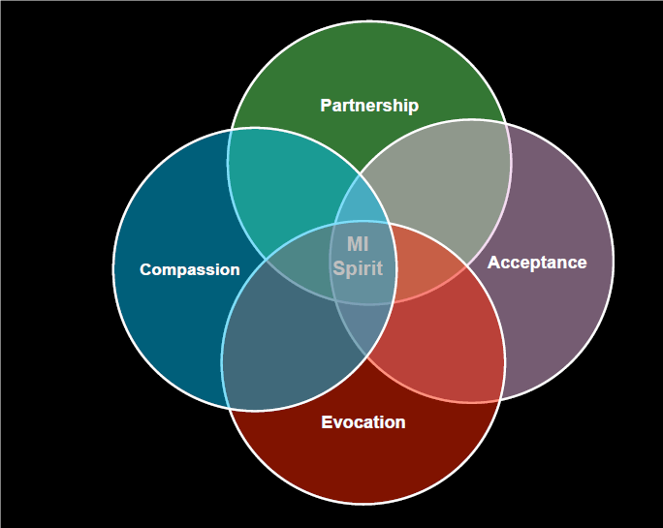
Spirit of MI
Spirit of Motivational Interviewing
Copyright © 2021 Health Management Associates, Inc. All rights reserved.
Notes:
Foundations of MI

Slide 47
Principles of MI
Express Empathy Affirmations Express and Affirm Personal choices | Develop Discrepancy Identify goals and values. Help client see discrepancies between their goals and values, and their current behavior.
Avoid Argumentation Understand that ambivalence is a form of thinking about the issue. Countertransference can contribute to any resistance to discussing the issue. | Support Self-efficacy Maintain a strength-based approach Unconditional positive regard The client is the expert
Copyright © 2021 Health Management Associates, Inc. All rights reserved.
Notes:
Consider creating the context that these are well established MI principles, and that using these principles and MI strategies to establish a relationship positions us to get better at decision-making including being able to discern the changes they can control and the things they cannot

Slide 48
Resist the “Righting Reflex”
“People are more persuaded by what they hear themselves say than what someone else tells them” (self-perception theory, 1972).
Copyright © 2021 Health Management Associates, Inc. All rights reserved.

Slide 49
Core Skills of Motivational Interviewing
OARS + I
Change Talk Strategies
Open-Ended Questions
Affirmations
Reflections
Summary
+
Information Exchange
Listening for change talk
Copyright © 2021 Health Management Associates, Inc. All rights reserved.
49

Slide 50
Open or closed?
For each of the following questions, place “O” in the chat function if you think the question is open ended, and “C” if you think the question is closed.
How is your back pain impacting your overall life?
Is it important for you to serve your children healthy food?
Do you have any concerns about the stress in your life?
How, if at all, does your alcohol use affect your parenting?
Do you think your meth use is improving your sex life?
If you were to stop using meth, how would your days be different?
Can I ask you something?
Copyright © 2021 Health Management Associates, Inc. All rights reserved.
50

Slide 51
Affirmations
What are they?
Strengths and attributes
Successes
Hopes
Desires
Efforts to improve things
Humanity
Compassion
What are the Results?
Strengthen the relationships
Build trust
Support confidence and self-esteem
Build a meaningful working alliance
Copyright © 2021 Health Management Associates, Inc. All rights reserved.

Slide 52
Affirmations
These statements should show appreciation for a client’s challenges and achievements, however they are not meant to be “cheers” and shouldn’t start with “I am”.
“You really thought clearly about your next steps”
“Wow, that must’ve taken a lot of courage”
“You applied some self-care and it helped you stay calm”
“You’ve achieved so much this week”
“You are determined and continue to search for answers”
Stepping it Up – Affirmation + building experience and confidence
"You are staying alcohol-free in the face of many challenges", tell me how that feels...
"You are not avoiding difficult conversations, what is helping you do that?"
Copyright © 2021 Health Management Associates, Inc. All rights reserved.

Slide 53
Reflections
Reflective Listening:
When people are ambivalent, MI helps organize and integrate our mind, helping to create congruent decisions that make change possible.
Simple: Express that you understand what the client is saying and that you are listening
Complex: Step it up a notch by providing feedback or expanding on a feeling
Tips:
Avoid using the pronoun “I” (i.e., making the reflection about the listener)
Avoid negating change talk by using “and” instead of “but”. Both realities exist at once.
Should be brief
Copyright © 2021 Health Management Associates, Inc. All rights reserved.

Slide 54
Examples of Reflections
For the following scenario, use the chat function to suggest
open-ended questions the provider could ask next.
Client: I like to party, I don’t see a problem as long as I’m at home. It’s when I leave the house that things get out of hand.
Provider: Things are fine when you party at home. Partying is different when you leave the house.
(What Open-ended question could you follow with here?) Type it in the chat feature
Copyright © 2021 Health Management Associates, Inc. All rights reserved.

Slide 55
Summaries
Summaries allow us to keep track of the session, ask more questions and find out if we are really understanding the client’s unique situation.
After you state a summary ask:
“did I get that right?”
“did I miss anything?”
Encourage the client to “Use the edit button”. If your reflection is not accurate, say “edit me”.
Copyright © 2021 Health Management Associates, Inc. All rights reserved.

Slide 56
A summary is a bouquet filled with
all the material the client has provided.
Copyright © 2021 Health Management Associates, Inc. All rights reserved.

Slide 57
Core Skills of Motivational Interviewing
OARS + I
Change Talk Strategies
Open-Ended Questions
Affirmations
Reflections
Summary
+
Information Exchange
Listening for change talk
Copyright © 2021 Health Management Associates, Inc. All rights reserved.
57

Slide 58
Sustain Talk
Change Talk
Client speech which favors maintaining and not changing a specific behavior
Client speech which favors changing a specific behavior
Copyright © 2021 Health Management Associates, Inc. All rights reserved.
58

Slide 59
DARN CAT
Preparatory Change Talk
Mobilizing Change Talk
Desire: I want to…
Ability: I can…
Reasons: There are good reasons to….
Need: I really need to…
Commitment: I’m going to, I will…
Activation: I’m ready to
Taking steps: I did
Copyright © 2021 Health Management Associates, Inc. All rights reserved.
59

Slide 60
80/20
WAIT and WAIST
REMEMBER THE GOLDEN RULE
The client should be talking more than the provider and open-ended questions are an ideal way to keep the conversation going.
Copyright © 2021 Health Management Associates, Inc. All rights reserved.

Slide 61
Ways to Incorporate MI practice into your Work
Post-it notes in your workspace or find posters on Pinterest
Organize MI skills meetings once a month (many online curricula can guide you)
Send a MI video to the team and spend 10 min discussing it before a meeting.
Focus on one skill each week. It’s Affirmations week!!!
Find films or shows with ambivalent characters and discuss what skills you could use.
Have a MI book club.
Practice with songs (Still, Should I stay or should I go, please don’t leave me, A million reasons).
Lift up good examples for recognition and review
Take advantage of cases with challenging patients or outcomes to review and role play as part of routine workflow such as
During case reviews
On rounds
During supervision
Copyright © 2021 Health Management Associates, Inc. All rights reserved.

Slide 62
Developing proficiency in MI is like learning to play a musical instrument. Some initial instruction is helpful, but real skill develops over time with practice, ideally with feedback and consultation from knowledgeable others. As with other complex skills, gaining proficiency is a lifelong process.
- William Miller, 2008
Copyright © 2021 Health Management Associates, Inc. All rights reserved.

Slide 63
References: Stigma
Botticelli, M. P., & Koh, H. K. (2016). Changing the Language of Addiction. JAMA. 316(13), 1361. doi:10.1001/jama.2016.11874. https://www.ncbi.nlm.nih.gov/pubmed/27701667.
Greenwald AG, Poehlman TA, Uhlmann EL, Banaji MR. Understanding and using the implicit association test: III meta-analysis of predictive validity. J Pers Soc Psychol. 2009;97(1):17-41. doi:10.1037/a0015575.
Livingston JD, Milne T, Fang ML, Amari E. The effectiveness of interventions for reducing stigma related to substance use disorders: a systematic review. J Addict. 2011;107(1):39-50. doi:10.1111/j.1360-0443.2011.03601.
McLaughlin DF, McKenna H, Leslie JC. The perceptions and aspirations illicit drug users hold toward health care staff and the care they receive. J Psychiatr Ment Hlt. 2000;7(5):435-441. doi:10.1046/j.1365-2850.2000.00329.
Mom and Baby Substance Exposure Initiative (MBSEI) Toolkit, Best Practice #37. nastoolkit.org
National Academies of Sciences, Engineering, and Medicine. Ending discrimination against people with mental and substance use disorders: the evidence for stigma change. Washington, DC: The National Academies Press. https://www.nap.edu/catalog/23442/ending-discrimination-against-people- with-mental-and-substance-use-disorders. Published 2016. Accessed December 19, 2019.
STIGMA ABATEMENT RESOURCES
Educational Development Center. Words Matter: How Language Can Reduce Stigma. https://preventionsolutions.edc.org/sites/default/files/attachments/Words-Matter-How-Language-Choice-Can-Reduce-Stigma.pdf
SAMHSA Anti-Stigma Toolkit. A Guide to Reducing Addiction-related Stigma. https://www.montefiore.org/documents/ANTI-STIGMA-TOOLKIT-A-Guide-to-Reducing-Addiction-Related-Stigma.pdf
Copyright © 2021 Health Management Associates, Inc. All rights reserved.
63
Notes:
Last reported data in CA is from 2011

Slide 64
References: Motivational Interviewing
Center for Substance Abuse Treatment. Enhancing Motivation for Change in Substance Abuse Treatment. Treatment Improvement Protocol (TIP) Series, No. 35. HHS Publication No. (SMA) 13-4212. Rockville, MD: Substance Abuse and Mental Health Services Administration, 1999 (revised, 2013). Retrievable at https://store.samhsa.gov/system/files/sma13-4212.pdf
Case Western Reserve Center for Evidence-based Practices – The Spirit of MI. https://www.centerforebp.case.edu/resources/tools/the-spirit-of-mi
MBSEI Toolkit, Best Practice #6 – Appendix A is an abbreviated MI curriculum with several useful internet links. nastoolkit.org
Motivation Interviewing Network of Trainers (MINT). https://motivationalinterviewing.org/
Miller, W. R., & Rollnick, S. (2002). Motivational interviewing: Preparing people to change addictive behavior (2nd ed.). New York, NY: The Guilford Press.
Prochaska J, Norcross J, and DiClemente C. Change for Good: A Revolutionary Six Stage Program for Overcoming Bad Habits and Moving Your Life Positively Forward. New York Avon Books 1995.
“An Example of an MI ‘Session’” from the work of WR Miller and S Rollnick
Sobell & Sobell. (2008.) Motivational Interviewing Strategies and Techniques: Rationalesand Examples
Copyright © 2021 Health Management Associates, Inc. All rights reserved.
64
Notes:
Last reported data in CA is from 2011

Slide 65
5-minute stretch break!

Slide 66
Ethical and Legal Issues, Funding and Policy Considerations

Slide 67
Learning Objectives:
Ethical and Legal Issues, Funding and Policy Considerations
I
II
III
IV
Describe the ethical considerations related to HIV disclosure and how those have changed over time
Explain privacy protection and the considerations that affect those protections related to HIV testing and disclosure
List the purpose and key components of the Ryan White Programs
Summarize at least 3 critical steps needed to end the HIV Epidemic
Copyright © 2021 Health Management Associates, Inc. All rights reserved.

Slide 68
Principles of Bioethics in America
Autonomy / Respect for Persons – respecting decisions of autonomous persons
Assumes capacity
Protecting the vulnerable, those without capacity to make autonomous decisions
Beneficence – act in the best interest of the patient
Minimize risks and balance benefits
Justice – fair treatment
Benefits and burdens are distributed fairly in society
Copyright © 2021 Health Management Associates, Inc. All rights reserved.

Slide 69
Considering Ethics: Structural Lens
Ethical principles should NEVER be applied rigidly, mechanically, or in absolute terms
Sometimes the principles are in conflict
Our understanding of HIV/AIDS has changed dramatically and influences how policies and regulations are made and interpreted
Better understanding of progression and how to mitigate
Phenomenal advances in treatment and prevention
Copyright © 2021 Health Management Associates, Inc. All rights reserved.
69

Slide 70
Confidentiality: General
A core duty (ethical and legal) of medical practice that requires providers to keep patients’ personal health information private
Prohibits disclosure without consent
Encourages steps to ensure security of records/info and prevention of unauthorized access
Extends to all communication about patient
HIPAA, 42 CFR Part 2, FERPA
Exceptions to release without consent
Exposed Emergency Medical Services (EMS) and Correctional personnel
Partner information to the PH Commissions only
Public health and safety
HIPAA exceptions: treatment, operations, billing/payment
42 CFR Part 2 Exceptions: emergency, child abuse, Dept. Veterans Affairs, court ordered, qualified services organizations
Copyright © 2021 Health Management Associates, Inc. All rights reserved.
70
Notes:
Family education rights and Act

Slide 71
Testing, Reporting and Disclosure
In general, no specific informed consent or pre-test counseling is required in MN
Informed consent must be obtained in case of an EMS exposure
Mandatory provision of HIV education materials for clients in chemical dependency treatment programs
Results are held confidential with exceptions:
Results are treated as confidential unless the client approves release of results
Name-based reporting must be provided to health commission within 30 days of diagnosis
“Anonymous” testing is not completely anonymous
In MN it is a criminal offense to knowingly “transfer” a communicable disease to another through “direct transmission”
Infected individuals must disclose to sexual partners and those with whom they share needles (in a court of law, self-disclosure is a defense in the former, but not in the latter)
But what about disclosure for those with undetectable viral lode?
Copyright © 2021 Health Management Associates, Inc. All rights reserved.
Notes:
Anonymous testing means the client’s name is not recorded with the test
Direct transmission includes sex and needle sharing
The Partner Services Program offers people who have been diagnosed with HIV or an STD with free medical, prevention, and other services, including help with partner notification. Call the Partner Services Program at 651-201-5414.

Slide 72
Disclosure and Viral Suppression
In 2017, MDH joined several state health departments in supporting Undetectable = Untransmittable (U=U)
U=U is behind the concept of treatment as prevention
When an HIV+ person has a confirmed undetectable CD4 or viral load within the last 12 months the MDH will not take partner notification action.
Partner notification is a practical precaution if there is any reason to believe that a partner may have been exposed to HIV.
Providers or people living with HIV may still carry out partner notification independently or with assistance from the MDH Partner Services Program.
Copyright © 2021 Health Management Associates, Inc. All rights reserved.
Notes:
Risk of HIV Transmission With Undetectable Viral Load by Transmission Category (https://www.cdc.gov/hiv/risk/art/index.html)
Transmission Category Risk for People Who Keep an Undetectable Viral Load
Sex (oral, anal, or vaginal) Effectively no risk
Pregnancy, labor, and delivery 1% or less†
Sharing syringes or other drug Unknown, but likely reduced risk
injection equipment
Breastfeeding Substantially reduces, but does not eliminate risk. Current recommendation in the US is that mothers with HIV should not breastfeed their infants.
† The risk of transmitting HIV to the baby can be 1% or less if the mother takes HIV medicine daily as prescribed throughout pregnancy, labor, and delivery and gives HIV medicine to her baby for 4-6 weeks after giving birth.

Slide 73
Disclosure and Viral Suppression
Precedent
The law basically says disclose or provide “practical means of preventing transmission”. In Minnesota, a case has been tried where a person argued that they used a condom and therefore did not expose their partner, and they won the case. That precedent setting case informs us that in MN, a person could use a condom and not inform their partner of their HIV+ status and still be within their legal rights.
Rainbow Health tells us that most people feel like the U=U defense would be upheld in MN, but it hasn’t happened (know their knowledge).
Copyright © 2021 Health Management Associates, Inc. All rights reserved.

Slide 74
Disclosure and Viral Suppression
Thoughts for Providers
Change the paradigm that people with HIV having sex is bad/risky to normalize people with HIV having sex.
Reduce the emotional charge often present to help people navigate this in a sensitive, client centered and less stigmatizing way.
Help people understand that most people with HIV are concerned about transmission, do what they need to reduce risk and that disclosure is a complex issue
Discuss and promote treatment as prevention
Copyright © 2021 Health Management Associates, Inc. All rights reserved.

Slide 75
Ryan White HIV/AIDS Program
Provides a comprehensive system of care for people living with HIV
Most funds support primary medical care and other medical-related and support services
Provides ongoing access to HIV medications
Small amount of funds used for technical assistance, clinical training, and development of innovative models of care
Copyright © 2021 Health Management Associates, Inc. All rights reserved.

Slide 76
Ryan White HIV/AIDS Program
Includes 5 Parts: A, B, C, D, and F
Administered by the HIV/AIDS Bureau (HAB), within the Health Resources and Services Administration (HRSA)
RWHAP Parts designed to work together to ensure a comprehensive system of care in urban, suburban, and rural communities throughout the U.S.
Payor of last resort
Copyright © 2021 Health Management Associates, Inc. All rights reserved.

Slide 77
Ryan White HIV/AIDS Program
Part A
Funding for areas hardest hit by the HIV epidemic
Funding for two categories of metropolitan areas:
Eligible Metropolitan Areas (EMAs), with at least 2,000 new cases of AIDS reported in the past 5 years and at least 3,000 people living with HIV
Transitional Grant Areas (TGAs), with 1,000 – 1,999 new cases of AIDS reported in the past 5 years and at least 1,500 people living with HIV
Funds are used to develop or enhance access to a comprehensive system of high-quality community-based care for low-income PLWH
Copyright © 2021 Health Management Associates, Inc. All rights reserved.

Slide 78
Ryan White HIV/AIDS Program
Part B
Funding to all 50 States, DC, Puerto Rico, U.S. territories and jurisdictions to improve the quality, availability, and organization of HIV health care and support services
Provides funds for medical and support services
Includes the AIDS Drug Assistance Program (ADAP), which provides access to HIV-related medications, through direct purchase and purchase of health insurance
Also provides funds to emerging communities with a growing epidemic, reporting 500-999 new cases in the past 5 years
Copyright © 2021 Health Management Associates, Inc. All rights reserved.

Slide 79
Ryan White HIV/AIDS Program
Part C
Funding to support “early intervention services”: comprehensive primary health care and support services for PLWH in an outpatient setting
Competitive grants to local community-based organizations, community health centers, health departments, and hospitals
Priority on services in rural areas and for traditionally underserved populations
Capacity development grants provided to help public and nonprofit entities deliver HIV services more effectively
Copyright © 2021 Health Management Associates, Inc. All rights reserved.

Slide 80
Ryan White HIV/AIDS Program
Part D
Funding to support family-centered HIV primary medical and support services for women, infants, children, and youth living with HIV
Competitive grants to local public and private health care entities, including hospitals, and public agencies
Includes services designed to engage youth with HIV and retain them in care
Recipients must coordinate with HIV education and prevention programs designed to reduce the risk of HIV infection among youth
Copyright © 2021 Health Management Associates, Inc. All rights reserved.

Slide 81
Ryan White Federal Programs
Part F
Funds support clinician training, dental services, and dental provider training. In addition, Part F funds the development of innovative models of care to improve health outcomes and reduce HIV transmission.
Funds Minority AIDS Initiative (MAI)
Funds Special Project of National Significance (SPNS)
Funds AIDS Education and Training Centers (AETCs)
Copyright © 2021 Health Management Associates, Inc. All rights reserved.

Slide 82
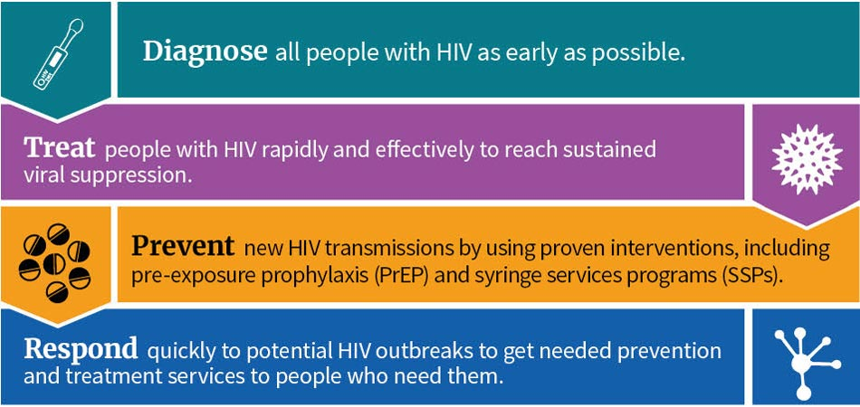
Ending the HIV Epidemic
The Ending the HIV Epidemic initiative focuses on four key strategies that, implemented together, can end the HIV epidemic in the U.S.

Slide 83
Copyright © 2021 Health Management Associates, Inc. All rights reserved.

Slide 84
Copyright © 2021 Health Management Associates, Inc. All rights reserved.
Notes:
This is also referred to as the “90-90-90 plan”

Slide 85
Funding
Fiscal Year 2021 HHS Budget Resources for the Ending the HIV Epidemic Initiative
In December 2020, Congress passed, and the President signed the fiscal year 2021 (FY21) federal budget, which included $404.5 million for implementation of the EHE initiative:
$175 million for the Centers for Disease Control and Prevention (CDC) to reduce new HIV infections.
$208.5 million for the Health Resources and Services Administration (HRSA), allocated as $105 million to deliver HIV care through the Ryan White HIV/AIDS Program (RWHAP); $102 million to provide HIV testing, linkage to care, and prescription of pre-exposure prophylaxis (PrEP) and associated medical costs through the Health Centers program; and $1.5 million for rural HIV technical assistance through Bureau of Primary Health Care-funded Primary Care Associations.
$5 million to the Indian Health Service (IHS) for an initiative to treat or reduce the transmission of HIV and HCV.
$16 million for the National Institutes of Health (NIH) for evaluation activities to identify effective interventions to treat and prevent HIV.
Copyright © 2021 Health Management Associates, Inc. All rights reserved.

Slide 86
Funding
President Biden’s Fiscal Year 2022 Budget Request Includes $670 Million for the Ending the HIV Epidemic Initiative
To help accelerate and strengthen efforts to end the HIV/AIDS epidemic in the United States, the Budget includes $670 million within HHS to help aggressively reduce new HIV cases while increasing access to treatment, expanding the use of pre-exposure prophylaxis, also known as PrEP, and ensuring equitable access to services and supports.
Copyright © 2021 Health Management Associates, Inc. All rights reserved.

Slide 87
Funding
State Opioid Response Grants: $1.5 Billion over 2 Years
The SAMSHA program aims to address the opioid crisis by increasing access to medication-assisted treatment using the three FDA-approved medications for the treatment of opioid use disorder, reducing unmet treatment need, and reducing opioid overdose related deaths through the provision of prevention, treatment and recovery activities for opioid use disorder (OUD) (including illicit use of prescription opioids, heroin, and fentanyl and fentanyl analogs).
This program also supports evidence-based prevention, treatment and recovery support services to address stimulant misuse and use disorders, including for cocaine and methamphetamine.
Source: https://www.samhsa.gov/newsroom/press-announcements/202008270530
Copyright © 2021 Health Management Associates, Inc. All rights reserved.

Slide 88
References: Ethics and Legal
Center for HIV Law and Policy https://www.hivlawandpolicy.org/states/minnesota
CDC Compendium of State Laws (includes MN Statutes re: criminalization of knowing transmission) https://www.cdc.gov/hiv/policies/law/states/index.html
CDC Guidelines on Case Reporting and Surveillance https://www.cdc.gov/hiv/guidelines/reporting.html
MN Center for HIV Law and Policy https://www.hivlawandpolicy.org/resources
MN Health Department Disease Reporting Requirements and Resources
Reporting HIV and AIDS (for health professionals) https://www.health.state.mn.us/diseases/hiv/hcp/report.html
STD/HIV Partner Services Program for help with partner notification https://www.health.state.mn.us/diseases/stds/partnerservices.html
FAQ on Reporting https://www.health.state.mn.us/diseases/stds/hcp/reportfaq.html
HIV and TB Fact Info https://www.health.state.mn.us/diseases/hiv/hcp/hivandtb.html
UCSF Compendium of State HIV Laws Quick Reference https://nccc.ucsf.edu/wp-content/uploads/2014/03/State_HIV_Testing_Laws_Quick_Reference.pdf
How Should Physicians Respond if Patient HIV Denial Could Exacerbate Racial Health Inequities? AMA J Ethics. 2021;23(5):E382-387. doi: 10.1001/amajethics.2021.382. https://journalofethics.ama-assn.org/article/how-should-clinicians-respond-if-patient-hiv-denial-could-exacerbate-racial-health-inequities/2021-05
Copyright © 2021 Health Management Associates, Inc. All rights reserved.

Slide 89
References: Funding and Policy
HRSA Information about Ryan White Programs: https://hab.hrsa.gov/about-ryan-white-hivaids-program/about-ryan-white-hivaids-program
CDC Information on Ending the HIV Epidemic in the US: https://www.cdc.gov/endhiv/index.html
MN Department of Health End HIV MN Resources: https://www.health.state.mn.us/endhivmn#:~:text=END%20HIV%20MN%20will%20address,for%20people%20living%20with%20HIV
CDC Ending the HIV Epidemic Funding Announcement: https://www.cdc.gov/nchhstp/newsroom/2021/ehe-funding.html
Copyright © 2021 Health Management Associates, Inc. All rights reserved.

Slide 90
QUESTIONS?

Slide 91
Next Steps
Join us for Session 4 next Wednesday!
Your registration should have included a reoccurring calendar invite for all four sessions
Please complete the evaluation and post-test for this session that will be sent out after via email (evaluations must be completed for those seeking CEU/CME credits).
Follow-up questions?
Cami McIntire: cmcintire@healthmanagement.com
Copyright © 2021 Health Management Associates, Inc. All rights reserved.

