Slide 1
MEDICARE OUTLOOK:
An Analysis of Potential Policy Changes Under the Trump Administration
WWW.HEALTHMANAGEMENT.COM

Slide 2
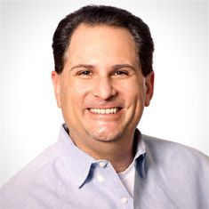
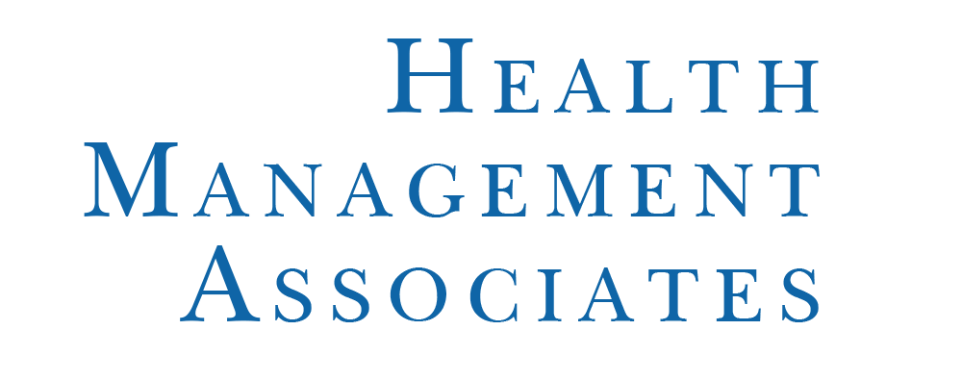
Webinar Panel
Mary Hsieh, PharmD MPH
Aimee Lashbrook, JD, MHSA
Jason Silva, JD, PMP
Notes:
Medicaid Director by State:
Eileen, Vern, Steve – MI
Matt – IL
Tom – MA
Izanne – PA
Pat, Kathy – IN
Tony – AZ
Gary – FL
Barb – OH
Liddy: Community Strategies team: focus on upstream social determinants of health. Our expertise includes:
conducting needs assessment to find community-specific service gaps and disparities;
identifying local partners and making connections that can achieve community goals;
working with community organizations to develop solutions and bring about on-the-ground results; and
pursing grants and exploring other funding sources for projects and programs.
Before HMA, worked with hospital/health systems, health plans but mainly as a leader in the non profit sector. Provided health coaching, transitional care coordination, PCP care coordination, faith-based screenings and referrals, and health insurance navigation and literacy.

Slide 6
LEARNING OBJECTIVES
Understand the ACA’s Medicare provisions, and what’s at stake in proposals to repeal and replace or otherwise modernize the program
Identify key perspectives likely to shape the future of Medicare
Evaluate potential opportunities and threats to insurance-based programs like Medicare Advantage and Medigap
Discuss components of a Medicare premium support program, and political will to proceed with major changes
Assess future of value-based programs like CMMI, IPAB, and MACRA
Highlight policy windows to understand when changes, if any, could occur

Slide 7
UNCERTAINTIES LIE AHEAD
Medicare Advantage
MACRA CMMI
IPAB
Defined Contribution
Premium Support
Health Savings Accounts
Privatization
Value-Based Framework
Medigap Reform
Coding Intensity
Part A & B Deductibles
Medicare Eligibility
Provider Rules and Reimbursement
Dual Eligibles
Business relies on certainty, but certainty is in short supply following the 2016 election…
The only thing certain is the degree of uncertainty under the new administration and Congress
Medicare Fee For Service
Private Medicare Market
Notes:
-57 million Americans depend on Medicare for their health care coverage
-Business relies on certainty, but certainty in the health care industry is in short supply following the election
-The only certain thing at this time is the degree of uncertainty for key healthcare provisions under the new administration and Congress
-While no one has a crystal ball to know how everything will ultimately play out, the varying degrees of uncertainty begin to unfold as we separately examine key areas of potential change

Slide 8
KEY PERSPECTIVES MAY IMPACT THE FUTURE OF MEDICARE
PRESIDENT TRUMP
115TH CONGRESS
Campaigned on a promise not to cut Medicare or Social Security
“Every Republican wants to do a big number on…Medicare. And we can’t do that…It is not fair to the people who have been paying in for years” [Trump on the Campaign Trail, NH 2016]
“President-elect Trump made it very clear in the course of the campaign that we’re going to keep our promises in Social Security and Medicare” [VP-Elect Mike Pence, Dec 4]
“I don’t think President-elect Trump wants to meddle with Medicare or Social Security” [Reince Priebus, CBS’s Face the Nation, Jan 2017]
But nominated Tom Price, a critic of the Medicare program
And supports at least some degree of change
“The Administration will act to… Modernize Medicare, so that it will be ready for the challenges with the coming retirement of the Baby Boom generation – and beyond” [Trump Transition website, Dec 2016]
The GOP generally supports an overhaul of Medicare, including raising the age of eligibility and moving to a premium support model
Desire to balance the budget, which implicates entitlement programs like Medicare
Influential GOP leaders, including House Speaker Rep. Paul Ryan, have tried to tackle Medicare reform for almost a decade
Democratic leadership has vowed to fight significant changes to the program
Competing priorities may influence GOP agenda
Notes:
However, Trump is also on record as promising not to cut Medicare—how supportive will he be of Congressional plans?

Slide 9
KEY PERSPECTIVES MAY IMPACT THE FUTURE OF MEDICARE
REP. TOM PRICE (R-GA) HHS Secretary
SEEMA VERMA CMS Administrator Nominee
Orthopedic surgeon with MD from University of Michigan and Residency at Emory University
One of 16 physicians on the GOP Doctors Caucus
Will be first physician to lead HHS since 1993
Vocal opponent of ACA with close ties to Rep. Ryan
Voted for MACRA (the SGR replacement), but has concerns about implementation
Supports moving Medicare from defined benefit to defined contribution with premium support
Supports health savings accounts
Vocal critic of CMMI’s mandatory demonstrations, and other Medicare policies perceived to create barriers between patient-physician relationship
Healthcare consultant and helped develop Medicaid expansion plans in Indiana, Iowa, Kentucky, Michigan and Ohio
Introduced health savings accounts (HSAs) into the Indiana Medicaid program and supportive of state flexibility and consumer driven health care
Served as VP of Planning for the Health & Hospital Corporation of Marion County and Director with the Association of State and Territorial Health Officials (ASTHO) in Washington, D.C.
Notes:
AARP –
“AARP has a strategy ready to fight cuts to this popular program”
AHIP – “Medicare Advantage: Real Results, Prove Solutions
AMA –
“Support a Medicare defined contribution program”
“ Support the restructuring of Medicare’s age-eligibility requirements and incentives to match the Social Security schedule of benefits.”

Slide 10
POSSIBLY SOME ATTEMPTS TO “MODERNIZE” MEDICARE
Near-term strategies may include repealing a few Medicare-specific provisions of the ACA, as well as attempts to make more fundamental changes with a focus on program sustainability
One long-term strategy would change Medicare from a defined benefit plan to a defined contribution plan, i.e., premium support, but it faces a major uphill battle
Additional near-term and long-term policies with potential to stimulate Medicare Advantage and private plans
Notes:
Bullet 1: While the ACA has been controversial and there are many different POVs, the one issue that almost all GOP leaders can agree on is repeal. Although it has received little attention, a full repeal would eliminate among other things, free preventive services such as flu shots and screenings for cancer and diabetes. It may also impact on the doughnut hole which has been improved. Near-term strategies are likely…
Bullet 2: Continued near-term… The current trend of Medicare Advantage growth is approximately 1-2% per year and the CBO’s projection supports this growth over the next 10 years. The GOP sees this growth as endorsement by elderly Americans that this is the vehicle to fund a more sustainable Medicare program for the nation’s seniors.
Bullet 3: The big controversy is around “defined contribution plan” also known as premium support. This proposal is likely to be a long-term strategy.
Bullet 4: The details affecting different Medicare policy will vary but the fundamental platform will be around increased competition and choice (between Medicare Advantage and FFS). To the extent that privatization promote those values, we expect to see greater support. The big question will be how much will privatization cost.
-

Slide 11
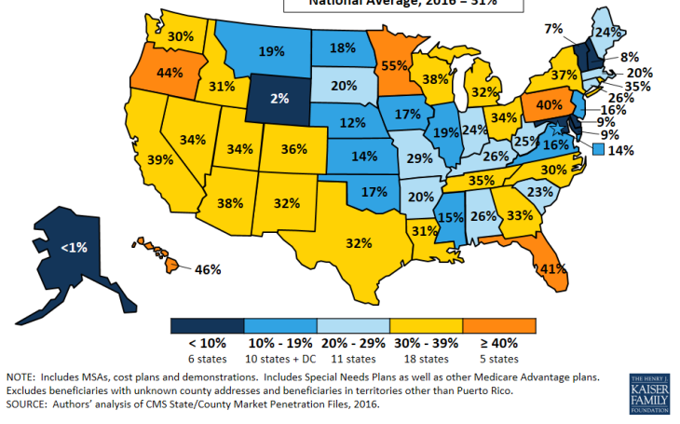
SHARE OF BENEFICIARIES IN PRIVATE MEDICARE PLANS, 2016
Notes:
Data from 2016
Overall market average = 31%

Slide 12
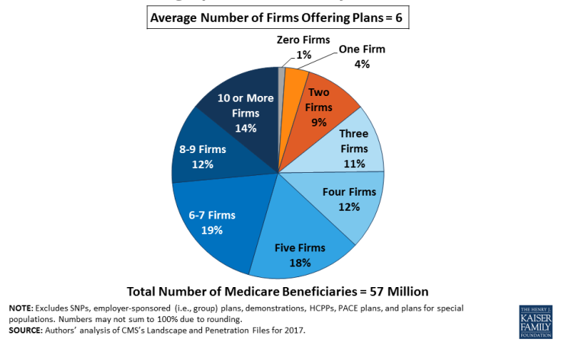
THE CHOICE OF MEDICARE ADVANTAGE PLAN FOR BENEFICIARIES

Slide 13
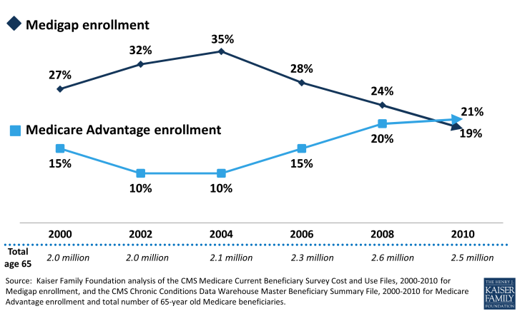
MEDIGAP ENROLLMENT CONTINUES TO DECLINE

Slide 14
FULL REPEAL UNLIKELY BUT WOULD HAVE A MAJOR IMPACT
The ACA included over 100 provisions impacting the Medicare program
Preventive Benefits
MA Payment Methodology
Part B and D Premiums
Program Integrity
Misc. Program Extenders
Medigap Changes
Medicare Shared Savings (ACOs) and Other Alternative Payment Models
Closing the Donut Hole and Coverage Gap Discount Program
Value-Based Programs
MA Coding Intensity Adjustment
MA Benchmark Caps
Hospital Wage Index
Health Insurer Tax
Other ACA Taxes and Fees
Center for Medicare and Medicaid Innovation (CMMI)
Physician-Owned Hospital Ban
Independent Payment Advisory Board
Lower Likelihood
Higher Likelihood
Notes:
Closing the donut hole and Medicare ACOs are not typically what one thinks of when they think of Obamacare, and we forget that the ACA had a significant impact on Medicare providers, plans, and beneficiaries.
Full repeal would cause significant disruption in the Medicare market, but is unlikely. Helpful to think through which of the ACA’s Medicare provisions could be included in a partial repeal.
The scale helps think through which provisions have a higher likelihood of being included in a partial repeal, considering previous GOP targets and budget reconciliation rules, which provide that only those provisions impacting spending may be included
Provisions most at risk are those provisions unpopular with the GOP that are also subject to budget reconciliation
Republicans lack a filibuster-proof majority in the Senate, and some of these things probably can’t be achieved through the budget reconciliation process
Budget Reconciliation:
Congress has to pass a budget resolution for budget reconciliation to be used.
Normally, reconciliation is limited to one spending/revenue bill per year, or per budget resolution.
There are rumblings that reconciliation may occur twice next year because Congress is considering two budget resolutions next year and that would allow for two reconciliations next year. The thought is maybe the first reconciliation would deal with the repeal of the ACA, and the second reconciliation would deal with other spending items – possibly including Medicare. Stan Collender (Forbes Contributor) and VOX
http://www.vox.com/policy-and-politics/2016/11/23/13709518/budget-reconciliation-explained
Tom Price indicated that he hopes to advance Medicare changes in a reconciliation package later in 2017. CQ 11-17-16 “Lawmakers Working on Legislative Text for Medicare Overhaul”

Slide 15
RANGE OF PROPOSALS IMPACTING PRIVATE MEDICARE MARKET
MEDICARE HSAs | Provide additional flexibility for Medicare Savings Accounts and HSAs for Medicare beneficiaries
VALUE-BASED INSURANCE DESIGN | Provide greater flexibility in benefit design and permit MA plans to incentivize high-value services
BENCHMARK CAP | Repeal cap that limits funding for 4- and 5-star plans in certain areas
CODING INTENSITY ADJUSTMENT | Freeze CMS’ ability to affect MA payments through coding intensity adjustments
PART D NEGOTIATION | Allow federal government to negotiate drug prices under Part D
MEDIGAP REFORM | Limit availability for first dollar coverage
MEDICARE COMPARE | Publicly report MA and FFS performance on core quality measures on CMS website, by service area, to encourage competition and transparency
COMPETITIVE BIDDING | New methodology that informs federal payments by adjusting for historical MA bid and FFS/MA quality performance
Paul Ryan, “A Better Way”
American Enterprise Institute
Trump Campaign/Administration
Heritage Foundation
Notes:
Another idea to improve competition between MA and FFS – randomly assign new beneficiaries that do not make affirmative election to an MA plan instead of FFS (AEI). Or allow MA plans to offer plans that would allow members to pay even less than the Part B premium, such as by sending a rebate check so members could see actual savings (AEI)

Slide 16
RANGE OF PROPOSALS IMPACTING MEDICARE FEE FOR SERVICE
ELIGIBILITY AGE | Increase age of Medicare eligibility from 65 to 67, consistent with Social Security
COMBINED DEDUCTIBLE/ MOOP | Combine Part A and B deductibles, and establish Maximum Out of Pocket (MOOP) and streamline cost-sharing
PREMIUM INCREASES | Increase Part B and D premiums for higher income seniors
PRIVATE CONTRACTING | Allow providers and beneficiaries to voluntarily enter into an arrangement for items and services outside of Medicare, with access to some reimbursement from Medicare. Some proposals would start with a pilot or demonstration.
PROVIDER REIMBURSEMENT | Such as: + Repeal ban on physician-owned hospitals + Repeal ACA’s changes to hospital wage index related to the rural floor + Reform GME funding
MEDICARE SAVINGS PROGRAMS | Combine the three Medicare Savings Programs (MSPs) into one and require states to use one uniform asset test for qualification in the new MSP program
Paul Ryan, “A Better Way”
American Enterprise Institute
Trump Campaign/Administration
Heritage Foundation
Notes:
Wage Index:
Hospital wage index fix has bipartisan support – Massachusetts has been able to benefit from this ACA change to the detriment of other states – Republican and Democratic administrations have acknowledged the disparities with this Medicare funding mechanism. Don Berwick has also been critical of this system.
POH:
The plan calls for a repeal of the ban on physician-owned hospitals with no details other than lifting the ban will “make markets more competitive by driving down prices and increasing quality”
The Affordable Care Act includes a prohibition on new physician-owned hospitals and expansion of existing facilities, unless they get explicit backing from the CMS.
Physician-owned hospitals have been trying to get the ban reversed since the passage of the ACA in 2010.
A proposal was included in a discussion draft of legislation dealing with short hospital stays (two midnight rule) in the House in 2014.
Also tried to have the ban repealed as part of the SGR package in 2015.
The opposition to POHs is from the American Hospital Association (AHA) and the Federation of American Hospitals (FAH). This is a lobbying battle and AHA and FAH have been successful in this battle by keeping the ban in place at this time.
Modern Healthcare (3/31/15) “You can't always get what you want; just ask physician-owned hospitals”
Part D negotiation – Trump supported the concept while campaigning for president, but may be difficult to achieve backing of Republican-controlled Congress
Reform GME Funding – Potential changes could range from a phase out or reallocation of funds; combination of funding streams; shifting control to the states; or move to a more value-based system; or a system that follows the resident instead of an institution.
Other Ro proposals:
-Exempt C and D plans from state taxes (Roy)
-Fraud and abuse reduction (Roy)
-Allow seniors to opt out of Medicaid without forfeiting social security benefits (Roy, Heritage)

Slide 17
LEGISLATIVE PROPOSALS TO “REPEAL AND REPLACE” THE ACA
 | Full Repeal | Partial Repeal | Medicare-Related Provisions
ObamaCare Replacement Act of 2017: Sen. Paul |  | ✕ | Expands and provides new flexibilities for HSAs and MA MSAs. Provides a physician bad debt deduction.
Patient Freedom Act of 2017: Sens. Cassidy and Collins |  | ✕ | Limits charges for OON emergency care, including for Medicare beneficiaries.
American Health Care Reform Act of 2017: Rep. Roe | ✕ |  | All Medicare provisions in the ACA repealed. Expands and provides new flexibilities for HSAs and MA MSAs. Increases transparency of Medicare claims data.
World’s Greatest Healthcare Plan Act of 2016: Rep. Sessions and Sen. Cassidy |  | ✕ | No change to ACA’s Medicare provisions. Implements per capita caps to finance state Medicaid programs. New flexibilities for physician-owned facilities; limits charges for OON emergency care, including for Medicare beneficiaries.
Empowering Patients First Act of 2015: Rep. Price | ✕ |  | All Medicare provisions in the ACA repealed. Allows direct contracting between physicians and patients under Medicare. Expands and provides new flexibilities for HSAs and MA MSAs. Provides a physician bad debt deduction.
Restoring Americans’ Healthcare Freedom Reconciliation Act of 2015: Rep. Price |  | ✕ | Repeals ACA’s taxes and fees. No other Medicare-specific provisions.
Patient Choice, Affordability, Responsibility, and Empowerment (CARE) Act: Sens. Burr, Hatch and Rep. Upton |  | ✕ | Repeals ACA’s taxes and fees. No other Medicare-specific provisions.
Source: Kaiser Family Foundation. Comparison of Medicare Provisions in Recent Bills and Proposals to Repeal and Replace the Affordable Care Act (January 2017), available at http://kff.org/medicare/issue-brief/comparison-of-medicare-provisions-in-recent-bills-and-proposals-to-repeal-and-replace-the-affordable-care-act/; bill summaries

Slide 18
MEDICARE PREMIUM SUPPORT
Basic Approach
Option of purchasing health insurance from a number of competing plans. Federal government would pay a portion of the cost of coverage for a set of services that is actuarially equivalent to the services covered by FFS. In most proposals, FFS would remain an option.
Objectives
Defined Contribution
Budget Predictability and Sustainability
“Modernize Medicare”
Several Proposals
Ryan-Wyden
Paul Ryan “Path to Prosperity”
Paul Ryan “A Better Way”
Premium Support Models
Domenici-Rivlin (Bi-partisan)
Considerations
Annual Growth Factor? Cap?
Level of Contribution?
Will FFS remain an option?
Beneficiary Protections?
Insurer Requirements?
Benefit Standards?
Risk Adjustment?
Geographic Adjustments?
Income-Related Adjustments?
Marketplace?
Regulating Body?
Health Savings Account (HSA)?
Limited to New Beneficiaries Only?
Potential Impact
Risk that rising Medicare costs could be passed onto Medicare beneficiaries
New flexibilities and enhanced market opportunities for plans, but if contribution is too low few plans will participate
What happens if Medicare FFS is phased out (MACRA, GME, DSH, etc.)?
Notes:
Political likelihood? Democrats have vowed to fight major changes to Medicare.

Slide 19
FUTURE OF MACRA AND VALUE-BASED INITIATIVES
MACRA
CMMI
IPAB
While no one has a crystal ball to know how everything will ultimately play out, the varying degrees of uncertainty begin to unfold when reviewing the following key healthcare provisions:
Medicare Access and CHIP Reauthorization Act of 2015 (MACRA) – specifically, the Quality Payment Program
Center for Medicare & Medicaid Innovation (CMMI) – a.k.a. The Innovation Center
Independent Payment Advisory Board (IPAB)

Slide 20
FUTURE OF MACRA AND VALUE-BASED INITIATIVES
MACRA
CMMI
IPAB
Of these three highlighted healthcare provisions, MACRA’s Quality Payment Program probably has the least uncertainty:
First, MACRA was passed with strong bi-partisan support – 92 Senators and 392 U.S. House members
Second, MACRA ended the wildly unpopular Sustainable Growth Rate (SGR) formula, which required Congress to annually delay payment cuts for providers – i.e. the annual “doc fix”
Third, Andy Slavitt (former CMS Acting Administrator) has indicated that based on his conversations with people on Capitol Hill, he sees the implementation of MACRA moving forward (Nov. 15, 2016 CMS MACRA conference call)
Notes:
SGR increased physician payments when the growth rate of spending on physician services was down; it reduced physician payments when physician spending increased. In theory this seemed like a nice idea, but for more than a decade there would have been physician cuts, and these cuts were delayed each year by Congress – an annual process know as the “doc fix.” SGR was a headache for Congress and it was ultimately replaced by MACRA. MACRA is a permanent doc fix.

Slide 21
FUTURE OF MACRA AND VALUE-BASED INITIATIVES
MACRA
CMMI
IPAB
Like all components of the ACA, The Innovation Center’s future is uncertain, but there are a number of reasons to believe that it may not disappear
The Center is a component of the ACA that hasn’t received as much attention with the discussions around “repeal and replace”
The public’s perception of Obamacare is the exchanges, subsidies, Medicaid expansion, and the individual mandate – not The Innovation Center
ACOs, Medicaid-Medicare Plans (MMPs), and other programs to shift the healthcare system away from FFS have come out of The Innovation Center
The shift away from FFS is popular with both Democrats and Republicans, and it could be argued that it may even be more popular with Republicans
Republicans might now view the Center as a nice tool since they are now the governing party and will have control over the Center
Republicans also lack a filibuster-proof majority in the Senate, and the Center probably can’t be repealed through the budget reconciliation process
Notes:
Popular goal: reduce program expenditures while preserving or enhancing the quality of care for those individuals who receive Medicare, Medicaid, or Children’s Health Insurance Program (CHIP) benefits. – CMMI web site
The Ryan plan calls for repealing the CMMI as of January 1, 2020
The Innovation Center’s Seven Categories
1) Accountable Care
2) Episode-based Payment Initiatives
3) Primary Care Transformation
4) Initiatives Focused on the Medicaid and CHIP Population
5) Initiatives Focused on the Medicare-Medicaid Enrollees
6) Initiatives to Accelerate the Development and Testing of New Payment and Service Delivery Models
7) Initiatives to Speed the Adoption of Best Practices

Slide 22
FUTURE OF MACRA AND VALUE-BASED INITIATIVES
MACRA
CMMI
IPAB
Like The Innovation Center, the future of the Independent Payment Advisory Board (IPAB) is also uncertain, but the IPAB has garnered much more negative attention
The IPAB has been one of the most criticized provisions of the ACA – the IPAB has been referred to as a “death panel”
The IPAB is tasked with developing a proposal to reduce Medicare spending if the projected 5-year Medicare per capita growth rate exceeds the Medicare per capita target growth rate
To date, the IPAB has not been utilized because the projected 5-year Medicare per capita growth rate has not exceeded the Medicare per capita target growth rate
It’s possible the IPAB could quietly exist until a proposal to reduce Medicare spending is required from the board because the Republicans lack a filibuster-proof majority in the Senate, and the IPAB probably can’t be repealed through the budget reconciliation process
The IPAB could be triggered this year
Notes:
The Chief Actuary of CMS determines the projected per capita growth rate for Medicare. If the projection exceeds a target growth rate, the IPAB is required to develop a proposal to reduce Medicare spending by a specified amount – this was criticized as rationing care
The Senate is able to override payment cuts with a three-fifths vote.
Its also possible that because the IPAB is viewed as unpopular, some Senate Democrats could join with Republicans to eliminate the IPAB
The Ryan plan calls for repealing the IPAB

Slide 23
WHEN WILL THE UNCERTAINTIES BEGIN TO CLEAR?
FY 2017 Budget and Reconciliation Bill
Will focus on repealing ACA provisions
FY 2018 Budget and Reconciliation Bill
Could possibly involve Medicare
2017
Dec.
Jan.
April 3
Final MA/Part D Call Letter and Rates
Budget Reconciliation
Avoids filibuster because only 51 votes are needed
Limited to provisions that have an impact on budget
Opportunity to repeal parts of the ACA with a simple majority
EXAMPLE – FY 2017 Budget Reconciliation Process:
Step 1: Pass non-binding budget resolution - $1 B in savings for FY 2017
Step 2: Follow up with binding reconciliation bill (i.e., legislative language) – currently being drafted, with a new tentative target of the end of March or early April
February 1
MA/Part D Rate Notice and Draft Call Letter
Medicare outlook: business as usual in 2017-18
Notes:
Message: Business as usual in 2018
First reconciliation package for 2017 unlikely to impact Medicare significantly and will be focused on repeal of key provisions of the ACA like…
Reconciliation process impacting FY 2018 budget has greater chance of addressing other spending items, including Medicare
[placeholder to flag anything crazy in rate notice]
Anyone hearing anything about Part C or D rulemaking this year?
Price confirmation hearing: they don’t have reason to be concerned, look forward to helping them get the care they need
Republicans lack a filibuster-proof majority in the Senate, and some of these things probably can’t be achieved through the budget reconciliation process
Budget Reconciliation:
Congress has to pass a budget resolution for budget reconciliation to be used.
Normally, reconciliation is limited to one spending/revenue bill per year, or per budget resolution.
There are rumblings that reconciliation may occur twice next year because Congress is considering two budget resolutions next year and that would allow for two reconciliations next year. The thought is maybe the first reconciliation would deal with the repeal of the ACA, and the second reconciliation would deal with other spending items – possibly including Medicare. Stan Collender (Forbes Contributor) and VOX
http://www.vox.com/policy-and-politics/2016/11/23/13709518/budget-reconciliation-explained
Tom Price indicated that he hopes to advance Medicare changes in a reconciliation package later in 2017. CQ 11-17-16 “Lawmakers Working on Legislative Text for Medicare Overhaul”

Slide 24
TRUMP ADMINISTRATION: FIRST 30 DAYS
Executive Orders
Affirms commitment to repeal ACA and directs federal agencies “to waive, defer, grant exemptions from, or delay the implementation of any provision or requirement of the Act that would impose a fiscal burden on any state...”
New regulations require the repeal of two existing regulations.
Hiring freeze for federal agencies.
Confirmation Hearings
New HHS Secretary confirmed last week
Hearing for CMS nominee this week
Advance Notice and Draft Call Letter for CY 2018
Slight rate bump – 25 basis points
Pause of phase in of encounter data
Generally business as usual for MA plans
Notes:
Executive orders, confirmations pending, advance notice,
Add last slide with names and phone numbers

Slide 25
Q&A
Mary Hsieh, PharmD MPH
Principal
mhsieh@healthmanagement.com
Aimee Lashbrook, JD, MHSA Senior Consultant
alashbrook@healthmanagement.com
Jason silva, JD, PMP
Senior Consultant
jsilva@healthmanagement.com

