Slide 1
UNDERSTANDING negative reactions following overdose reversal with naloxone
Jo Neale
Professor of Addictions Qualitative Research
National Addiction Centre
Institute of Psychiatry, Psychology & Neuroscience
King’s College London
London, UK
Compassionate Overdose Response Summit, US
19th March 2024

Slide 2
DECLARATIONS & ACKNOWLEDGEMENTS
Declarations: In the last three years, I have secured research funding from Mundipharma Research Ltd & Camurus AB, and received honoraria from Indivior & Camurus AB for presentations
Acknowledgements: This presentation is based on 4 papers arising from 3 studies conducted between 1997 & 2020
Funders: Scottish Office; Australian Research Council; US National Institute on Drug Abuse (NIDA)
Principal Investigators: Professor Neil McKeganey; Professor Suzanne Fraser; Professor Sandy Comer
All study participants, co-investigators & co-authors

Slide 3
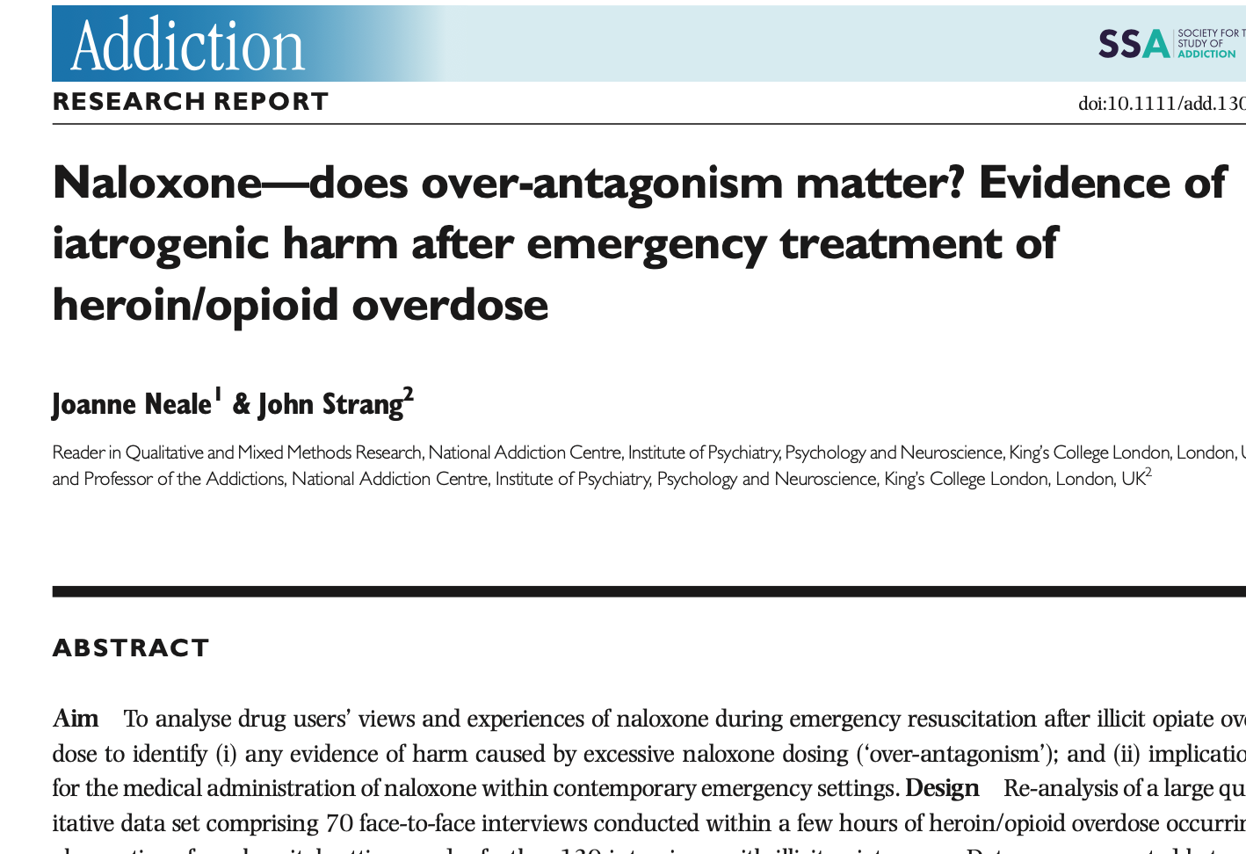
PAPER 1
Location: Scotland
Date: 1997-1999
200 qualitative interviews
153/200 participants had personally overdosed
Nearly all had witnessed an overdose

Slide 4
PAPER 1: KEY FINDINGS
Few participants knew naloxone by its generic or trade name
Nearly all understood street terms, e.g. ‘the jag’, ‘adrenaline’, or ‘the reverse’, or recognized naloxone from the researcher’s description
Participants described feeling ‘horrible’ or unwell, & reported acute withdrawal symptoms post naloxone administration
Participants reported going ‘mad’ or ‘crazy’ or losing their temper & becoming aggressive or violent because of withdrawal symptoms
Participants frequently reported that they had discharged themselves to find & use more drugs after naloxone administration

Slide 5
IMPLICATIONS
Negative reactions (including anger & acute withdrawal syndrome) are widely reported following overdose reversal with naloxone
Negative reactions following overdose reversal with naloxone can result in medical self-discharge, additional use of substances & potential risk of death

Slide 6
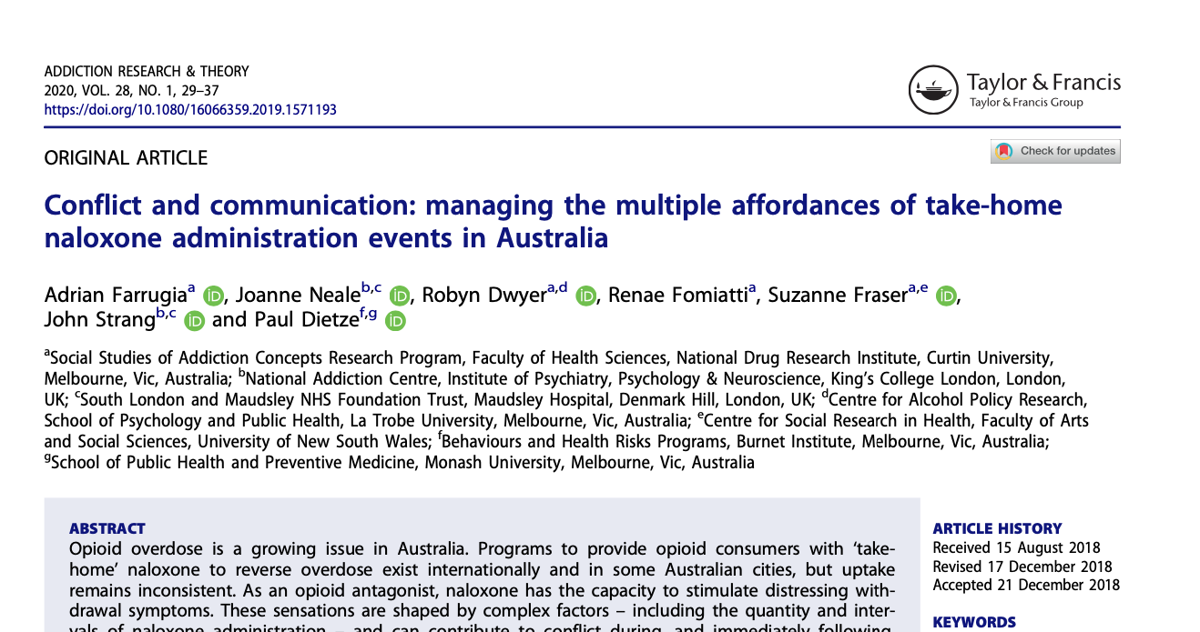
PAPER 2
Location: Australia
Date: 2017-2018
28 qualitative interviews
All participants used opioids
All participants had administered take-home naloxone

Slide 7
PAPER 2: KEY FINDINGS
Participants reported concerns about, & described experiences of, conflict during take-home naloxone administration
Participants also identified positive interactions during & after naloxone administration
Participants reported using specific techniques to reduce the likelihood of conflict & to increase positive responses during naloxone administration:
Titrating the dose of naloxone
Communicating with a person who had overdosed

Slide 8
IMPLICATIONS
Negative reactions following overdose reversal with naloxone are not inevitable
Anger (with the associated risk of conflict) following overdose reversal with naloxone can potentially be managed by dose titration & good communication with the person who has overdosed

Slide 9
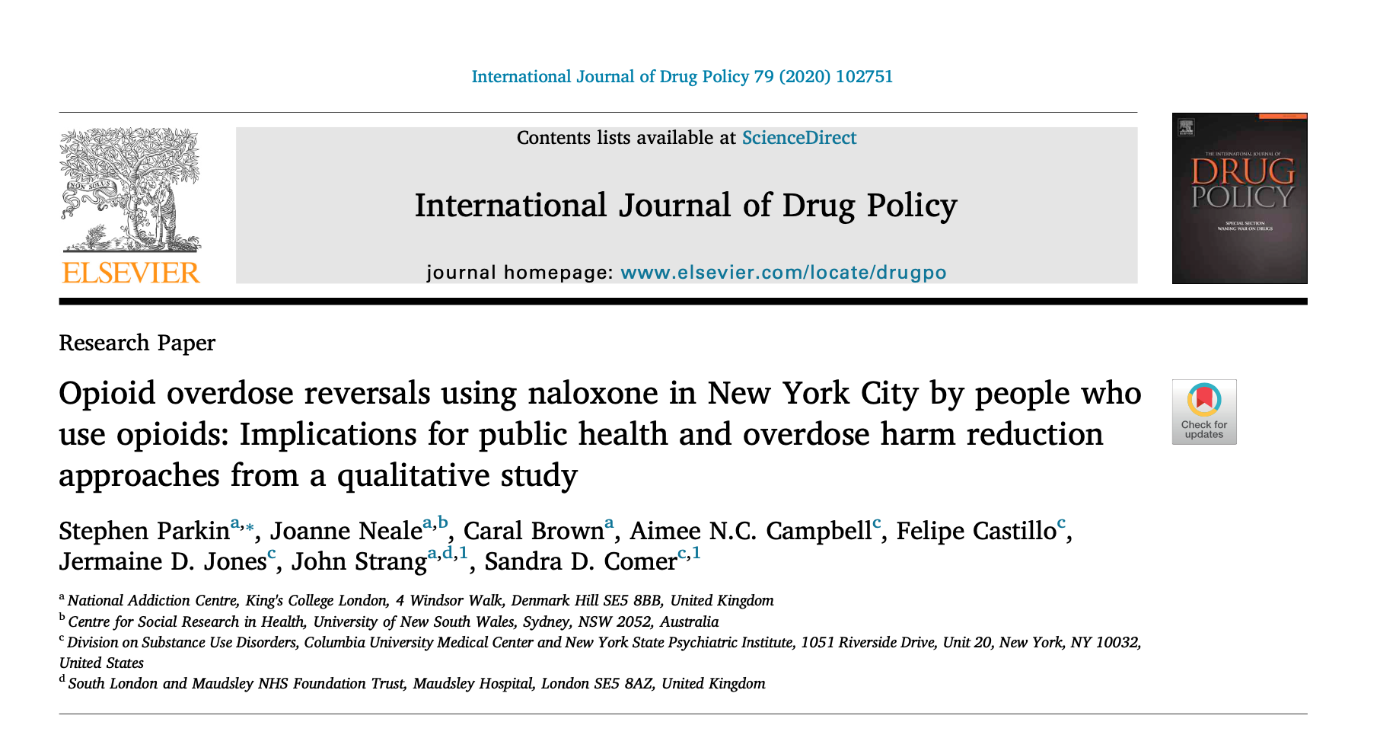
PAPER 3
Location: New York
Date: 2016-2018
46 qualitative interviews with people who used opioids
All participants had administered naloxone (some on multiple occasions)

Slide 10
PAPER 3: KEY FINDINGS
People who use opioids identified three outcomes following a successful opioid overdose reversal with intramuscular or intranasal naloxone:
‘rage’
‘withdrawal symptoms’
‘not rage, not withdrawal’
Rage and withdrawal symptoms did not always occur together
When rage and withdrawal symptoms did occur together, they did not always happen in the same order

Slide 11
IMPLICATIONS
Withdrawal symptoms & rage following naloxone administration may be unrelated phenomena

Slide 12
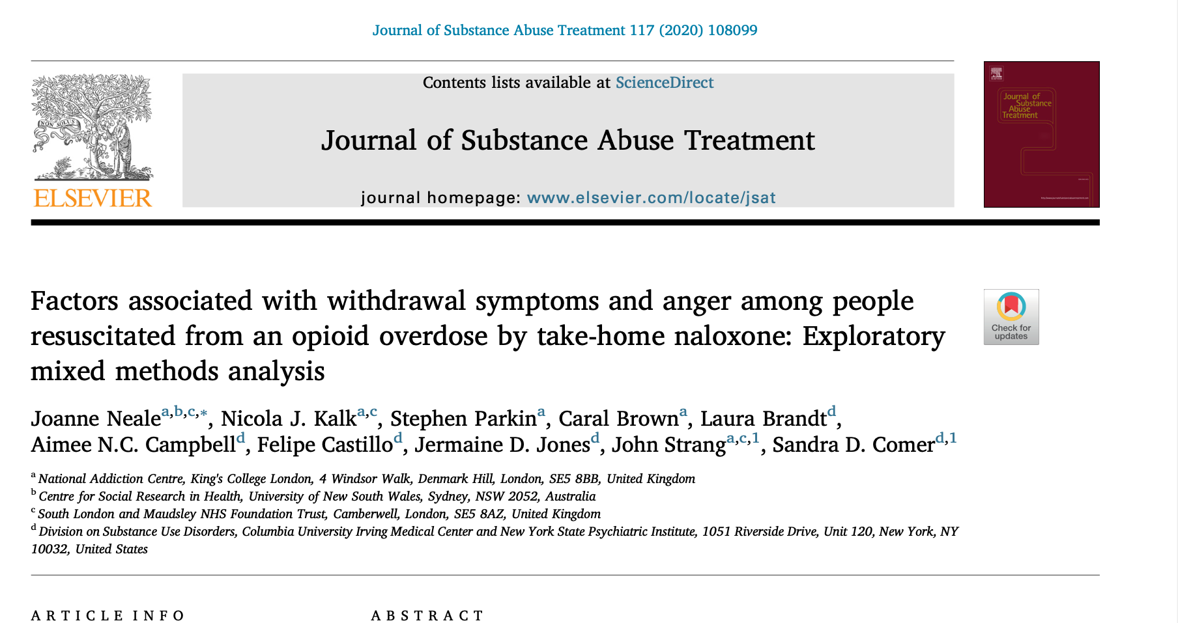
PAPER 4
Location: New York
Date: 2014-2019
RCT of overdose education & naloxone prescribing to people with opioid use disorder & qualitative interviews with trial participants who responded to an overdose
Analyses of 47 overdose events
Naloxone had been administered at all events

Slide 13
PAPER 4: KEY FINDINGS
Anger & aggression following naloxone administration for opioid overdose do not seem to be associated with withdrawal symptoms
Withdrawal symptoms are potentially associated with receiving more than one dose of naloxone
People who had overdosed were significantly more likely to display anger if the person resuscitating them criticized, berated or chastised them during resuscitation
People were significantly less likely to display anger if the person resuscitating them communicated positively with them

Slide 14
IMPLICATIONS
Withdrawal symptoms & anger following naloxone administration may be unrelated
Withdrawal following overdose reversal with naloxone can potentially be managed by dose titration
Anger following overdose reversal with naloxone can potentially be managed by good communication with the person who has overdosed

Slide 15
SUMMARY AND CONCLUSIONS
Negative reactions are widely reported following overdose reversal with naloxone
Negative reactions can result in medical self-discharge, additional use of substances & potential risk of death
Negative reactions following overdose reversal with naloxone are not inevitable
Contrary to common assumptions, withdrawal symptoms & anger following naloxone administration may be unrelated
Withdrawal following overdose reversal with naloxone can potentially be managed by dose titration
Anger following overdose reversal with naloxone can potentially be managed by good communication with the person who has overdosed
Take-home naloxone programmes may be strengthened by including training in how to titrate naloxone dosage & adopt a positive communication style when administering naloxone

Slide 16
PAPERS
Neale, J. & Strang, J. (2015) Naloxone – does over-antagonism matter? Evidence of iatrogenic harm after emergency treatment of heroin/opioid overdose, Addiction 110, 1644-52.
Farrugia, A., Neale, J., Dwyer, R., Fomiatti, R., Fraser, S., Strang, J. & Dietze, P. (2019) Conflict and communication: managing the multiple affordances of take-home naloxone administration events in Australia, Addiction Research and Theory 28, 29-37.
Parkin, S., Neale, J., Brown, C., Campbell, A. N., Castillo, F., Jones, J. D., Strang, J. & Comer, S. D. (2020) Opioid overdose reversals using naloxone in New York City by people who use opioids: implications for public health and harm reduction approaches from a qualitative study, International Journal of Drug Policy 15, 102751.
Neale, J., Kalk, N. J., Parkin, S., Brown, C., Brandt, L., Campbell, A. M. C., Castillo, F., Jones, J. D., Strang, J. & Comer, S. D. (2020) Factors associated with withdrawal symptoms and anger among people resuscitated from an opioid overdose by take-home naloxone: exploratory mixed methods analysis, Journal of Substance Abuse Treatment 117, 108099.

Slide 17
Thank you
Professor Jo Neale National Addiction Centre Institute of Psychiatry, Psychology & Neuroscience King’s College London
London, UK Email: joanne.neale@kcl.ac.uk
Webpage: https://www.kcl.ac.uk/people/joanne-neale Twitter: @Jo_S_Neale

