Slide 1


PARTNERSHIP OPPORTUNITIES FOR PAYERS, PROVIDERS AND STATES:
SUPPORTIVE HOUSING FOR HIGH UTILIZERS
Notes:
To do:
Table Of contents
Draft 1-2 slides: How does this apply to me & clients? SH as emerging area. Webinar, invite others that may need be interested

Slide 2




HMA HOUSING & HEALTH SUBJECT-MATTER EXPERTS
Meggan Schilkie
New York, NY
Office
Carol Clancy
San Francisco, CA
Office
Rachel Post
Portland, OR
Office
Scott Ackerson
San Antonio, TX
Office

Slide 3
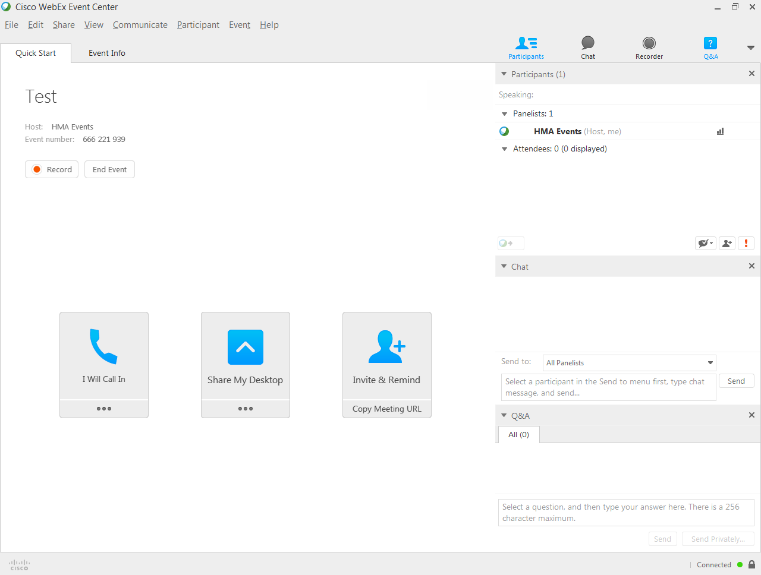

Slide 4
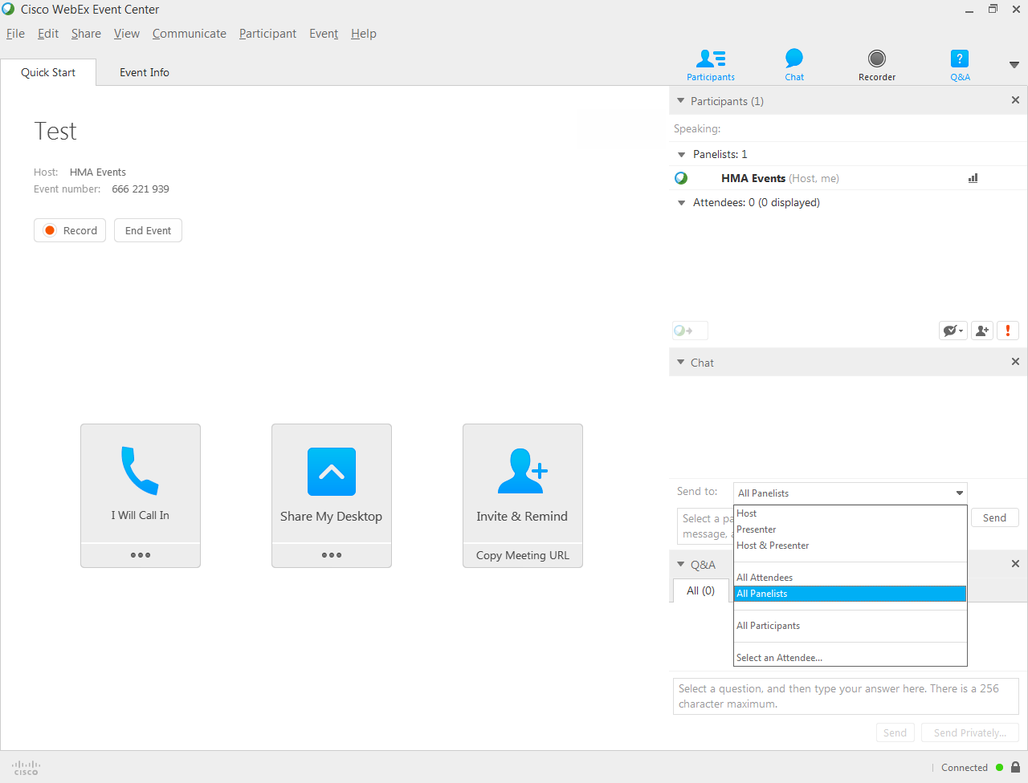

Slide 5
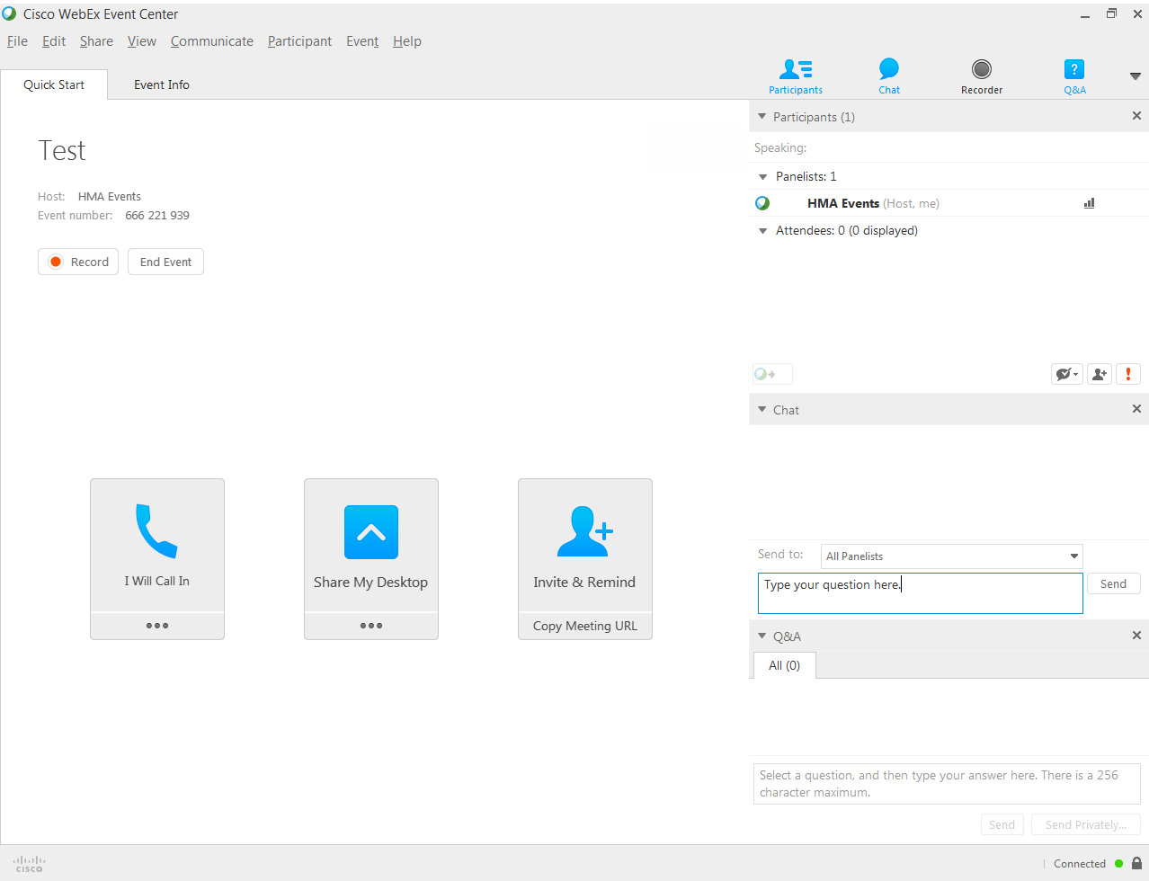

Slide 6

PRESENTATION OVERVIEW
I II III IV V VI
INTRODUCING SUPPORTIVE HOUSING
IMPLICATIONS FOR HMA CLIENTS
MAKING THE CASE: SCALE OF NEED AND IMPACT
MODELS OF SUPPORTIVE HOUSING
HMA’S WORK IN THIS ARENA
Q&A

Slide 7
DEFINITION AND KEY THEMES
Supportive housing is an evidence-based intervention that combines affordable housing assistance with wrap-around community based supportive services.
Housing stability dramatically impacts health outcomes.
For many individuals housing is their number one concern.
Evidence-based supportive housing helps people achieve and maintain stable housing.
Supportive housing is being funded and implemented by governments and organizations across the country.

Slide 8
HEALTH STATUS OF HEALTH CENTER USERS¹
Homeless
54%
Non-Homeless
32%
27%
11%
12%
5%
2%

Slide 9
INSURANCE STATUS OF HEALTHCARE FOR THE HOMELESS (HCH) PATIENTS, 2011-2014²

Slide 10
THE IMPACT OF HOUSING ON THE HEALTH CARE SYSTEM³
30%
20%
10%
0%
-10%
-20%
-30%
-40%
PRIMARY CARE UTILIZATION
COST TO THE HEALTH CARE SYSTEM
ED UTILIZATION
INPATIENT UTILIZATION
Permanent Supportive Housing
Housing for senior & people with disabilities
Notes:
Use this slide for smart art / charts / or screenshot images
This Oregon study, released by Enterprise Community Partners, explores the link between affordable housing and health care through the lens of several national health reform metrics: better connection to primary care, fewer emergency department visits, improved access to and quality of care, and lower costs.
An analysis by the Center for Outcomes Research and Education (CORE) found that when Medicaid-covered residents moved into one of 145 different affordable housing properties in Portland, Oregon, health care experiences changed dramatically. Over the following year, these residents used more primary care by 20 percent, had fewer emergency department visits by 18 percent, and accumulated lower medical expenditures by 12 percent. Residents also reported better access to and quality of health care. It was also found that integrated health services were a key driver of health care outcomes. The results hold national implications for health care systems, payers and policy makers looking for upstream solutions to address major health care needs and fulfill health care reform goals. Housing with integrated health services is an important solution toward bending the health care cost curve.
Huge policy questions and implications in the coming year. We recently started a housing and healthcare group within HMA to focus explicitly on this. More and more payers are looking at investing resources in housing even though CMS does not currently permit funding of housing (operational expenses, capital funding). Ways states and others have continued to get around this, requires complex blending of funding.

Slide 11

SUPPORTIVE HOUSING SIGNIFICANTLY REDUCES USE OF MORE EXPENSIVE INTERVENTIONS
Emergency room visits declined by 57%⁴
Emergency detoxification use declined by 87%⁵
Rate of incarceration declined by 52%⁶
+83% of individuals stay housed for at least 1 year⁷

Slide 12
DIFFERENCES IN AVERAGE NUMBER OF DAYS OF INSITUTIONAL USE PER PERSON 1-YEAR POST-NY/NY III
Number of Days

Slide 13

SUPPORTIVE HOUSING: THE NEED
2017 HUD Annual Homeless Assessment Report found +550,000 individuals experienced homelessness in the US. Of these, nearly 87,000 were chronically homeless.
Need for SH by re-entry population:
  Each year, +600,000 people are released from federal and state prisons and 9 million people are released from jail.
  Conservatively, 20% of those in the corrections system have serious mental illnesses and 65% have substance use disorders Inmates often leave in worse shape than they came in. ⁸
  Upon release, these individuals will likely require supportive housing.

Slide 14




SUPPORTIVE HOUSING:
PART OF A COMPREHENSIVE SOLUTION
Supportive, Affordable Housing
Integrated Health Care
Income & Employment
Positive Peer Relationships

Slide 15
PERMANENT SUPPORTIVE HOUSING FIRST VS.
TRANSITIONAL RECOVERY HOUSING
PERMANENT SUPPORTIVE HOUSING FIRST | TRANSITIONAL RECOVERY HOUSING
Point of Entrance: Streets and Shelter | Point of Entrance: Self-initiated Detox or Residential
Primary MH disorder with frequent co-occurring substance use disorder | Primary SUD with frequent co-occurring mental health
Scattered site housing | Housing offered in community (congregate) supportive of lifestyle change
Multi-disciplinary ACT teams: 1-10 case ratio with 24/7 crisis response | Peer Mentor/Care Manager ratio: 1 to 30 and 24/7 front desk
Permanent housing subsidy | Short-term rent assistance provided
Access to integrated health care using a harm reduction approach | Access to integrated healthcare, outpatient treatment & MAT if desired
EBP Supported Employment offered | EBP Supported Employment
EBP Benefits and Entitlement Acquisition | Recovery community supports & fellowship
Psychosocial programming (i.e. Clubhouse) | Support in securing permanent & often felony-friendly housing

Slide 16
HOUSING FIRST PUBLISHED OUTCOMES⁹
Reductions in Utilization of Major Service Before & After Entry into Supportive Housing
$41,542
$12,472
NC
MA
$33,190
$8,604
ME
$28,045
$14,009
NYC
$51,021
$40,924
CHICAGO
$13,652
$3,843
BEFORE entry into supportive housing
AFTER entry into supportive housing
Notes:
United States Interagency Council on Homelessness (2015). Opening doors federal strategic plan to prevent and end homelessness. Retrieved from https://www.usich.gov/resources/uploads/asset_library/USICH_OpeningDoors_Amendment2015_FINAL.pdf

Slide 17

RECOVERY HOUSING: OUTCOMES
75% Completed treatment and exited to permanent housing
95% Housed and in recovery 12 months post exit
37%* Exit with employment
12% Exit with other income
* Figure is artificially low due to program design of ongoing supported employment services

Slide 18
RECOVERY HOUSING: COST
Cost of 6 month-stay in Short-term Recovery Housing (includes rent, peer mentor, outpatient treatment and supported employment, supervision and indirect costs) | $9,894
—COMPARED TO—
Cost of 4 months of residential treatment | $27,480
Cost of 6 months of criminal activity¹⁰ | $37,080
Notes:
Create scale?

Slide 19
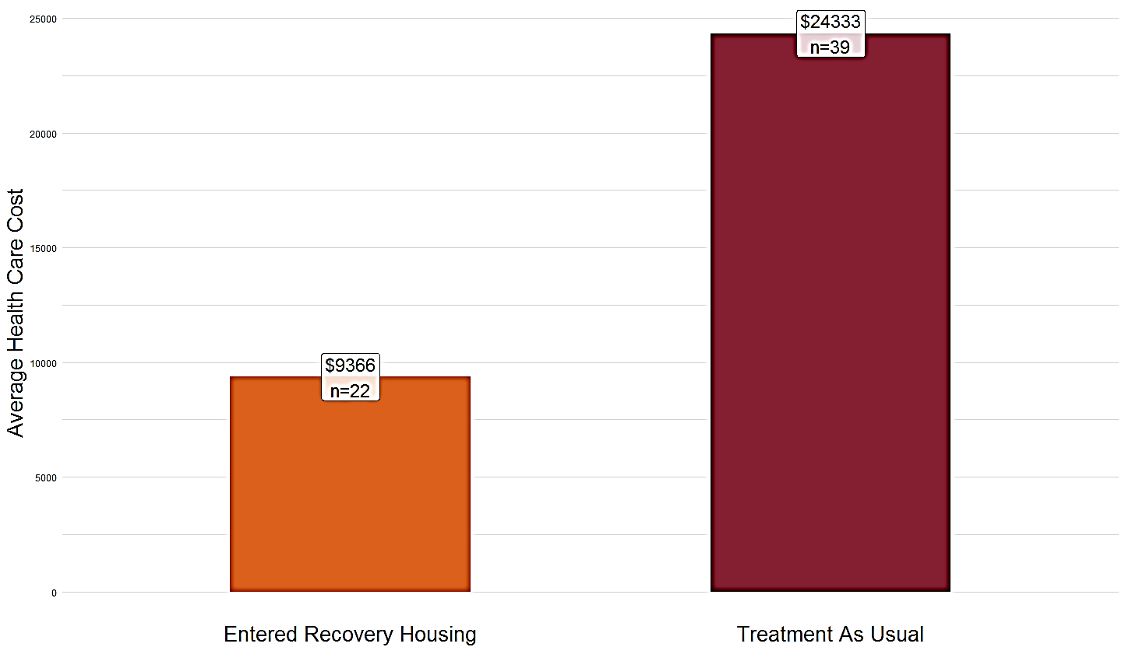
RECOVERY HOUSING: COST SAVINGS
5,000 10,000 15,000 20,000 25,000
$24,333
n=39
Clients who entered Recovery Housing after detox were:
3x as likely to complete SUD treatment
10x as likely to engage in primary care at FQHC clinic
Average Health Care Cost
$9,366
n=22
Entered Recovery Housing
Treatment as Usual
Differences are statistically significant, but sample size is small; average cost for 12 calendar months following month of detox admission

Slide 20
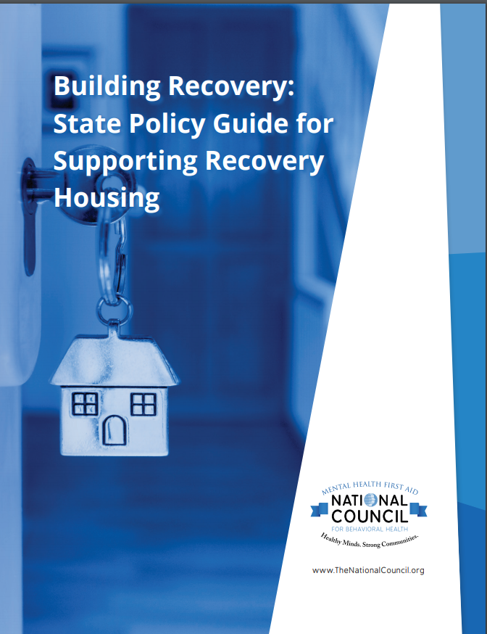
RECOVERY HOUSING TOOLKIT
Lori Criss | Paul Molloy | Steven Polin | Rachel Post | David Sheridan
Protecting Recovery Housing
Standards, Incentives, and Investment
Supporting Recovery Housing in Practice Additional Quality and Access Considerations
Resource Appendices
Legislative Matrix, Recovery Housing Fact Sheet, Resource List, Assessment Questions for Action, & Glossary of Key Terms
https://www.thenationalcouncil.org/wp-content/uploads/2018/05/18_Recovery-Housing-Toolkit_5.3.2018.pdf

Slide 21
RECOVERY HOUSING TOOLKIT
Lori Criss | Paul Molloy | Steven Polin | Rachel Post | David Sheridan
Over the past decade there has been growing awareness among health care leaders, the public and policymakers about the devastating effects and costs of addiction in the United States.
The Surgeon General released a landmark report, Facing Addiction in America (2016) and the President’s Commission on Combating Drug Addiction and the Opioid Crisis (2017) made a series of wide-reaching policy recommendations emphasizing the urgency and commitment to this crisis.
On every level of government and in the private sector, there are efforts under consideration to establish better policies and practices to prevent addiction and improve the treatment and outcomes for people in recovery.
https://www.thenationalcouncil.org/wp-content/uploads/2018/05/18_Recovery-Housing-Toolkit_5.3.2018.pdf

Slide 22




BLENDING SUPPORTED EMPLOYMENT
WITH SUPPORTED HOUSING¹¹
16 studies document IPS supported employment achieves 60% employment levels, with close to half retaining employment for 10 years
National unemployment rate for individuals receiving public mental health services is 80%
60% of the 7.1 million people receiving public mental health services nationwide want to work
1.7% receive supported employment opportunities provided by the states
Notes:
http://coloradocareyes.co/wp-content/uploads/2015/04/1332_ACA_state_waivers_for_innovation.pdf
Section 1332, State Innovation Waivers, https://www.cms.gov/CCIIO/Programs-and-Initiatives/State-Innovation-Waivers/Section_1332_state_Innovation_Waivers-.html
Application, Review, and Reporting Process for Waivers for State Innovation, Federal Register, Feb. 27, 2012, 77 FR 11700
Waivers for State Innovation, Guidance, Dec. 15, 2015, https://www.federalregister.gov/articles/2015/12/16/2015-31563/waivers-for-state-innovation

Slide 23

EVIDENCE BASED PRACTICE SUPPORTED EMPLOYMENT PRINCIPLES
Competitive employment is the goal
Zero Exclusion: Eligibility based on patient choice
Rapid job search
Service integration
Benefits Counseling
Long term support
Notes:
http://coloradocareyes.co/wp-content/uploads/2015/04/1332_ACA_state_waivers_for_innovation.pdf
Section 1332, State Innovation Waivers, https://www.cms.gov/CCIIO/Programs-and-Initiatives/State-Innovation-Waivers/Section_1332_state_Innovation_Waivers-.html
Application, Review, and Reporting Process for Waivers for State Innovation, Federal Register, Feb. 27, 2012, 77 FR 11700
Waivers for State Innovation, Guidance, Dec. 15, 2015, https://www.federalregister.gov/articles/2015/12/16/2015-31563/waivers-for-state-innovation

Slide 24
BRAIDING SERVICE FUNDS TO PRODUCE SUCCESS:
CASE STUDY- JANE DOE
Funding List
SAMHSA CSAT Block Grant
State General Fund
Medicaid
SNAP
TANF
Childcare Development Block Grant
HUD Section 8
County General Fund
WIOA Title II
Private Donors
Health plan & hospital community benefit fund
Notes:
Jane was a polysubstance homeless user with 2 girls in foster care and their father is in prison. She gave birth to youngest while at residential treatment and then into CCC’s family recovery housing with family mentoring and supported employment. Jane earned her GED and now is working as Parent Partner for Clackamas County Human Services where she earns $15 per hour and is off TANF. Receives minimal SNAP.

Slide 25





HMA’S CONTRIBUTIONS IN THIS ARENA
One Door, Santa Fe, NM

Slide 26
HOW HMA CAN HELP
Health Management Associates (HMA) is a leading independent national research and consulting firm in the healthcare industry. We help clients by providing technical assistance, resources, decision support and expertise in both health care and supportive housing arenas. We can support you in the following efforts:
Conduct community assessments/ gap analyses
Lead state and/or health plan efforts to operationalize and contract for services that address SDOH
Provide programmatic design and implementation assistance
Facilitate cross-system collaboratives that bring partners together to advance coordinated care including:
  Affordable housing providers,
  Homeless service providers,
  Government agencies,
  Economic development service partners,
  Community health centers
  Behavioral health providers

Slide 27
REFERENCES
Lebrun-Harris, L., et al. (June 2013). Health Status and Health Care Experiences Among Homeless Patients in Federally Supported Health Centers: Findings from the 2009 Patient Survey. Health Services Research 48 (3): 992-1017.
HRSA Uniform Data System, 2014.
Health in Housing: Exploring the Intersection Between Housing and Health Care. Center for Outcomes Research and Education. February, 2016.
Martinez, T. & Burt, M. (2006). Impact of permanent supportive housing on the use of acute care services by homeless adults. Psychiatric Services, 57, 992-999.
Larimer, M.E., Malone, D.K., Garner, M.D., et al. (2009). Health care and public service use and costs before and after provision of housing for chronically homeless persons with severe alcohol problems. The Journal of the American Medical Association, 301(13), 1349-1357.
Larimer, M.E., Malone, D.K., Garner, M.D., et al. (2009). Health care and public service use and costs before and after provision of housing for chronically homeless persons with severe alcohol problems. The Journal of the American Medical Association, 301(13), 1349-1357.
Barrow, S., Soto, G., & Cordova, P. (2004). Final report on the evaluation of the closer to home initiative.
Center on Addiction. 2010. Retrieved from https://www.centeronaddiction.org/newsroom/press-releases/2010-behind-bars-II
https://www.usich.gov/resources/uploads/asset_library/USICH_OpeningDoors_Amendment2015_FINAL.pdf
Herinckx, H. 2008, “Criminal Activity and Substance Abuse Study”, Portland State University-Regional Research Institute
http://www.bazelon.org/LinkClick.aspx?fileticket=TGW5AEIvqjs%3D&tabid=738

Slide 28
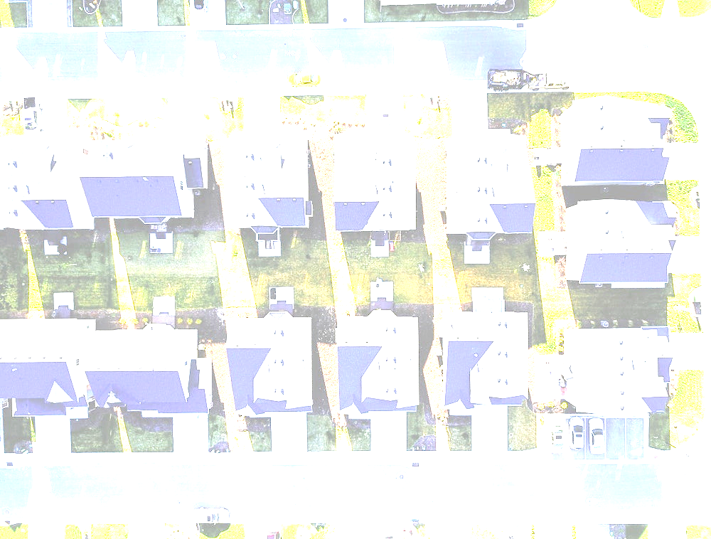
Questions?

Slide 29


CONTACT US
Meggan schilkie
Principal
mschilkie@healthmanagement.com
Carol clancy
Principal
cclancy@healthmanagement.com
Rachel post
Senior Consultant
rpost@healthmanagement.com
Scott ackerson
Principal
sackerson@healthmanagement.com

