Slide 1
The State of the States: Key Data on State Medicaid Long-Term Services and Supports Programs
Health Management Associates,
in partnership with
the Disability Policy Consortium
March 22, 2018

Slide 2
Webinar Agenda: Three Parts Today
The Broad Challenges Facing Medicaid Long-Term Services and Supports (LTSS)
A Closer Look at State Variation
The Path Moving Forward

Slide 3
Webinar Agenda: Part 1
THE BROAD CHALLENGES FACING MEDICAID LONG-TERM SERVICES AND SUPPORTS (LTSS)
Medicaid’s big role in LTSS; many people depend on Medicaid for LTSS
LTSS is unaffordable, and there is no alternative to Medicaid
Growth in HCBS expenditures, and provider rates for LTSS
Age wave driving future costs, and growing behavioral and cognitive needs
Workforce challenged to meet rising demand

Slide 4
Medicaid’s Big Role In LTSS

Slide 5
Over 5 Million People Depend on Medicaid-Funded LTSS
KEY POINTS
5.2 million persons received Medicaid LTSS in CY 2013, based on CMS estimates. Data is imperfect.
1.5 million (or 28% of people who received LTSS from Medicaid) received only institutional services.
Adults with disabilities and Adults 65+ represent about 85% of the people who receive LTSS.
Source: CMS, Sept. 2017.
IMPORTANT:
Many individuals who receive Medicaid-funded LTSS are also dual eligible individuals, who are covered under both Medicare and Medicaid.
LTSS = $158.2 billion across institutional and HCBS settings.

Slide 6
Why Medicaid? LTSS is Unaffordable to Most Individuals
KEY POINTS
The national median annual cost of care for homemaker services is $47,934.
Cost of homemaker services is:
Nearly 3 x higher than the income of a 2 person-household living at the Federal Poverty Level (FPL); and
1.2 x higher than the median household income for a 65+ household.
Source data: HMA using cost data from Genworth, 2017.

Slide 7
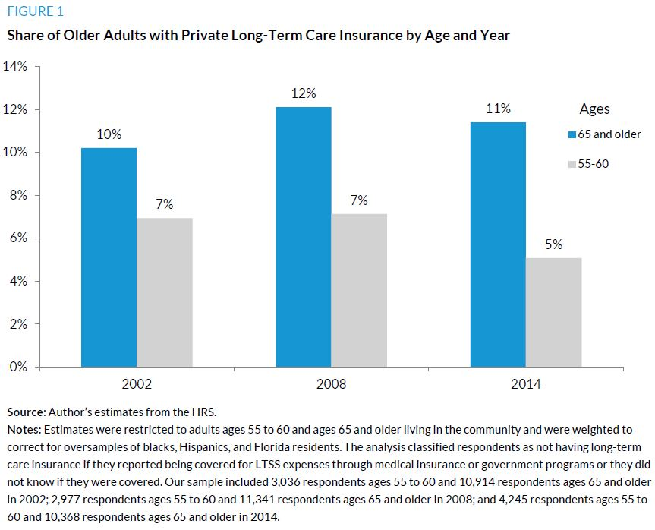
We Have NOT Found An Alternative To Medicaid Financing
KEY POINTS
Private LTSS coverage has not made significant inroads among Baby Boomers – and new sales are declining.
New private long-term insurance policies for healthy 55-year old couple: between $2,000-$5,000 a year for life.
Source: The Urban Institute, “Who is Covered by Private Long-Term Care Insurance?”

Slide 8
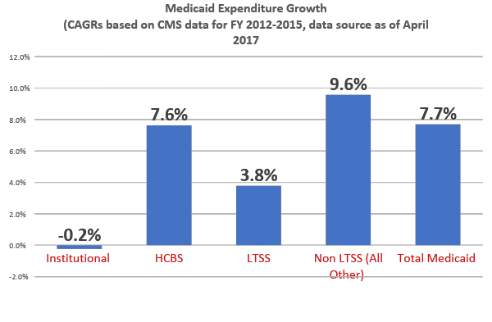
Growth in HCBS Expenditures Continues
KEY POINTS
Growth in HCBS underscores progress, but creates challenges.
Average annual rate of growth was 7.6% in HCBS expenditures between FY 2012-FY 2015.
HCBS growth exceeding the overall growth in LTSS, and nearly equal to the growth in total Medicaid.
Source: HMA based on data from CMS.

Slide 9
Provider Rate Increases for LTSS/MCOs
States Most Likely to Increase Payment Rates for LTSS and MCOs
Rates increased
States with Provider Payment Rate Restrictions
Rates restricted
NOTES: Provider payment restrictions include rate cuts for any provider or freezes for nursing facilities or inpatient hospitals. At the time of the survey, FY 2018 rates had not been determined for MCOs in Illinois, Iowa, New Mexico, or Wisconsin; FY 2018 rates had not yet been set for several other provider categories in New Mexico, Ohio, and Wisconsin.
SOURCE: KFF survey of Medicaid officials in 50 states and DC conducted by HMA, October 2017.
11

Slide 10
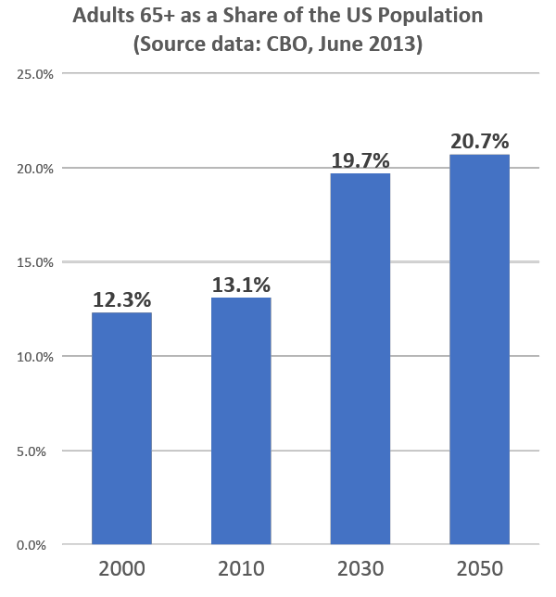
Medicaid’s LTSS Challenge: The Age Wave!
KEY POINTS
Rising Demand.
Congressional Budget Office: “Between 1946 and 1964, more than 75 million babies were born in the United States, forming a cohort that has come to be known as the baby-boom generation. The oldest people in the group turned 65 in 2011. The aging of that generation, in combination with increases in longevity and other factors, will cause the share of the population age 65 or older to grow rapidly from 2010 to 2030. The share of the population age 85 or older will grow rapidly beginning around 2030 and continuing until at least 2050.”
Source: CBO, Rising Demand for LTSS for Elderly People, (June 2013).

Slide 11
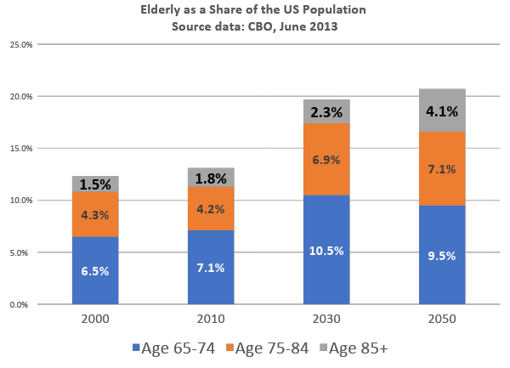
Future Costs Driven by Aging of the Over 65 Population
KEY POINTS
Big age shifts in the composition of the 65+ population between 2010 and 2050.
The elderly grow older: 74-84 plus the 85+ increase from 6% to 11.2% of the US population from 2010 to 2050.
Source: CBO, Rising Demand for LTSS for Elderly People, (June 2013).

Slide 12
Behavioral And Cognitive Care Needs Are Increasing
5.4 million Americans have Alzheimer’s disease (2016), which is the leading cause of dementia.
65 and older: 1 in 9 individuals have dementia
85 and older: at least 1 in 3 individuals have dementia
Dementia: a major neuro-cognitive disorder
Interferes with both cognitive function (memory, speech, language, judgment, planning) and performing everyday activities (making a meal, paying bills, shopping).
Often requires supervision even before ADLs significantly affected and can result in need for total care.

Slide 13
The Workforce Challenge: How To Meet Demand?
9 in 10 home care workers are women (median age 45); over 25% were born outside the United States.
Public programs represent 70% of the revenue to the industry.
Home care workforce has more than doubled in size (800,000 in 2006 to almost 1.6 million in 2016), per BLS.
PHI estimates another 800,000 independent providers work as personal care aides hired directly by consumers.
Home care workers earn median income of $13,800; wages stagnated between 2006-2016 ($10.33 to $10.49).
Source: US Home Care Workers: Key Facts, PHI, 2017

Slide 14
Future Workforce Needs Outpace Capacity
Workforce Demand
Workforce Supply
Gap
KEY POINTS
BLS projects demand for home care workers will grow by 633,000 by 2024; and, these projections reflect recent trends but DO NOT explicitly factor in projected population growth, aging of the over-65 population.
Labor force participation among women ages 20-64 will increase by only 1.2 million in total by 2024; as compared to 7.3 million in the previous decade.
Source: US Home Care Workers: Key Facts, PHI, 2017

Slide 15
Webinar Agenda: Part 2
A CLOSER LOOK AT STATE VARIATION
States vary in the size of the financial pressures and in their ability to respond
Rising demand; age wave with implications for the workforce and economy
LTSS expenditure pressures on Medicaid budget
System readiness factors including HCBS rebalancing and state integration efforts
Economic and social factors including state wealth and housing
State performance on LTSS
Heat Maps and Hot States

Slide 16
Heat and Bivariate Maps: Technical Description
A heat map, also called a density map, is based on a color classification scheme where lighter shades represent lower data values and darker shades represent higher data values.
The data classification method used in this presentation is based on the Jenks natural breaks classification method. Natural breaks are used to provide more meaningful visualization of data; boundaries are set where there are relatively big jumps in the data values.
An investigation between per capita income and percent HCBS in the United States is shown as a bivariate map. Bivariate mapping is an important technique in cartography. It is a variation of simple heat map that portrays two separate phenomena simultaneously. The main objective is to accurately and graphically illustrate the relationship between two spatially distributed variables.

Slide 17
Age Wave: “Oldest” States in 2030
WHAT DOES THE MAP SHOW?
The map shows the % of each state’s population that will be 65 and older in 2030.
What is the US average?
20% of the US population will 65+ in 2030.
What is the range for the US?
Range: 13.2% in Utah to 27.1% in Florida.
Top 5 “oldest” states by 2030: Montana, New Mexico, Wyoming, Maine, and Florida.
Key issues to note: The oldest states will face the greatest imbalance between the workforce and the potential demand for LTSS.
Source: HMA, based on US Census Bureau.
Florida

Slide 18
Age Wave: Highest Rate of Growth in 65+
WHAT DOES THE MAP SHOW?
The map shows the annual population growth rate for individuals 65 and older between 2015-2030.
What is the US rate of growth?
US population will grow by 3.5% between 2015-2030.
What is the range for the US?
Range: From < 2% in DC & West Virginia to 6.7% in Arizona.
Top 5 states, highest growth rates 2015-2030: Texas, Alaska, Nevada, Florida, Arizona.
Key issues to note: Lowest rates of growth across the Great Lakes, & Northern/Southern Mid West.
Source: HMA, based on US Census Bureau.
Arizona

Slide 19
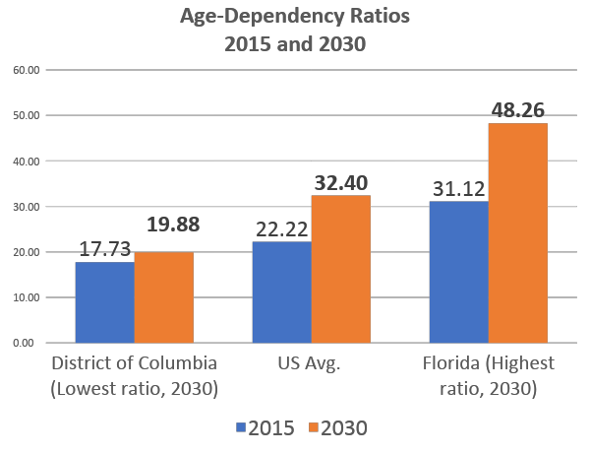
Implications of the Age Wave: Workforce & Economy
KEY POINTS
The age wave will have implications on the workforce and the economy.
The number of “65 and older” population for every 100 workers will grow from 22.2 in 2015 to 32.4 in 2030.
In 2030, the ratios will range from 19.88 in DC to 48.26 in Florida.
Source: HMA, based on US Census Bureau.

Slide 20
LTSS Expenditure Pressure on Medicaid Budget
WHAT DOES THE MAP SHOW?
The map shows LTSS expenditures as a % of total Medicaid expenditures in FY 2015.
What is the % for the US?
LTSS expenditures accounted for 30% of Medicaid expenditures in FY 2015.
What is the range for the US?
Range: 15.9% in AZ to 53% in ND.
Data is not perfect.
Top 5 states, highest %,: Wisconsin, Iowa, New Hampshire, Wyoming, and North Dakota (highest).
Key issues to note: States with more of their budget devoted to LTSS may feel the pressure from the demographic changes sooner. Data is purely illustrative of the variation; CMS data itself is not perfect.
Source: HMA, based on CMS data.
North Dakota

Slide 21
System Readiness: LTSS Rebalancing & Access to HCBS
WHAT DOES THE MAP SHOW?
The map shows HCBS expenditures as a % of total Medicaid expenditures in FY 2015.
What is HCBS as a % of LTSS expenditures for the US? Approximately 55%.
Key issues to note:
HCBS has become the main delivery mechanism for LTSS nationally; however, this varies by state.
As of 2015, several states were heavily dependent on higher-cost institutional LTSS.
Many other states stood below the national average percentage of LTSS expenditures in HCBS.
Source: HMA, based on CMS data.
Oregon

Slide 22
Heavy Reliance on Institutions by Older Adults in 2015
1 in 2 adults 65+ use institutional LTSS

Slide 23
State Wealth Can Affect State Response
WHAT DOES THE MAP SHOW?
The map shows the median annual household income in 2016.
What is the median annual household income for the US? It is $59,039.
Key issues to note:
States with lower median annual household income may face the biggest challenges in responding to the increase in demand for Medicaid LTSS.
Highest = $76,260 = New Hampshire #1 followed by Connecticut #2
Lowest = $41,099 = Mississippi #51
These states generally receive a higher federal matching rate (or federal financial participation, FFP) for Medicaid, which encourages states to leverage significant federal support.
New Hampshire

Slide 24
A Closer Look At Rebalancing LTSS And Income
WHAT DOES THE MAP SHOW?
The map shows the relationship between rebalancing LTSS and the state’s per capita income.
Key issues to note:
States with the lightest shade of gray are those with the highest level of rebalancing and highest per capita income.
Oregon is #1 in rebalancing LTSS (82.2%) & falls into the high income group.
Where is NH? LTSS rebalancing = 52.2%.
Many states, however, with relatively lower per capita incomes are lagging in terms of transition to HCBS, but certainly not all of them.
New Mexico is #2 in rebalancing LTSS (79%) and falls into the low income group.
WHAT CAN WE LEARN FROM STATES THAT HAVE MADE GREAT PROGRESS WITH RELATIVELY LESS WEALTH?
Oregon
New Mexico

Slide 25
Social Factors: Housing Matters, Unaffordable to Many
KEY POINTS
One metric used to measure housing affordability is the hourly wage requirement to rent a 2-bedroom apartment.
Affordable housing is critical to smooth transitions from the hospital and/or nursing home setting to the community.
Housing is a key SDOH for individuals with Medicaid-funded LTSS needs with low incomes.
Source: Data from National Low-Income Housing Coalition and US Census Bureau.

Slide 26
AARP State Scorecard on LTSS Performance
Five Categories
Affordability and access to LTSS
Choice of setting and provider
Quality of life and quality of life
Support for family caregivers
Effective transitions between nursing, homes, hospitals and homes
#1
Source data: AARP scorecard, June 2017.
The Commonwealth Fund, the SCAN Foundation, and AARP.

Slide 27
Webinar Agenda: Part 3
THE PATH MOVING FORWARD
No Easy Fix!
Engage stakeholders
Accelerate rebalancing to HCBS
Rethink geropsychiatric systems of care
Address workforce shortages
Align & Integrate Medicare and Medicaid programs
Focus on housing and social determinants of health
Advance strategies to promote integration and value

Slide 28
No Easy Fix!
Understand individual state landscape
Build strategies that promote stakeholder engagement
Establish common ground among stakeholders
This includes consumers, providers, advocates, payers alike
Identify shared goals
Understand state and system limitations
Forge partnerships to create solutions
Pursue data that supports evidence-based solutions

Slide 29
Engage All LTSS Stakeholders
1
Federal
State
Health Plans
ACOs
Providers
C O N S U M E R S

Slide 30
Accelerate Rebalancing & Expand In-Home Supports
2
Expand access to HCBS for all populations, including older adults and adults with physical/medical disabilities
Intervene earlier to divert, reduce Medicaid demand: Medicaid Section 1115 waivers that provide targeted in-home supports to people not otherwise eligible for Medicaid (MN)
Local county levy programs- dedicated senior services for those not yet Medicaid eligible (OH) (divert, delay need for institutional care)
Alzheimer’s Disease Support Services Program (Administration for Community Living grants to states)

Slide 31
Rethink Geropsychiatric Systems Of Care
3
Develop new approaches to providing care for individuals who have serious or chronic mental illness or substance use disorders and who are also experiencing the challenges of aging
Mobile crisis units trained to deal with dementia and development of more appropriate settings of care for crisis intervention with dementia patients (WI) https://legis.wisconsin.gov/2015/committees/assembly/ad/
Develop increased LTSS capacity for “hard to place” individuals, including individuals with SMI who develop dementia (CT; VA study) https://rga.lis.virginia.gov/Published/2017/RD513/PDF

Slide 32
Expand & Support Direct Care Workforce
4
Expand direct care workforce capacity: Develop workforce strategies (AZ, CT, MA, TN, WA, WI) and target wage increases in 11 states.
http://files.kff.org/attachment/Report-Results-from-a-50-State-Medicaid-Budget-Survey-for-State-Fiscal-Years-2017-and-2018
Promote consumer-directed care: Allow individuals to identify paid caregivers from among family and friends.
Support family caregivers (HI, WA, RI, NJ, NY, DC, CA, GA, IL, TN and others)
https://www.aarp.org/caregiving/;
https://www.aarp.org/caregiving/financial-legal/info-2018/caregiver-state-laws-fd.html;
https://www.acl.gov/programs/support-caregivers/national-family-caregiver-support-program
Expand telehealth, including remote monitoring; employ community paramedicine to extend access (NV).

Slide 33
Align and Integrate Medicaid and Medicare
5
Alignment between Medicare and Medicaid programs is key to the financial sustainability of Medicaid programs and Medicaid’s ability to manage LTSS and improve quality of life and outcomes.

Slide 34
Focus On Housing And Other Social Determinants
6
Housing related services: CMS informational bulletin outlines strategies that can be supported under Medicaid.
https://www.medicaid.gov/federal-policy-guidance/downloads/cib-06-26-2015.pdf
States increasingly leverage managed care plans to increase assessment and referral to community based services to address social determinants.
New CMS Innovation Acceleration Program opportunity: Housing Related Services and Partnerships (to promote community integration through LTSS).

Slide 35
Develop LTSS Value-Based Payment Models
7
KEY POINTS
Must link payments to outcomes in an intentional manner.
New CMS Innovation Acceleration Program: Incentivizing Quality and Outcomes in Community Based LTSS Programs.
Payment approach
Metrics
Greater Value, Higher Quality

Slide 36
QUESTIONS FROM OUR AUDIENCE Thank you for participating in this webinar.

Slide 37
HMA AND DPC WEBINAR TEAM
The HMA team including Sarah Barth, Ellen Breslin, Barbara Edwards, and Anissa Lambertino, in partnership with Dennis Heaphy of the Disability Policy Consortium (DPC), prepared, presented and/or developed all content, key data points, “heat maps” and graphs for this presentation.
Please feel free to contact us if you have any questions:
Sarah Barth (HMA): sbarth@healthmanagement.com
Ellen Breslin (HMA): ebreslin@healthmanagement.com
Barbara Edwards (HMA): bedwards@healthmanagement.com
Anissa Lambertino (HMA): alambertino@healthmanagement.com
Dennis Heaphy (DPC): dheaphy@dpcma.org

