Slide 1
Missouri’s Overdose Field Report: Naloxone dosing remains stable despite concerns otherwise
Rachel Winograd, PhD & Marc Doll, BSN, RN, NRP
University of Missouri, St. Louis
Department of Psychological Sciences
Missouri Institute of Mental Health
City of St. Charles Fire Department

Slide 2
Missouri in 2017
No centralized reporting system for non-fatal ODs
Attempt to (partially) fill that gap with
…Missouri’s Overdose Field Report (ODFR)
www.mohopeproject.org/odreport

Slide 3
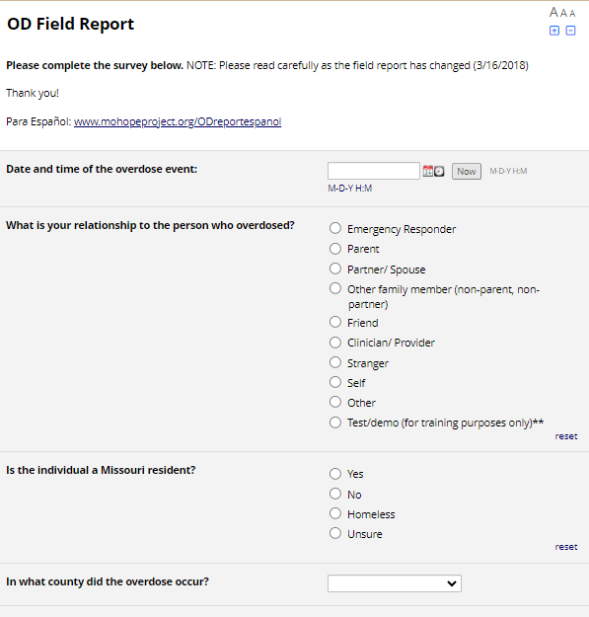
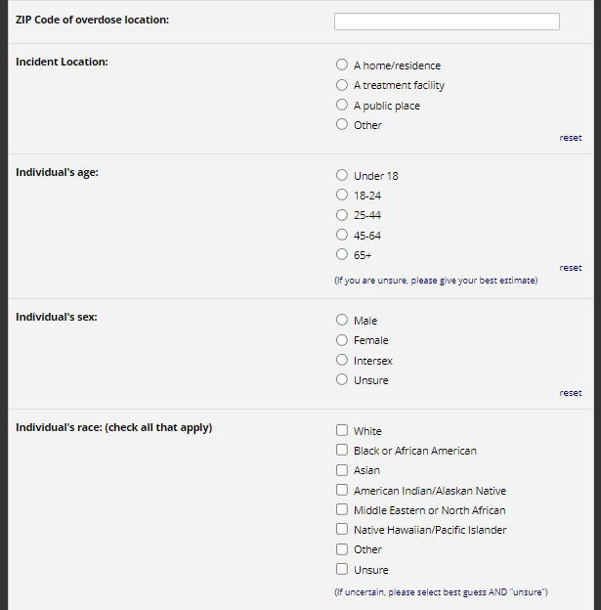
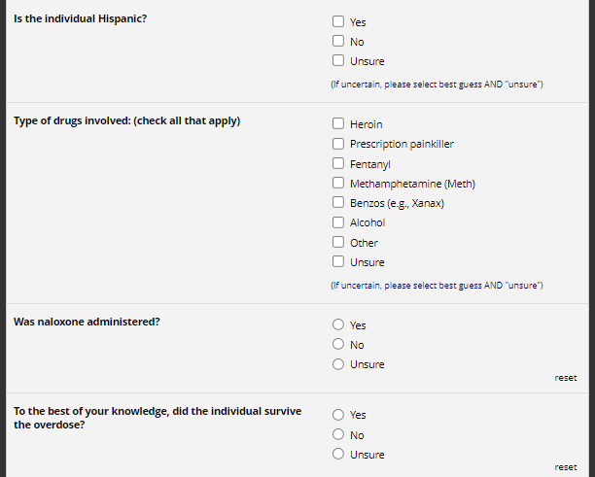

Slide 4
If an OD Field Report exists in the forest… will anyone fill it out…?
Shared info & instructions in every OEND training
SUD service providers
Community Coalitions
Emergency Responders*
* Required completed ODFRs for naloxone restocking
Hung fliers all around & included them in naloxone kits

Slide 6
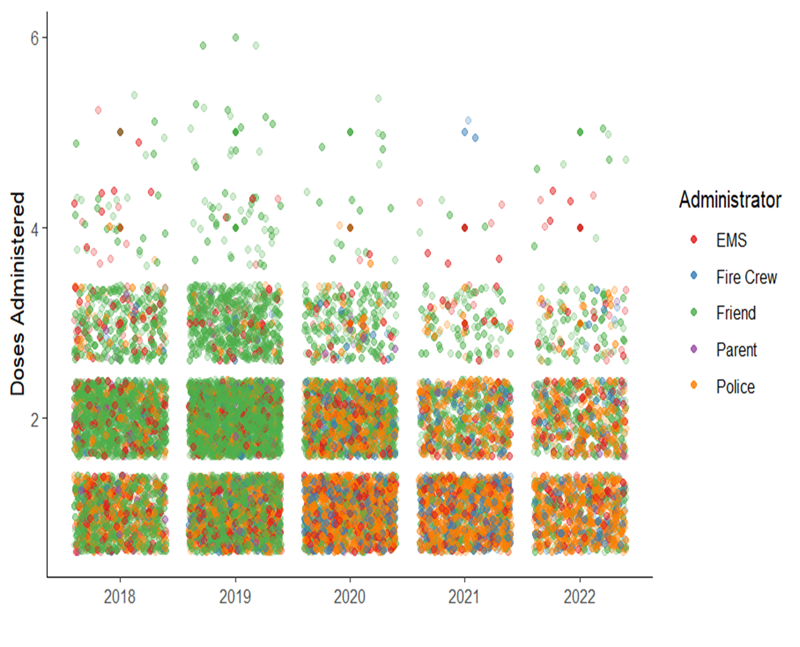
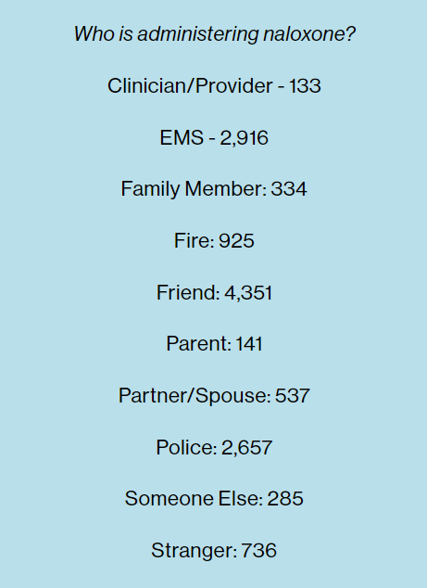

Slide 7
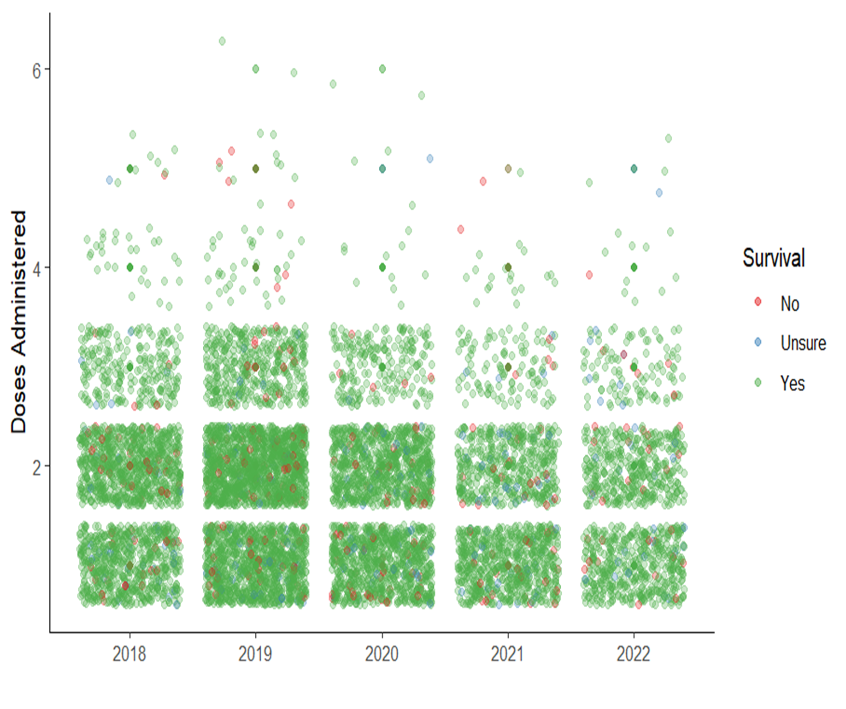
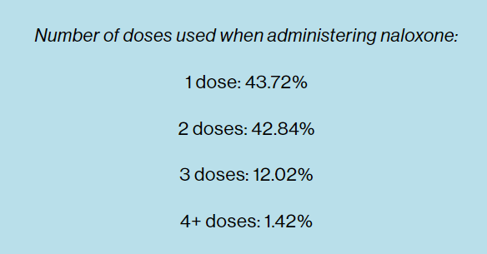
Naloxone Dosage Low While Survival High
Notes:
Nearly 87% was 1 or 2 doses

Slide 8
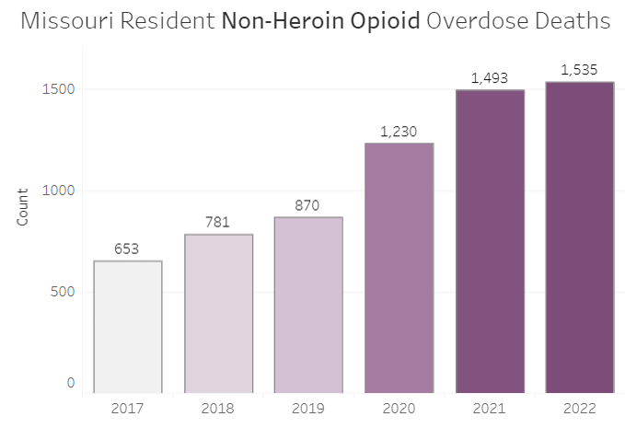
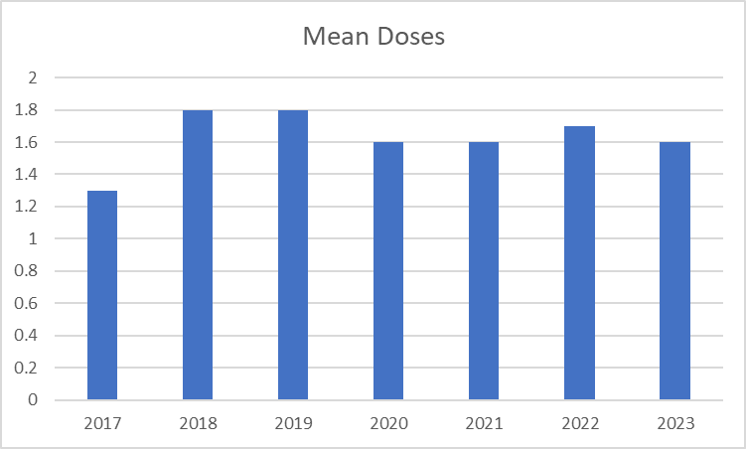
Missouri DHSS Opioid Dashboard: https://health.mo.gov/data/opioids/

Slide 9
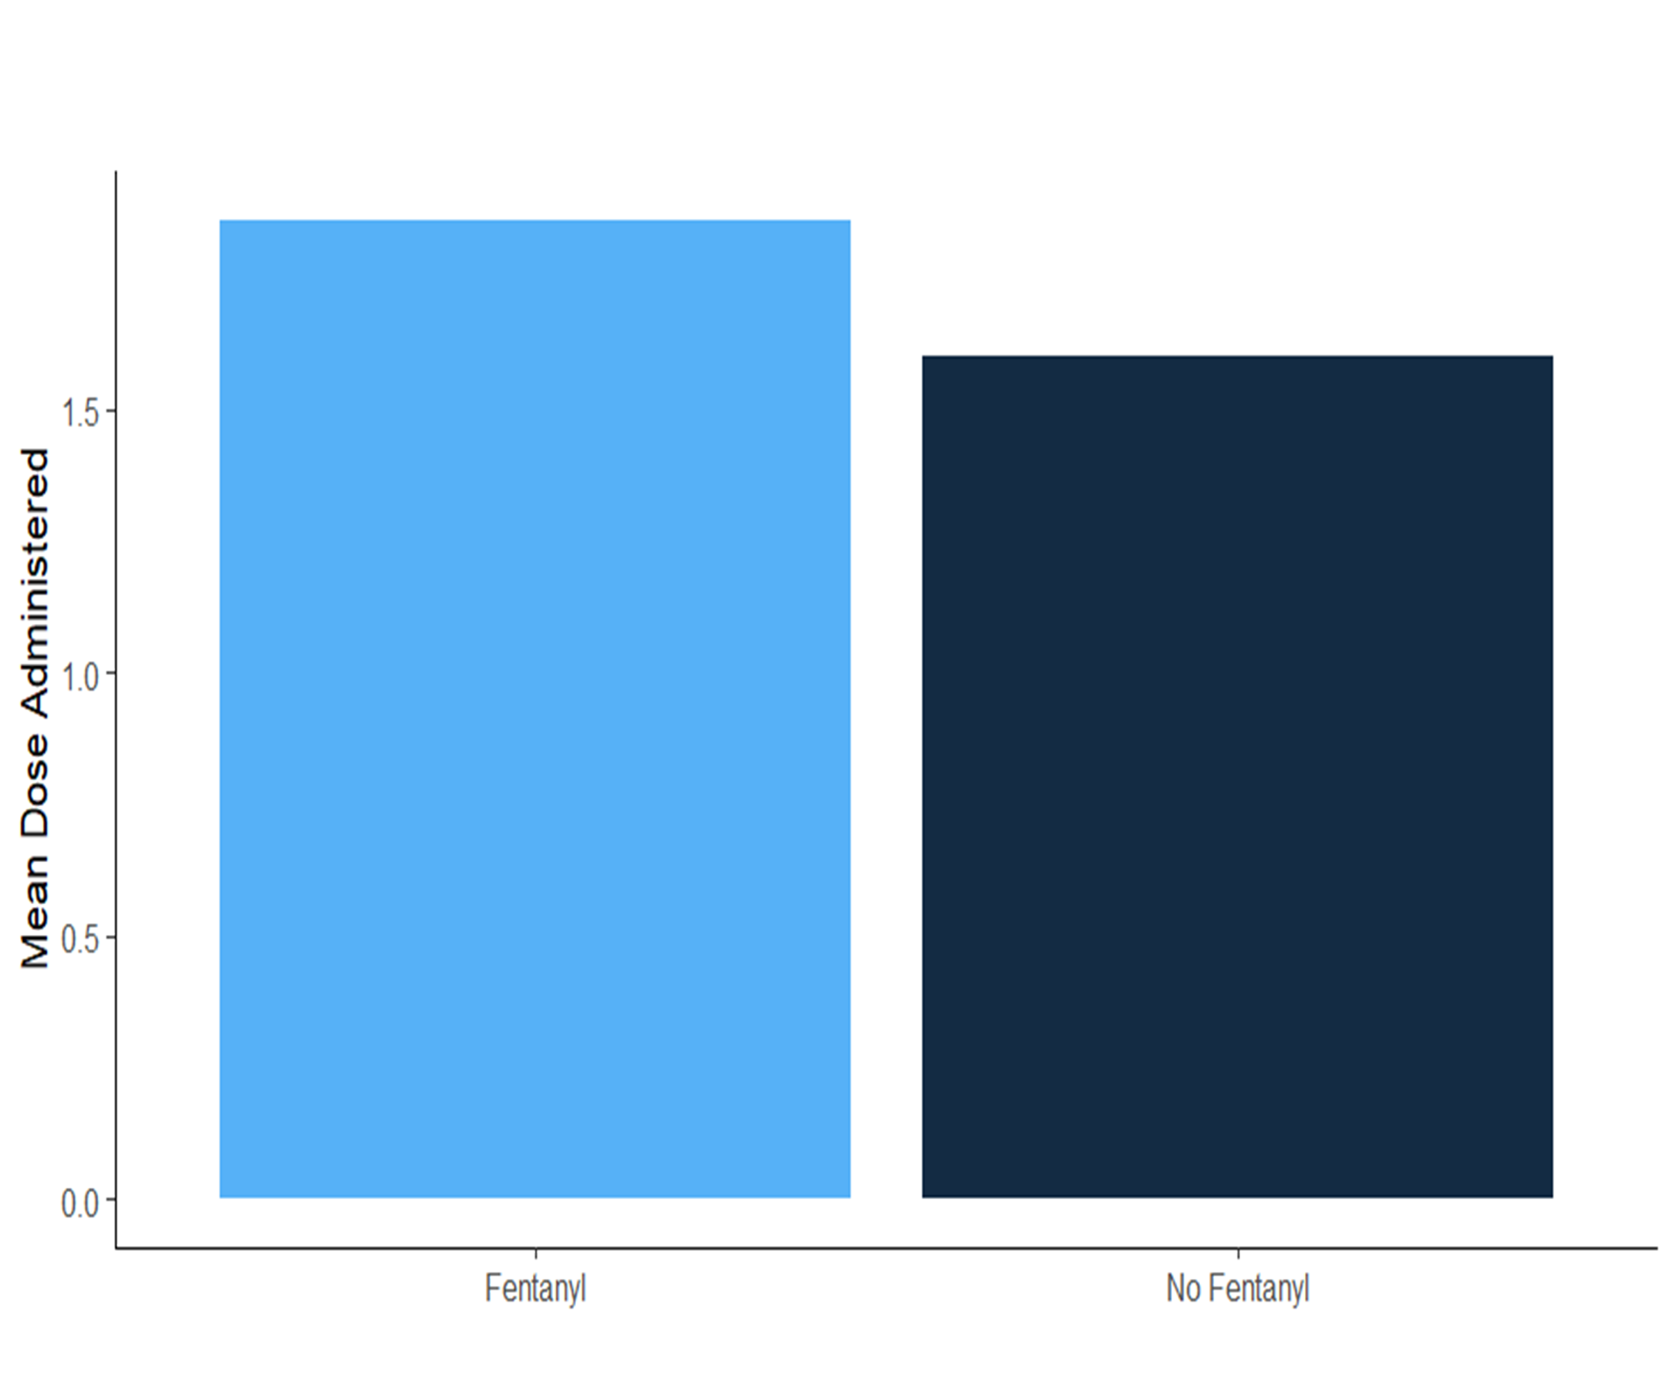
When fentanyl was believed to be involved in the overdose, more naloxone doses were administered compared to non-fentanyl involved overdoses (β = 0.14, 95% CI = 0.10, 0.17)
Notes:
ODFR paper:
https://osf.io/preprints/osf/t2cx7

Slide 10
Take-aways
Missouri’s OD Field Report = self-selected reports of fatal & non-fatal overdose events
Overall, number of naloxone doses administered did not increase alongside the increase in fentanyl in MO
However, when respondents believed fentanyl was present, they administered slightly more naloxone (1.8 doses) than when they did not suspect fentanyl to be present (1.6 doses)
Nearly 90% of ODs were reversed with 1 or 2 doses
Findings do not support a need for extra strength naloxone

Slide 11
Finding Allies in Unexpected Places
Dosing patterns consistent over time, no argument here
No standard EMS protocols/established best practices
System change is possible through relationship building

Slide 12
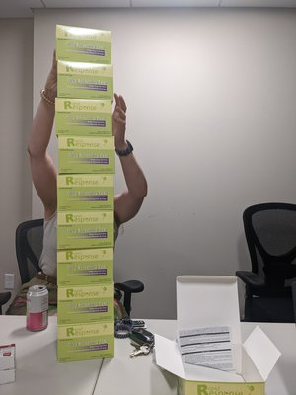
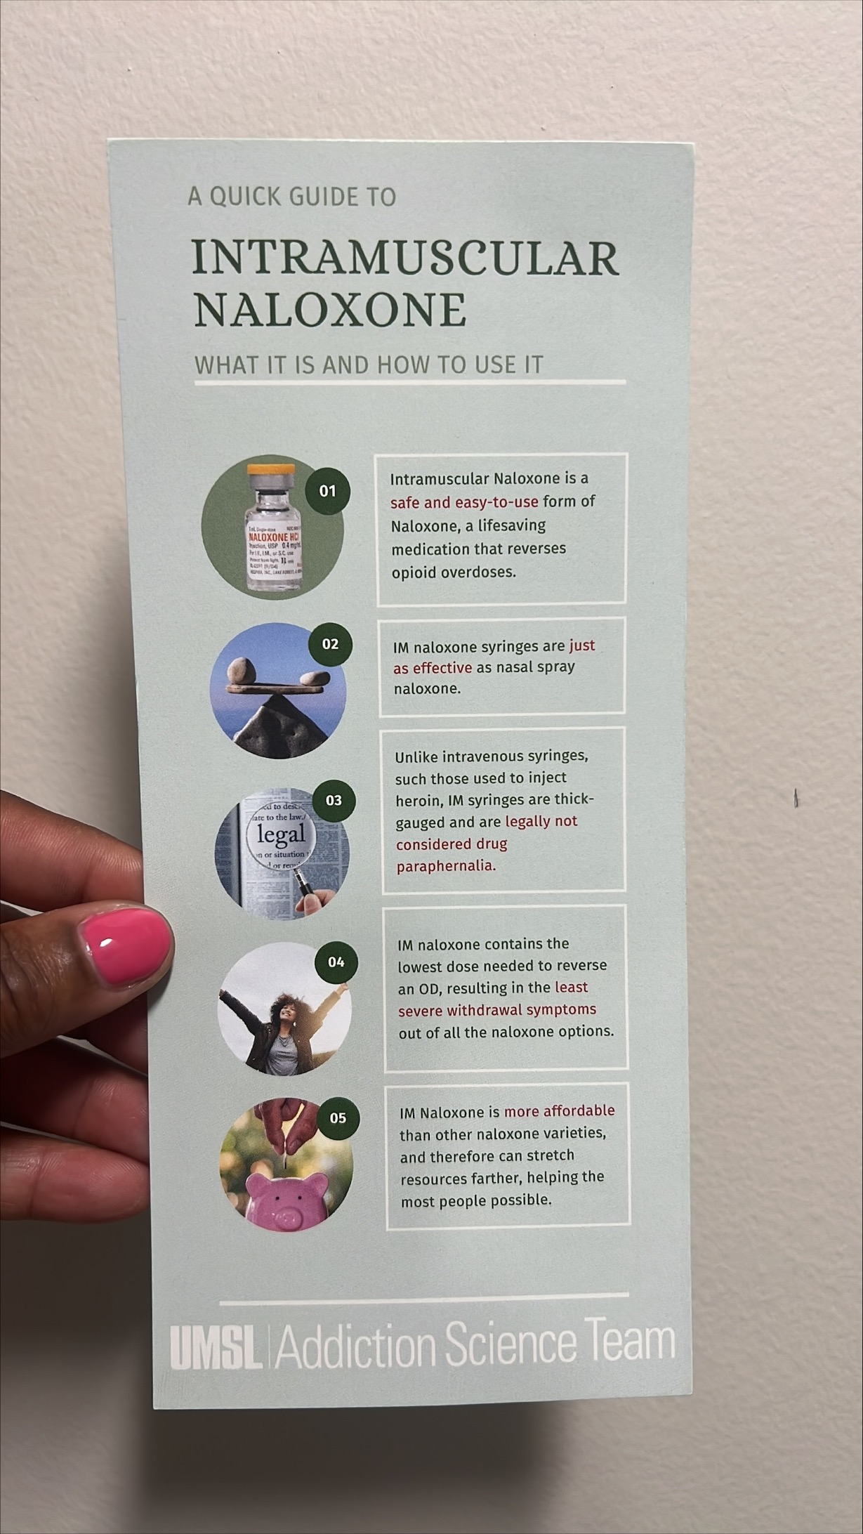
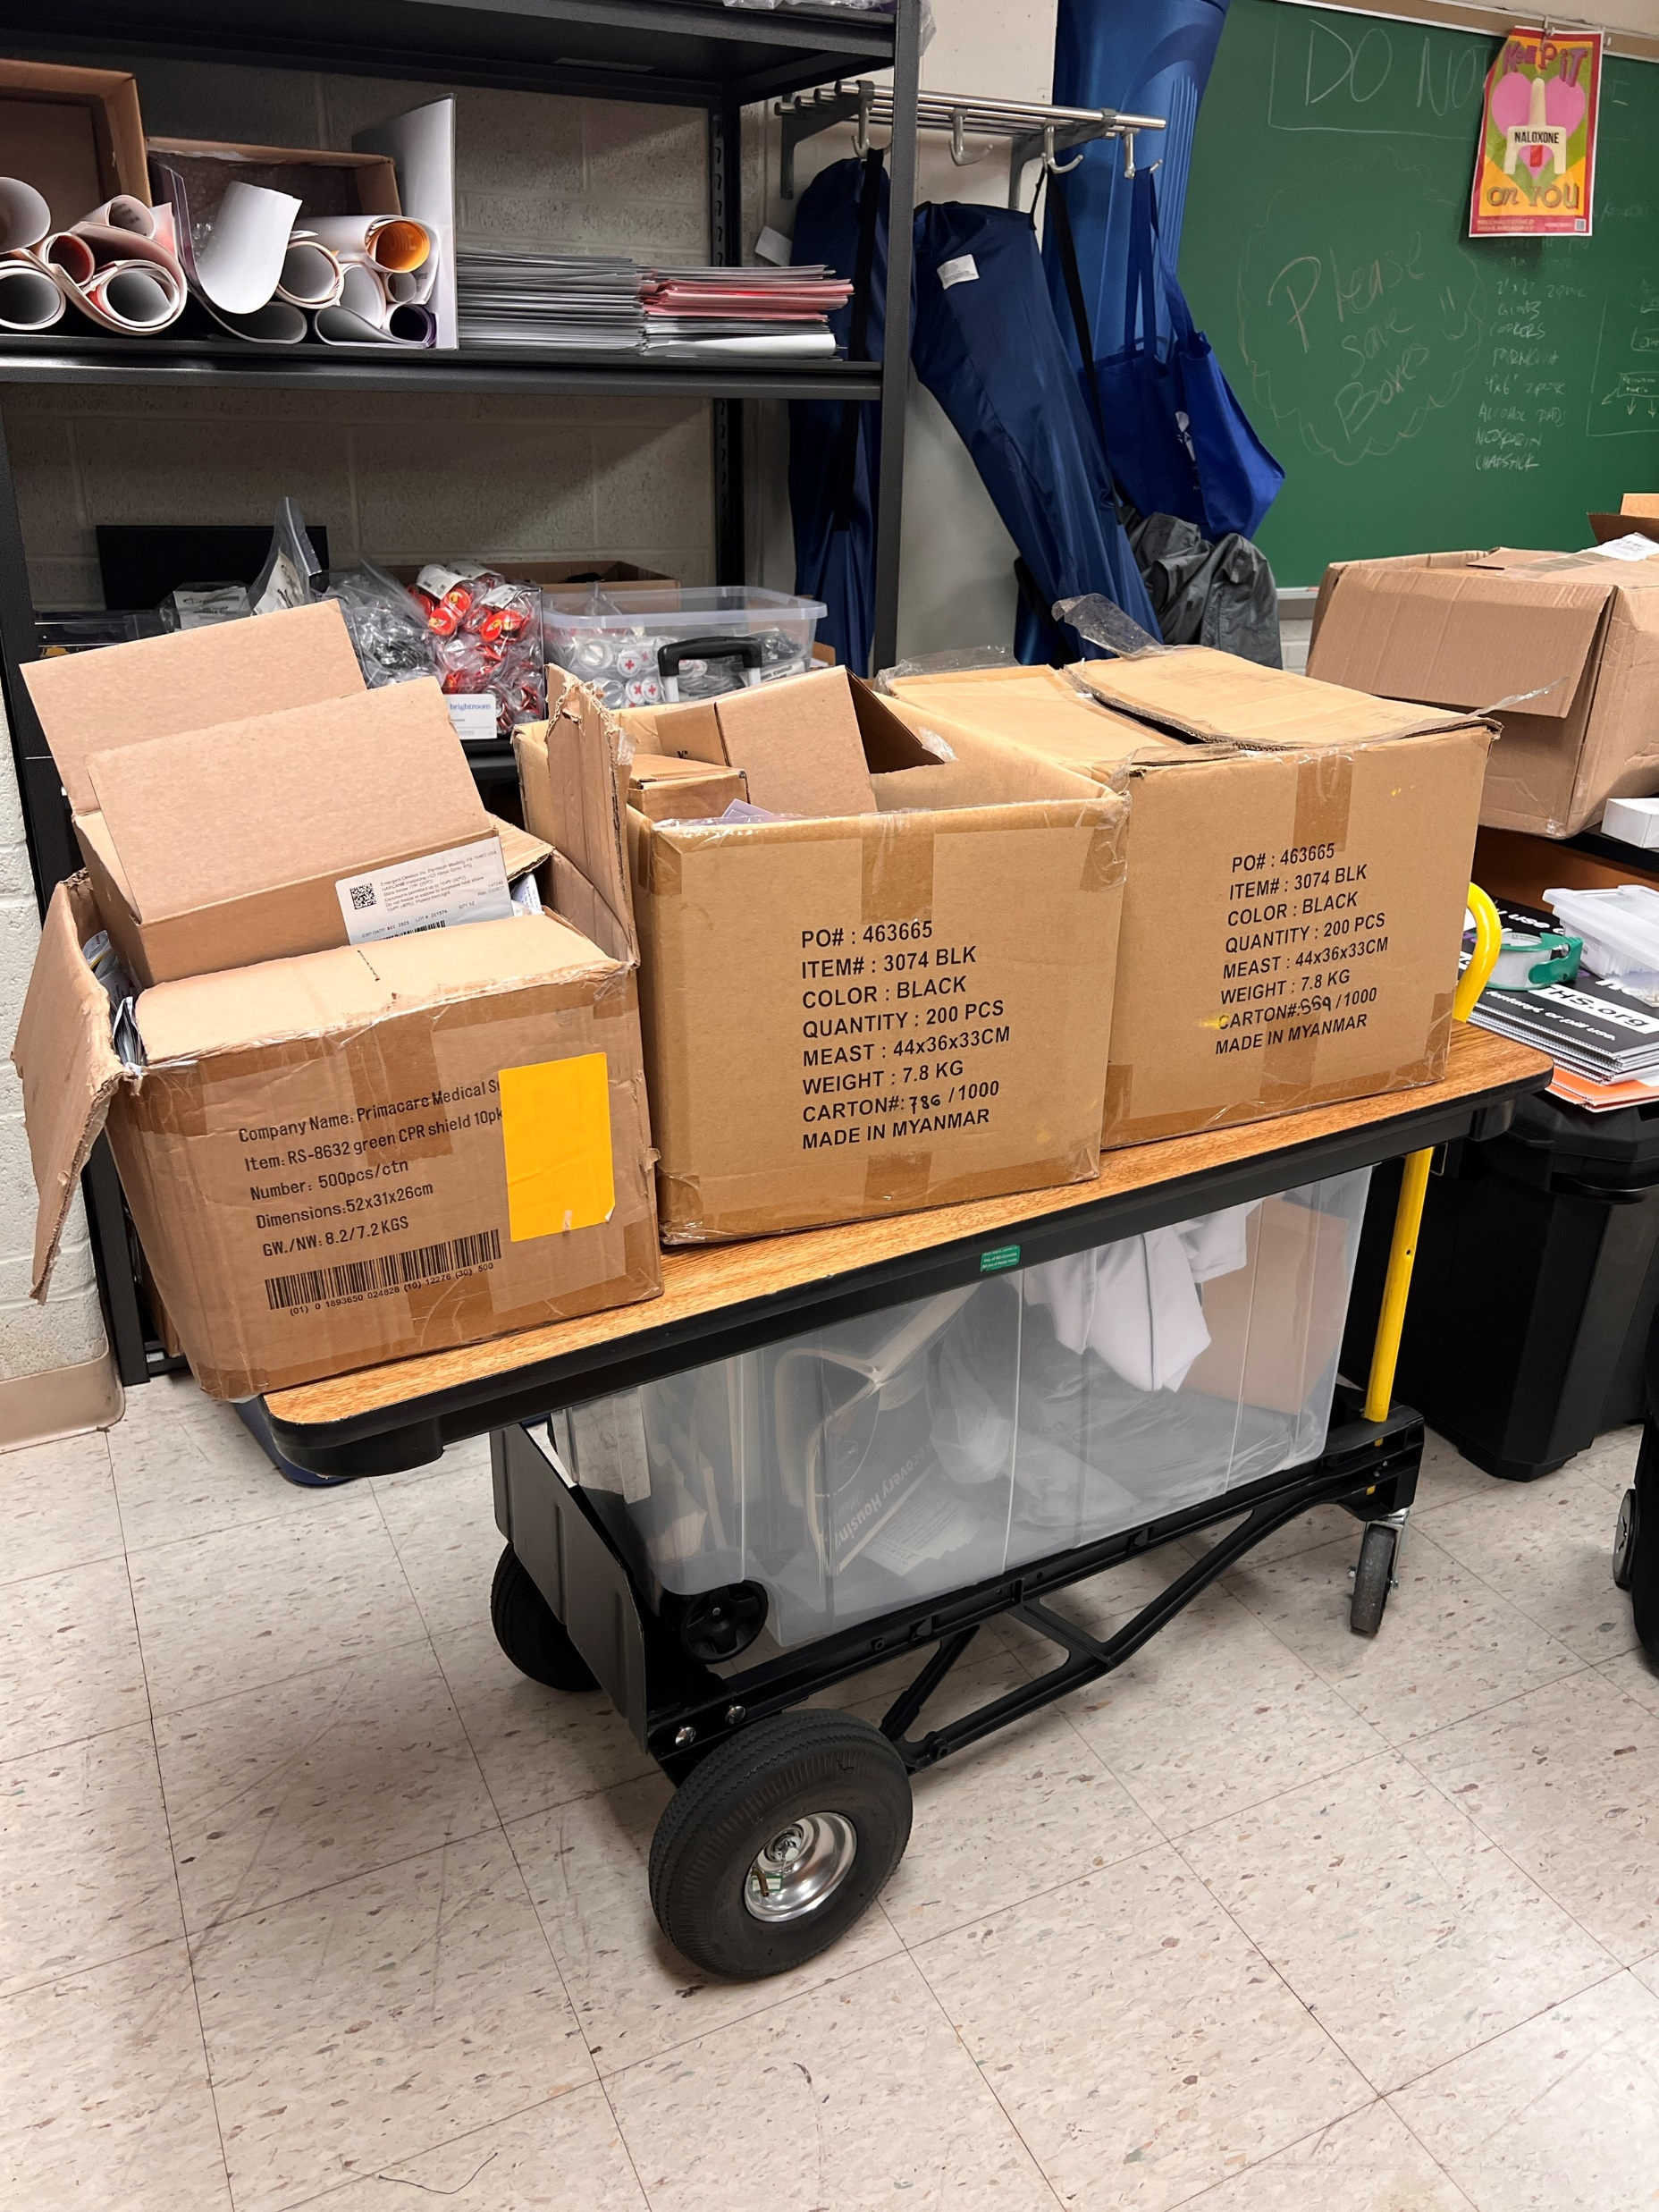
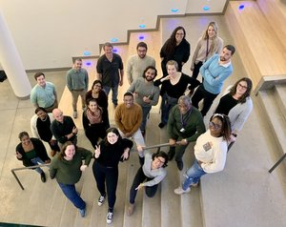
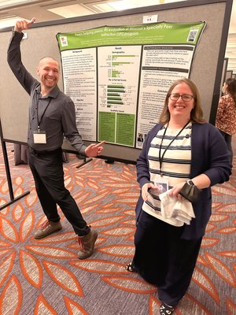
Thank you!
Kyle Vance
Sarah Phillips, MA
Chief George Sheets
The UMSL-MIMH Addiction Science team
(www.MIMHAddSci.org)
City of St. Charles Fire Department

Slide 13
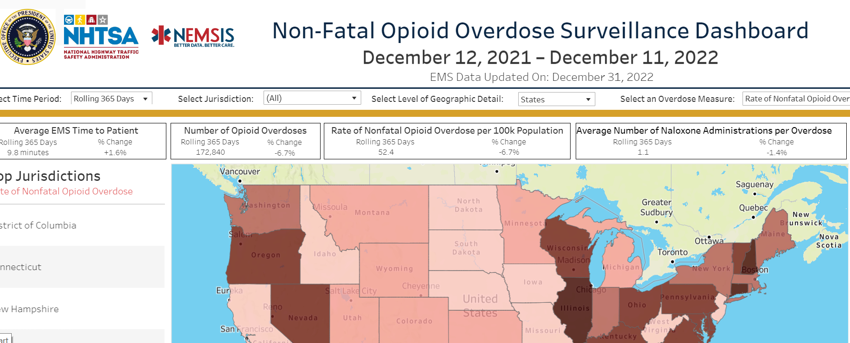
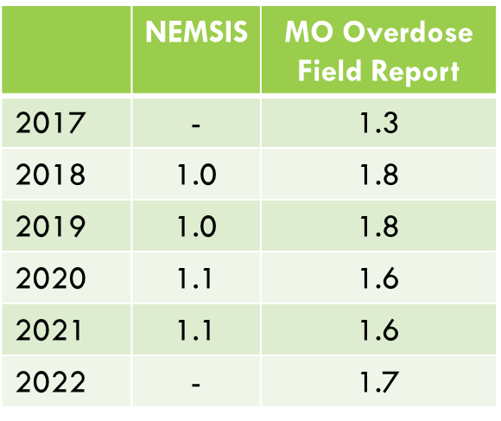
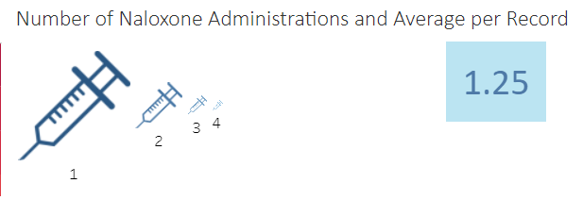
Evidence of more naloxone needed to respond to fentanyl ods?
No… looking at both national and Missouri data
Nation’l Emergency Medical Services Information System (NEMSIS)
Missouri’s Overdose Field Report (ODFR) System
Average # of naloxone doses needed
Notes:
Per NEMSIS, the average # of EMS naloxone administrations per OD call in 2021 was 1.1, same as 2020 and only slightly up from 1.0 in 2018/19. The conventional wisdom that fentanyl ODs require huge amounts of naloxone is simply not supported by the data.

